Slide 1

ANNUAL PRESENTATION

Slide 2
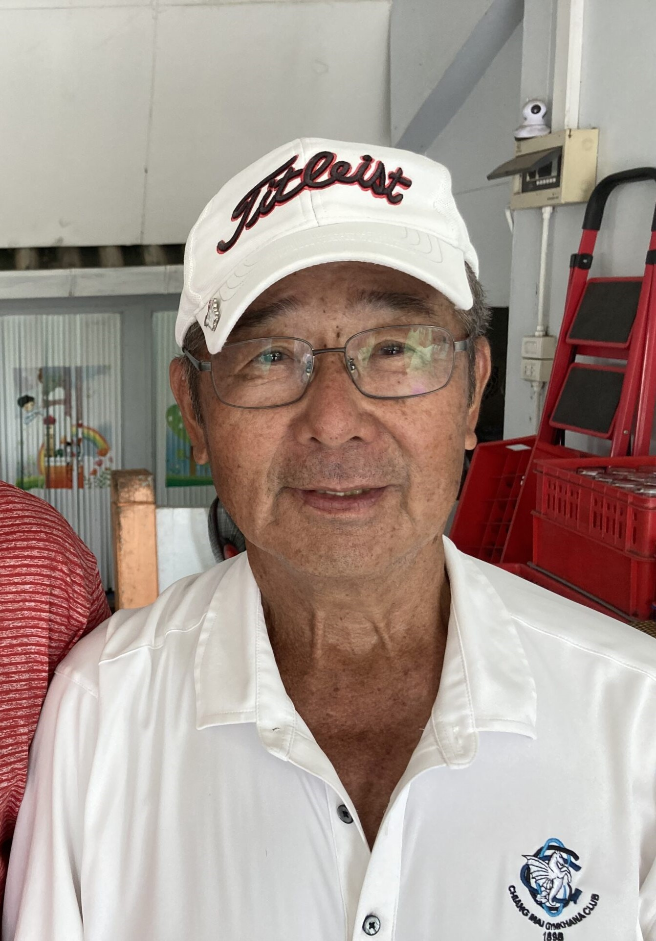
R.I.P
YUKIO DOI

Slide 3
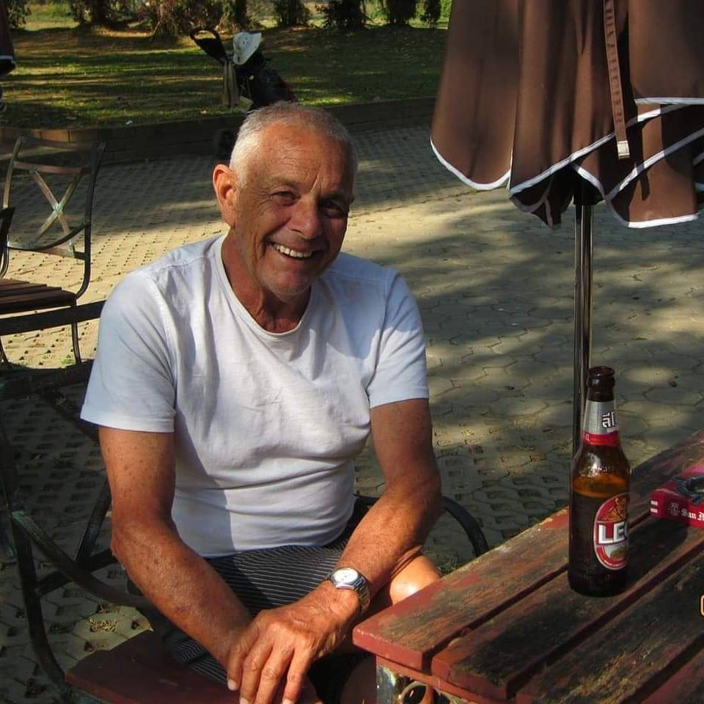
R.I.P
Dan
Evans

Slide 4
WELCOME
TO OUR
NEW
MEMBERS

Slide 5
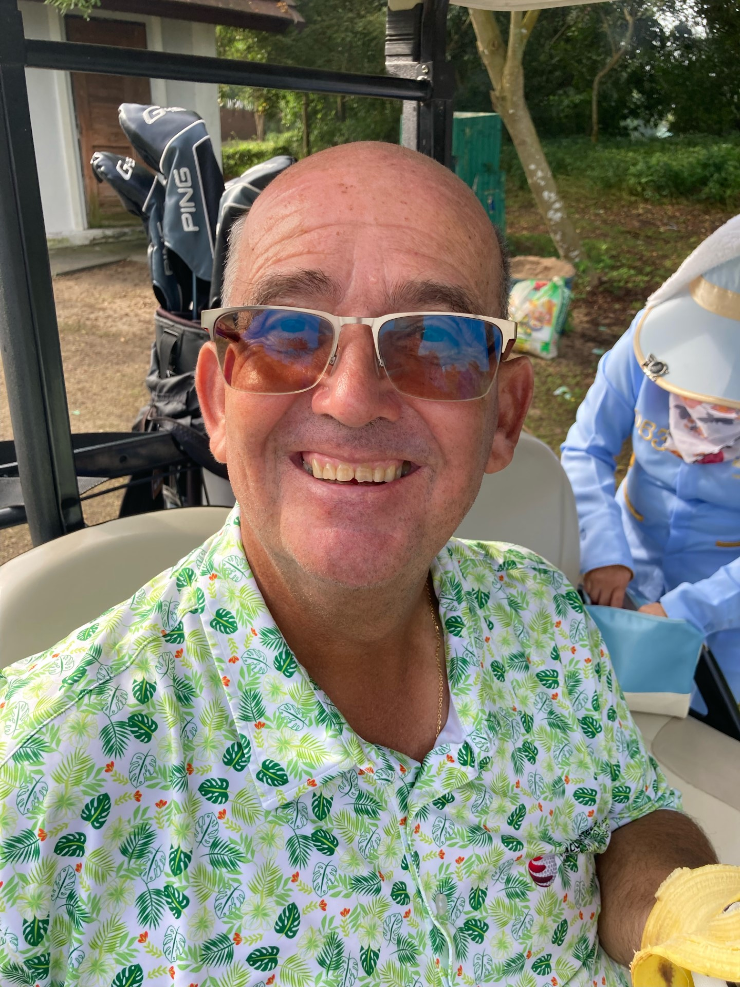
BILL
DUTHIE

Slide 6
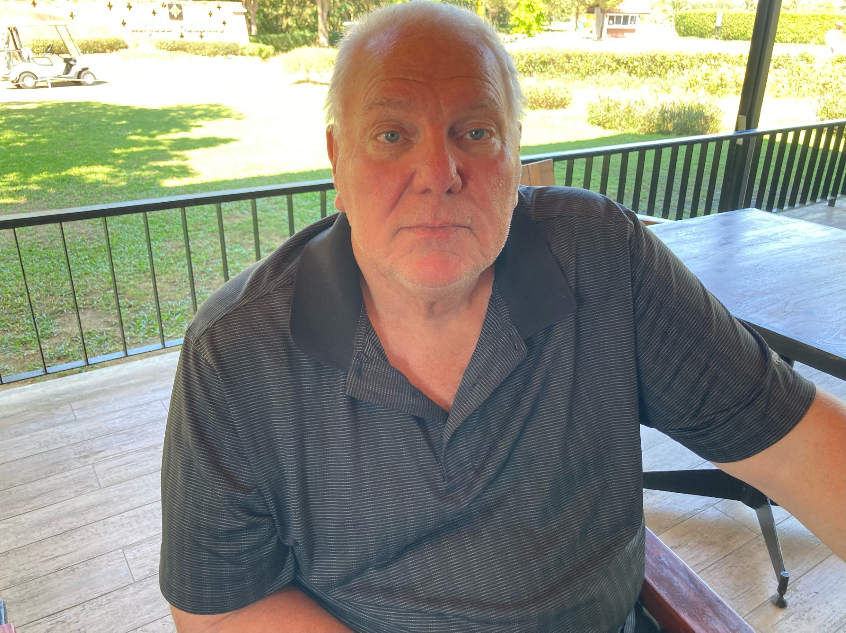
BRIAN COIL

Slide 7
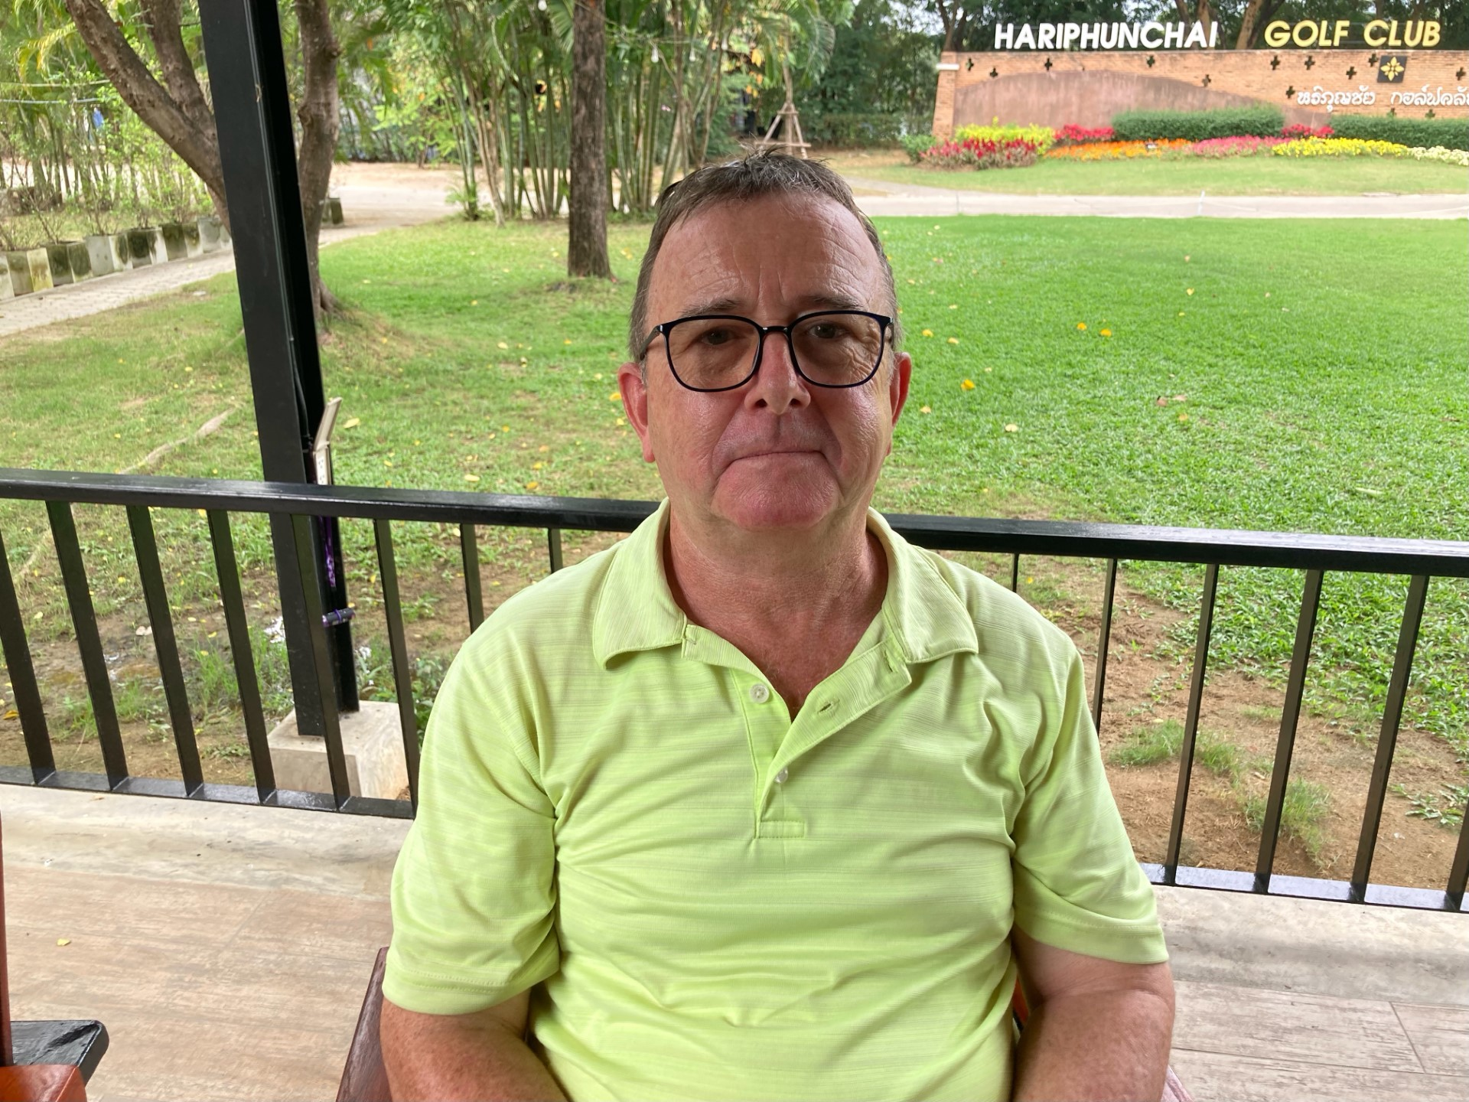
BRIAN RUNDLE

Slide 8
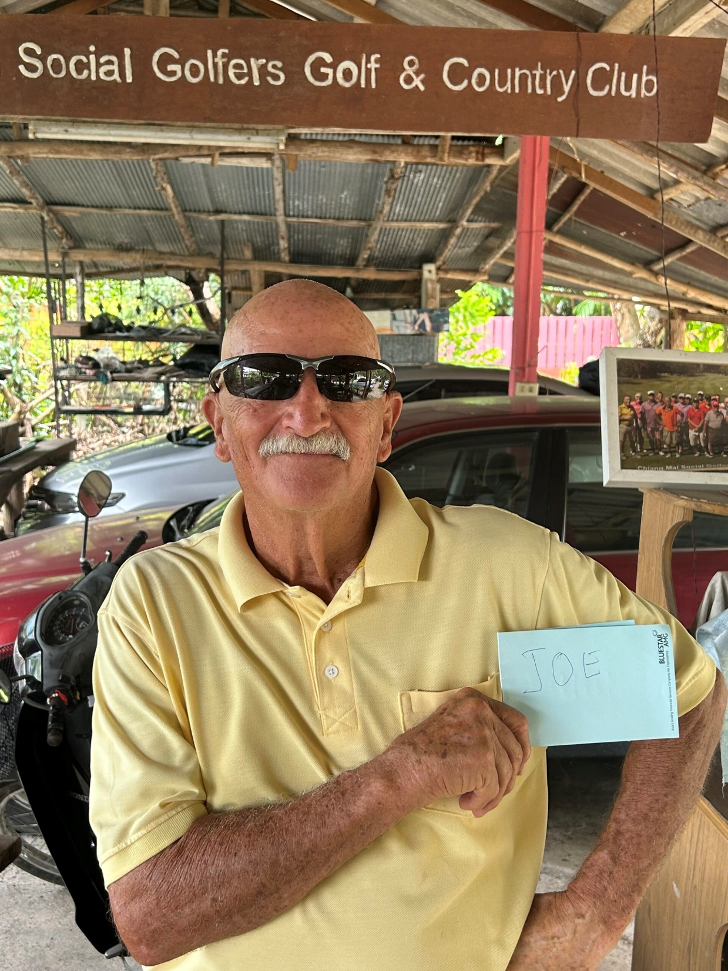
ERIC
GEORGE

Slide 9
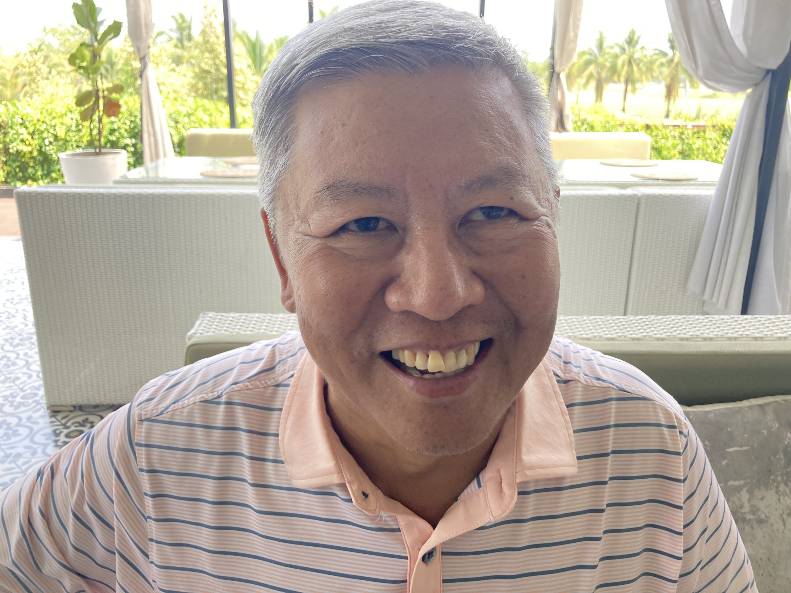
JAMES MA

Slide 10
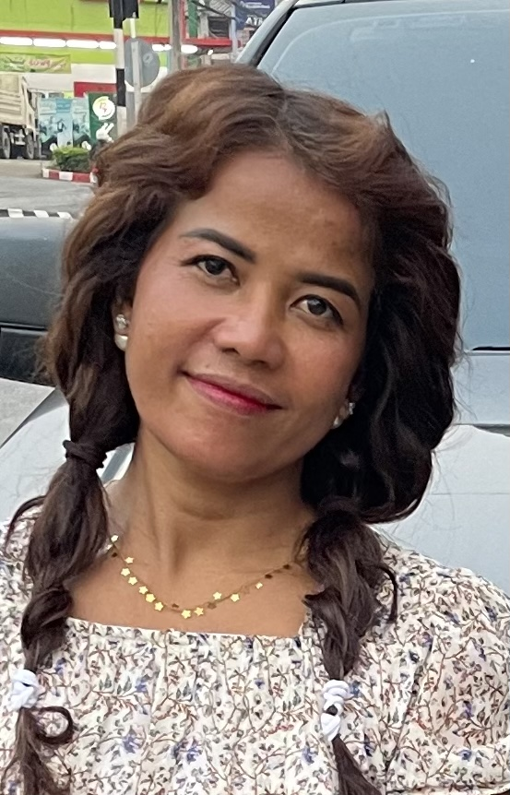
KAY KAY

Slide 11
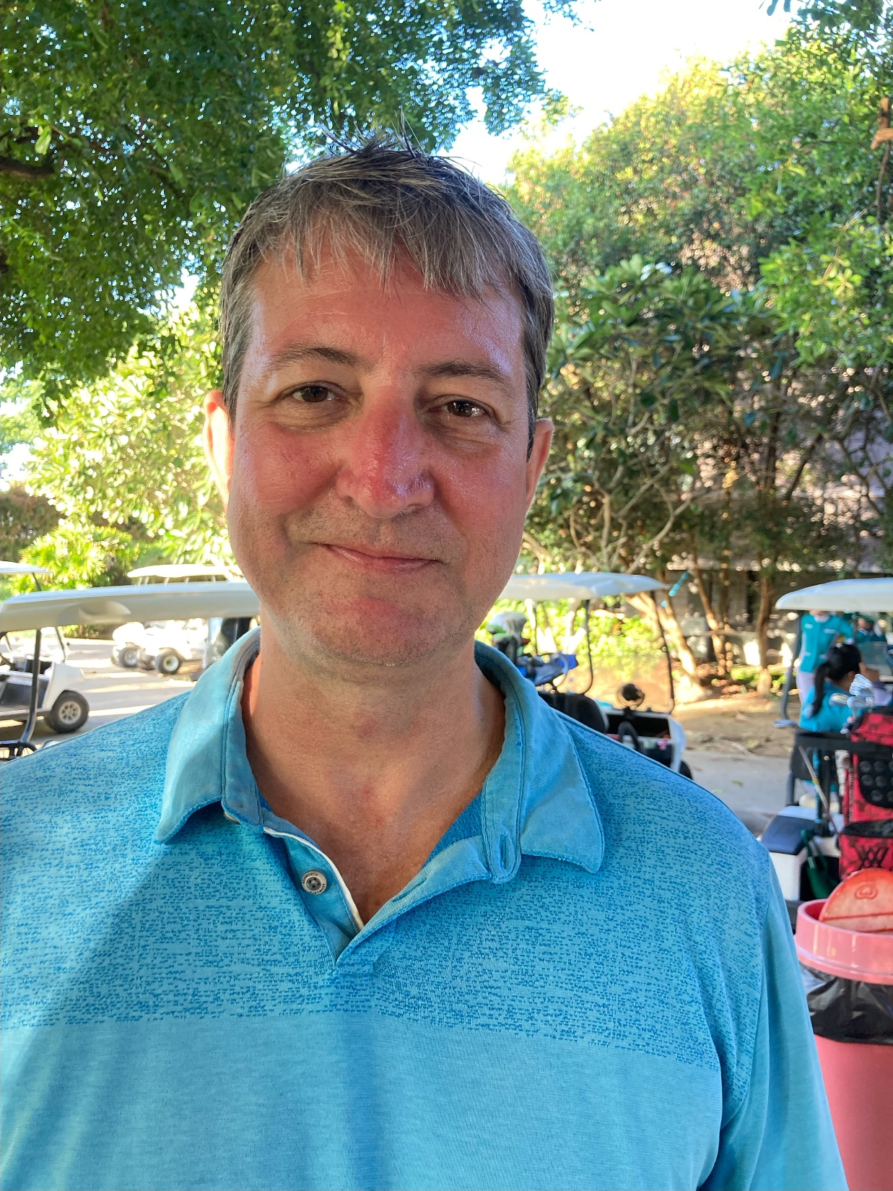
Tim
Maclean

Slide 12
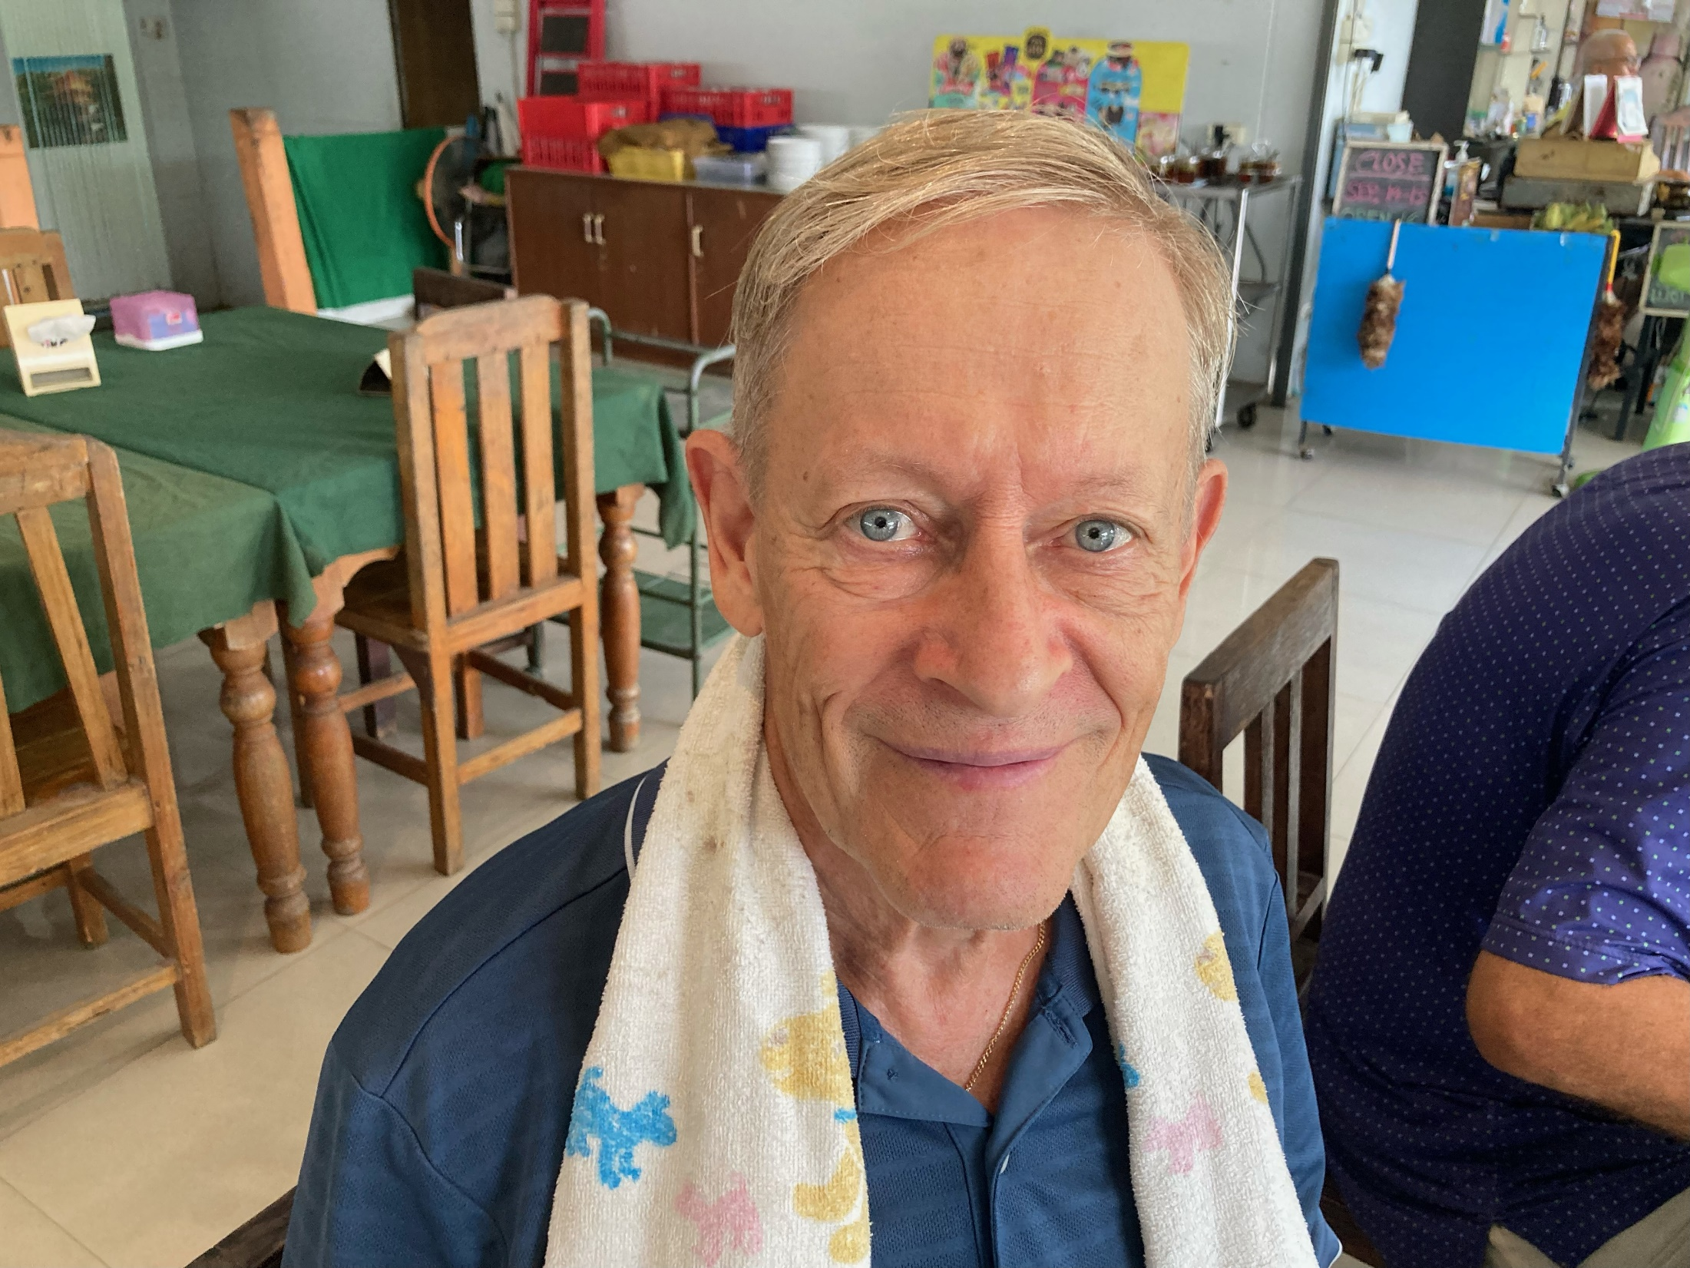
ARI TALVIARI

Slide 13
CARTER WILSON
STEPHEN SNOWDEN

Slide 14
Ram Taylor
Hole in One
15th Hole
Gassan Legacy
13th March 2024

Slide 15
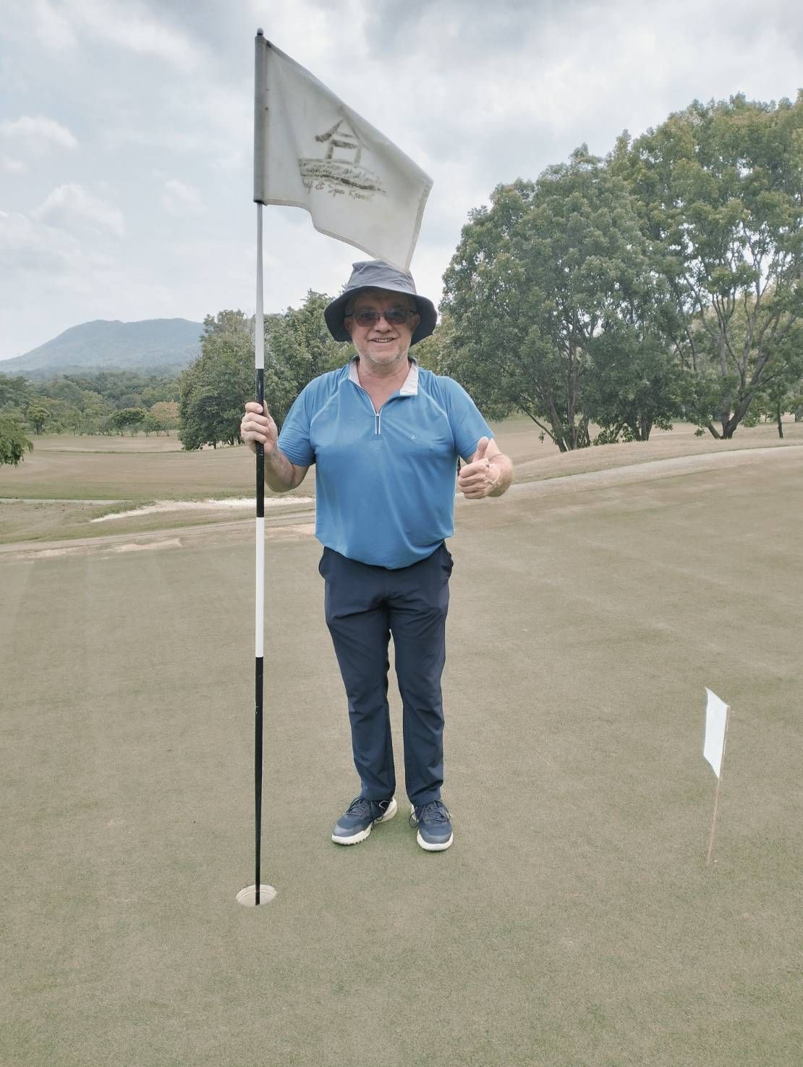
Serge Arnaud
Hole in One
8th Hole
Highlands
28th May 2024

Slide 16
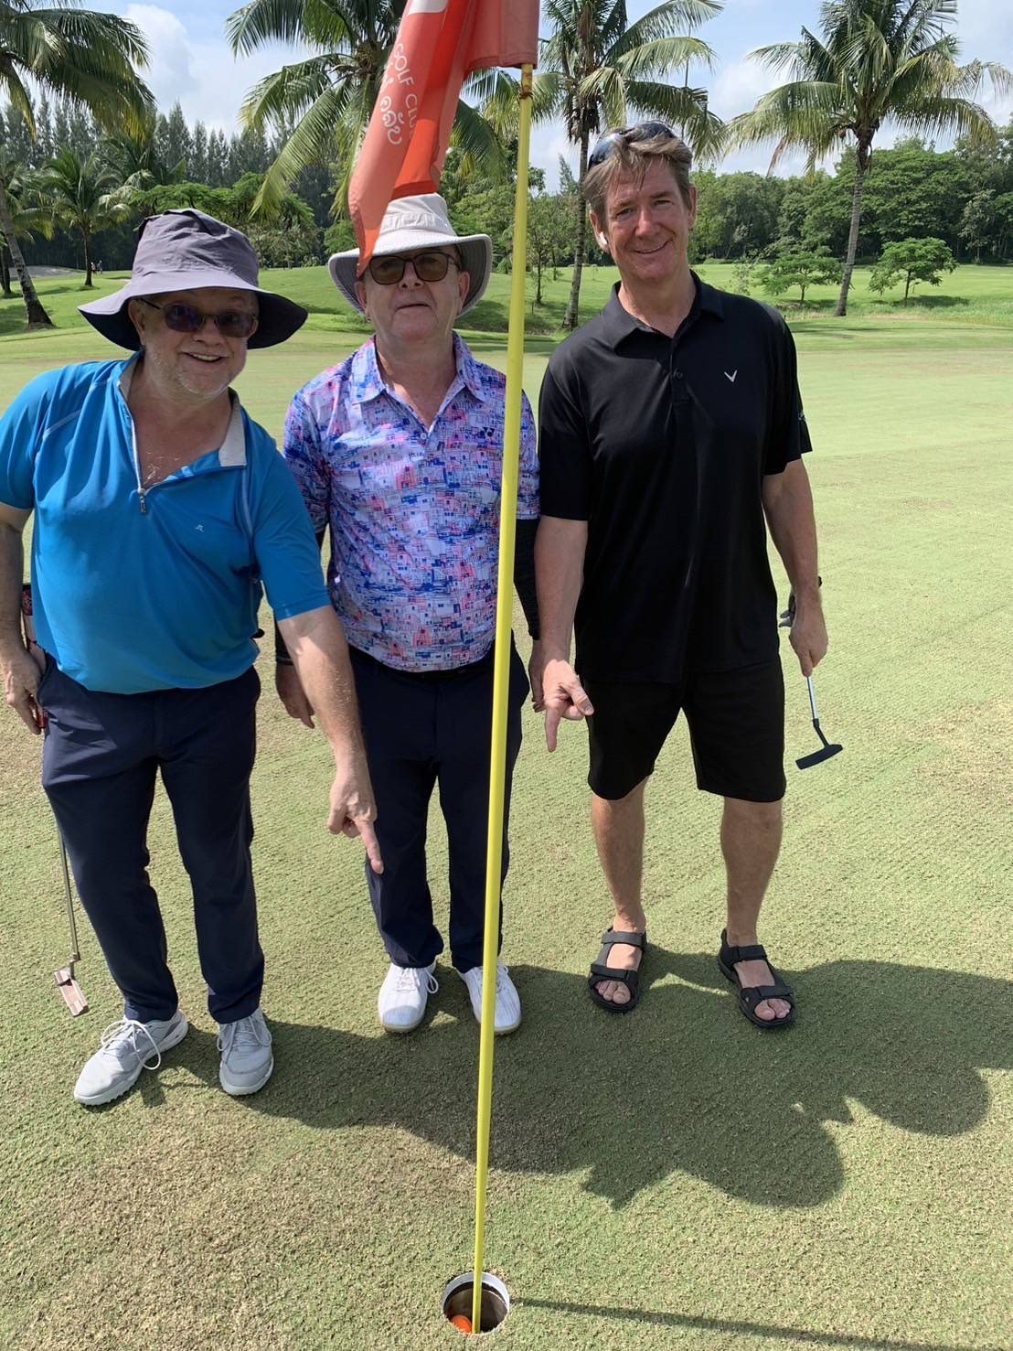
Brian Rundle
Hariphunchai
4th September
Hole 7

Slide 17
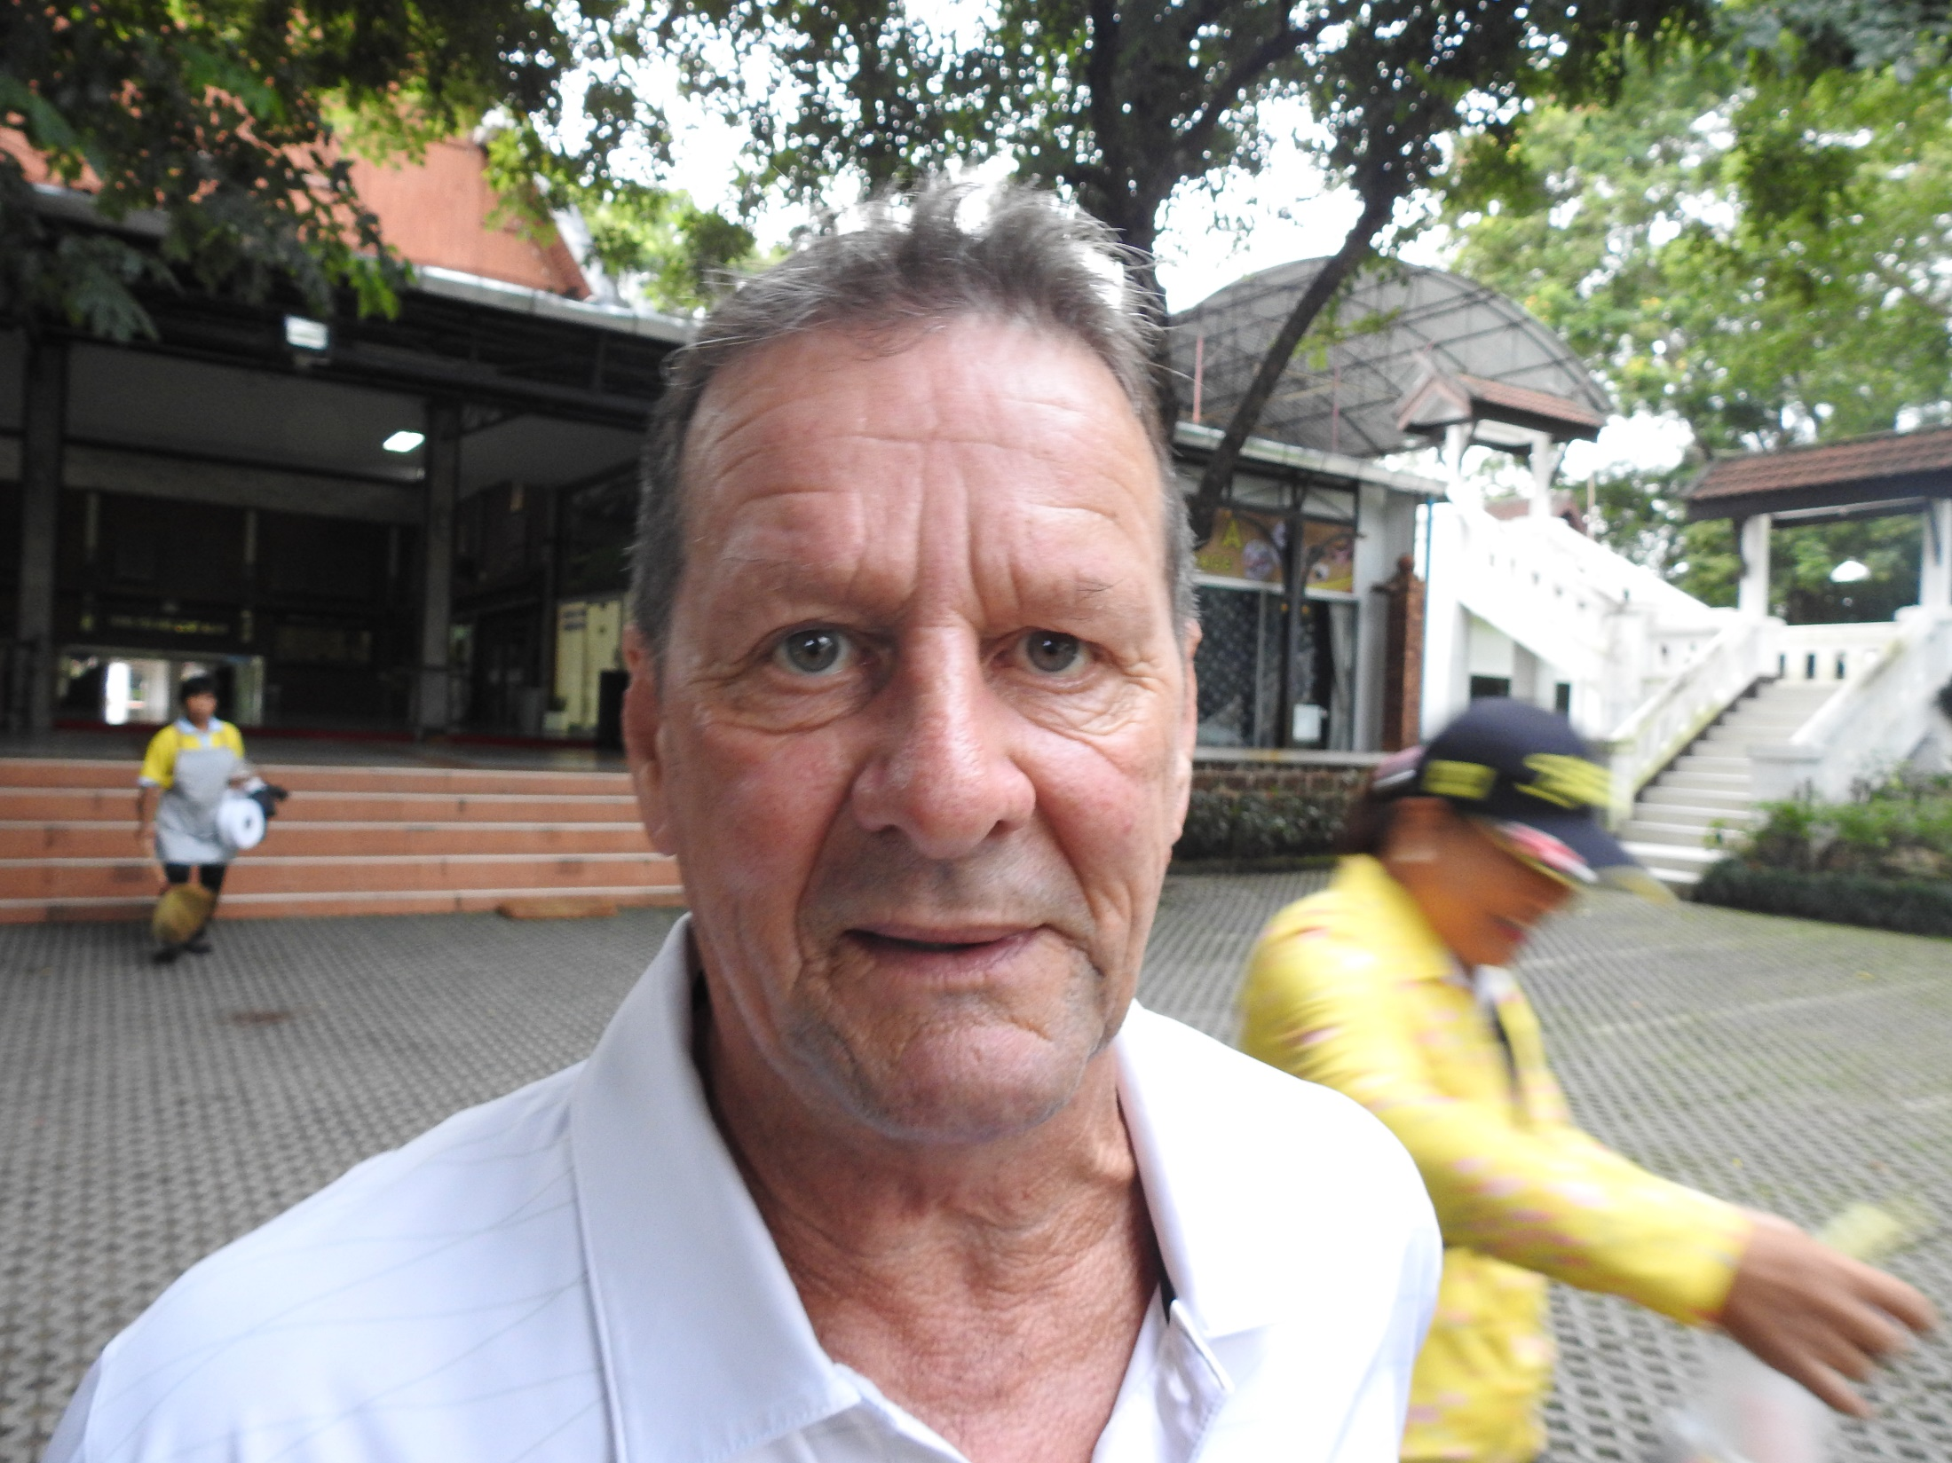
Chiang Rai Cup Winner 2023
Mike Roycroft

Slide 18
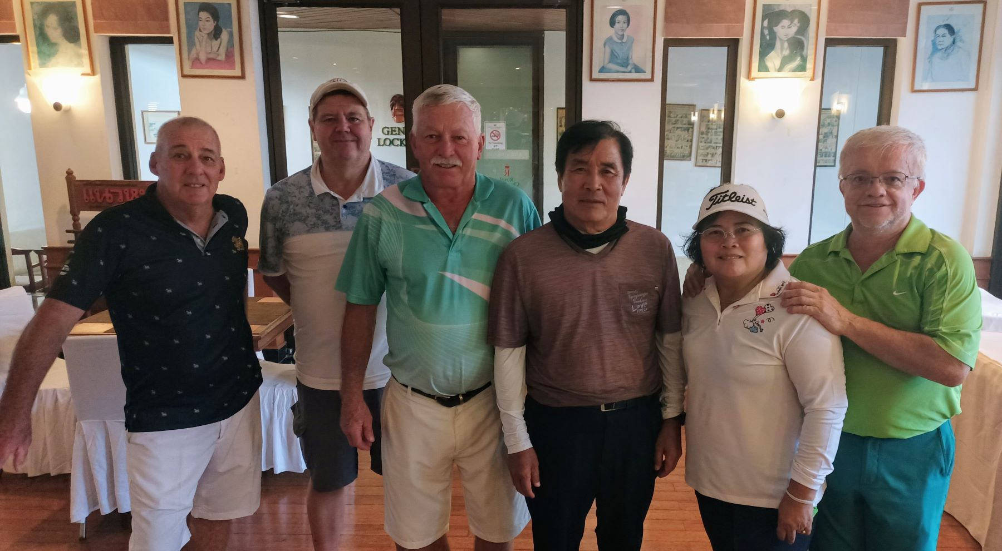
Royal Flush

Slide 19
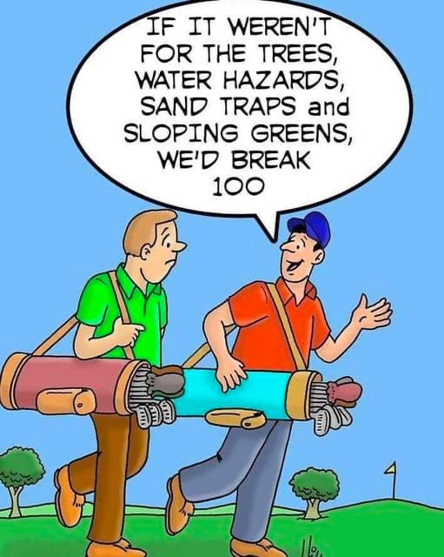

Slide 20
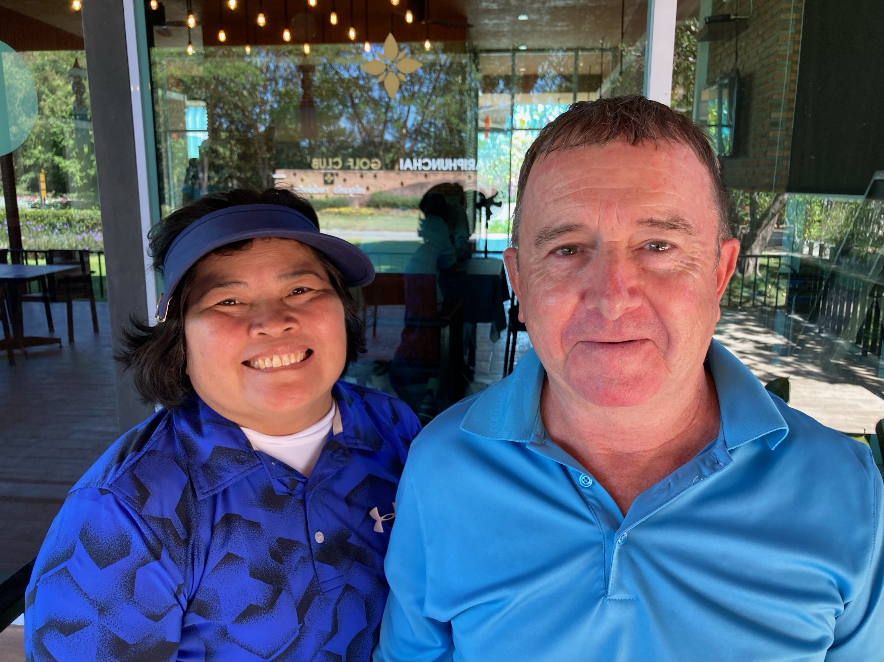

Slide 21
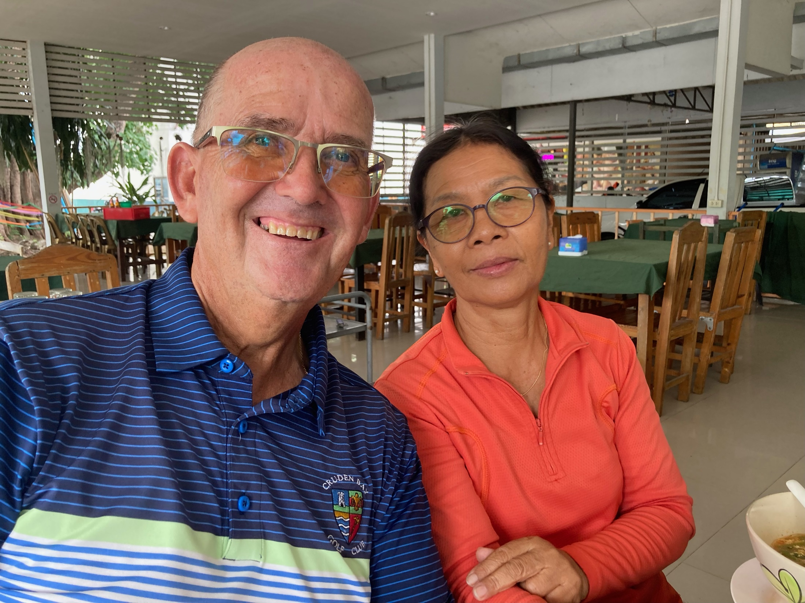

Slide 22
THE INTERNATIONAL

Slide 23
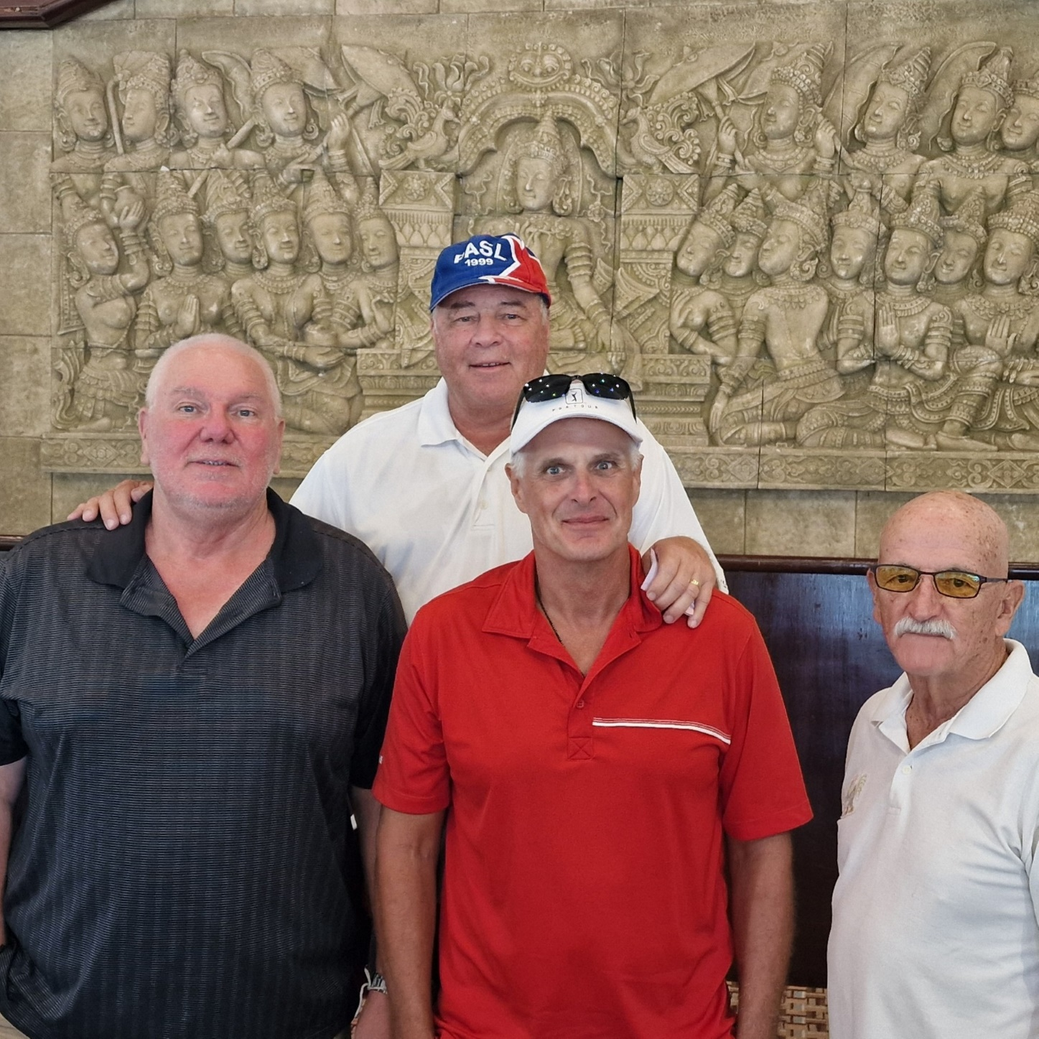
The Winners, Team U.S.A.2

Slide 24
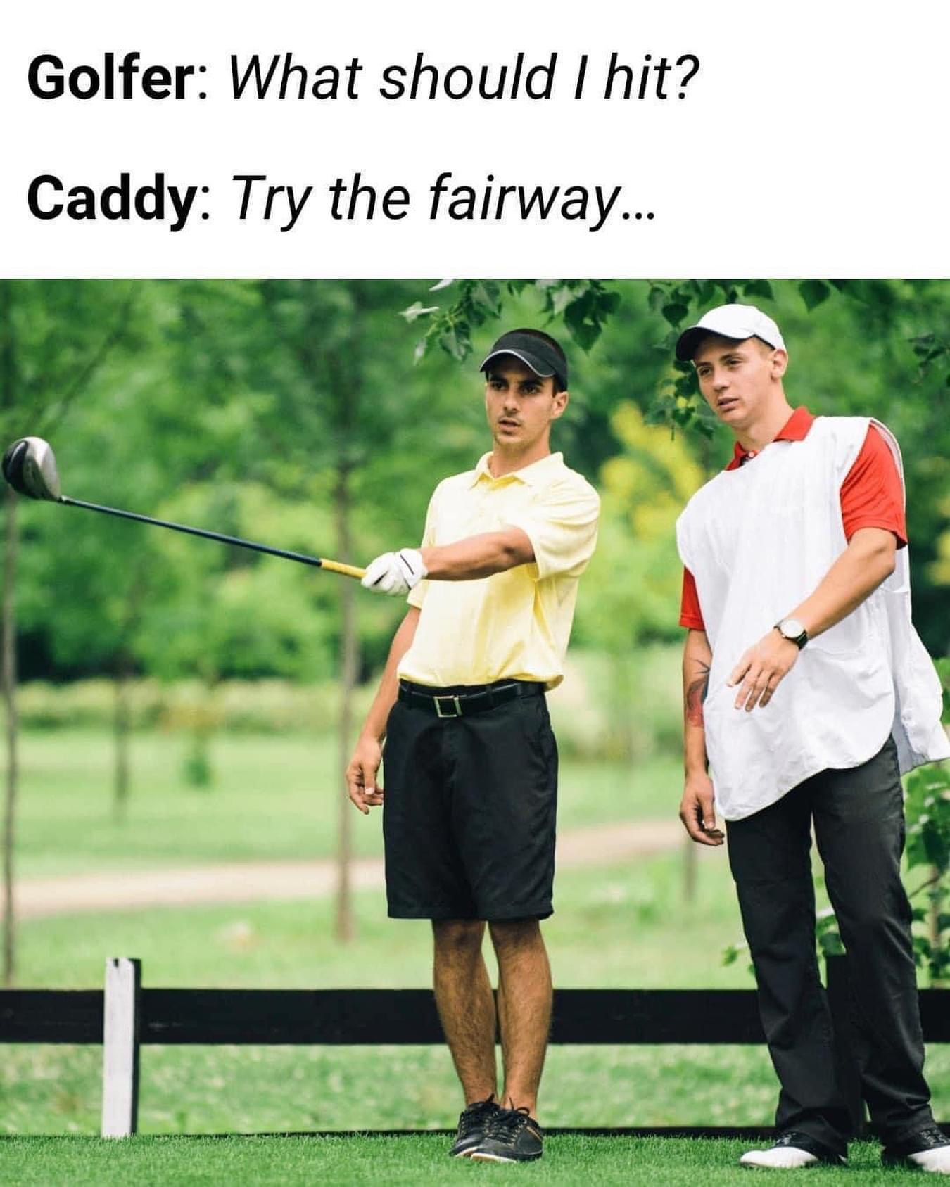

Slide 25
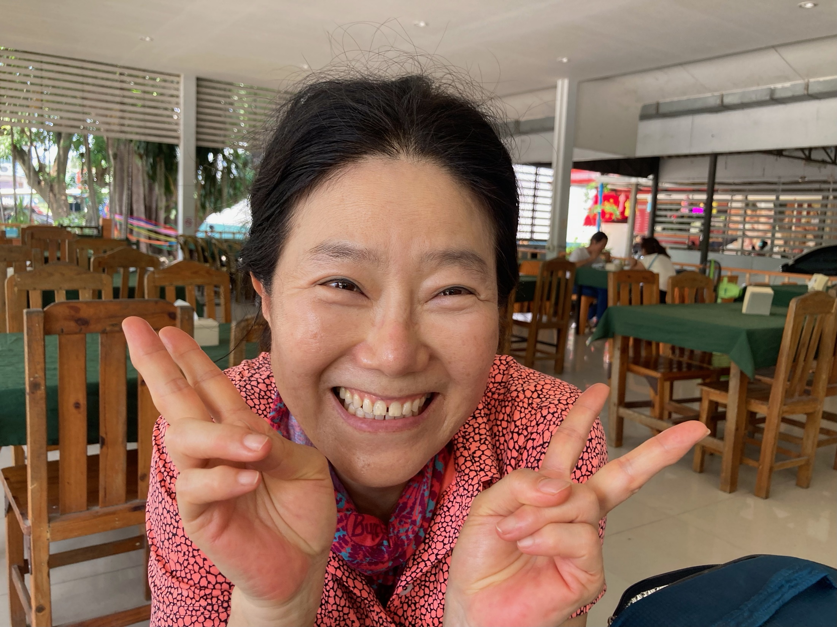

Slide 26
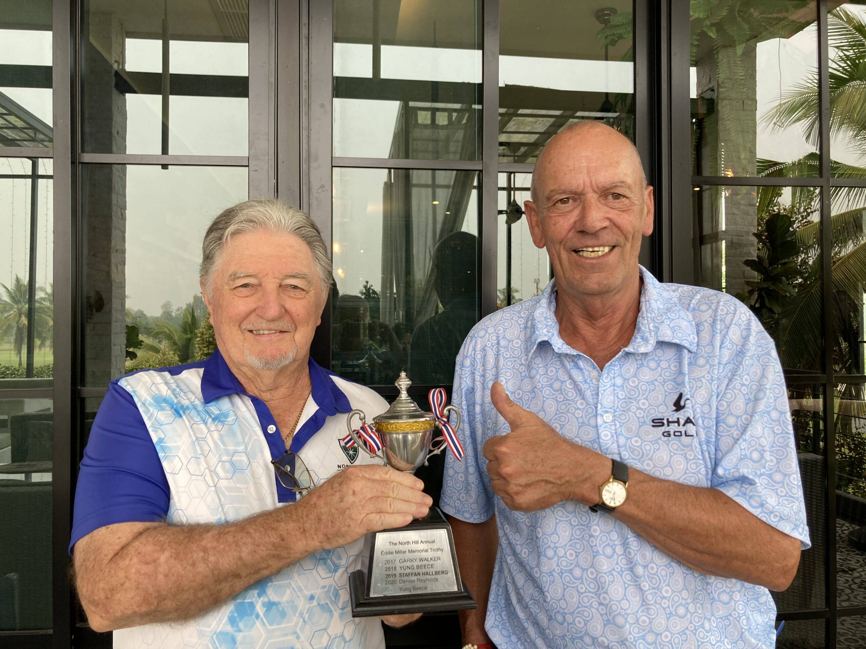
Eddie Millar Trophy

Slide 27
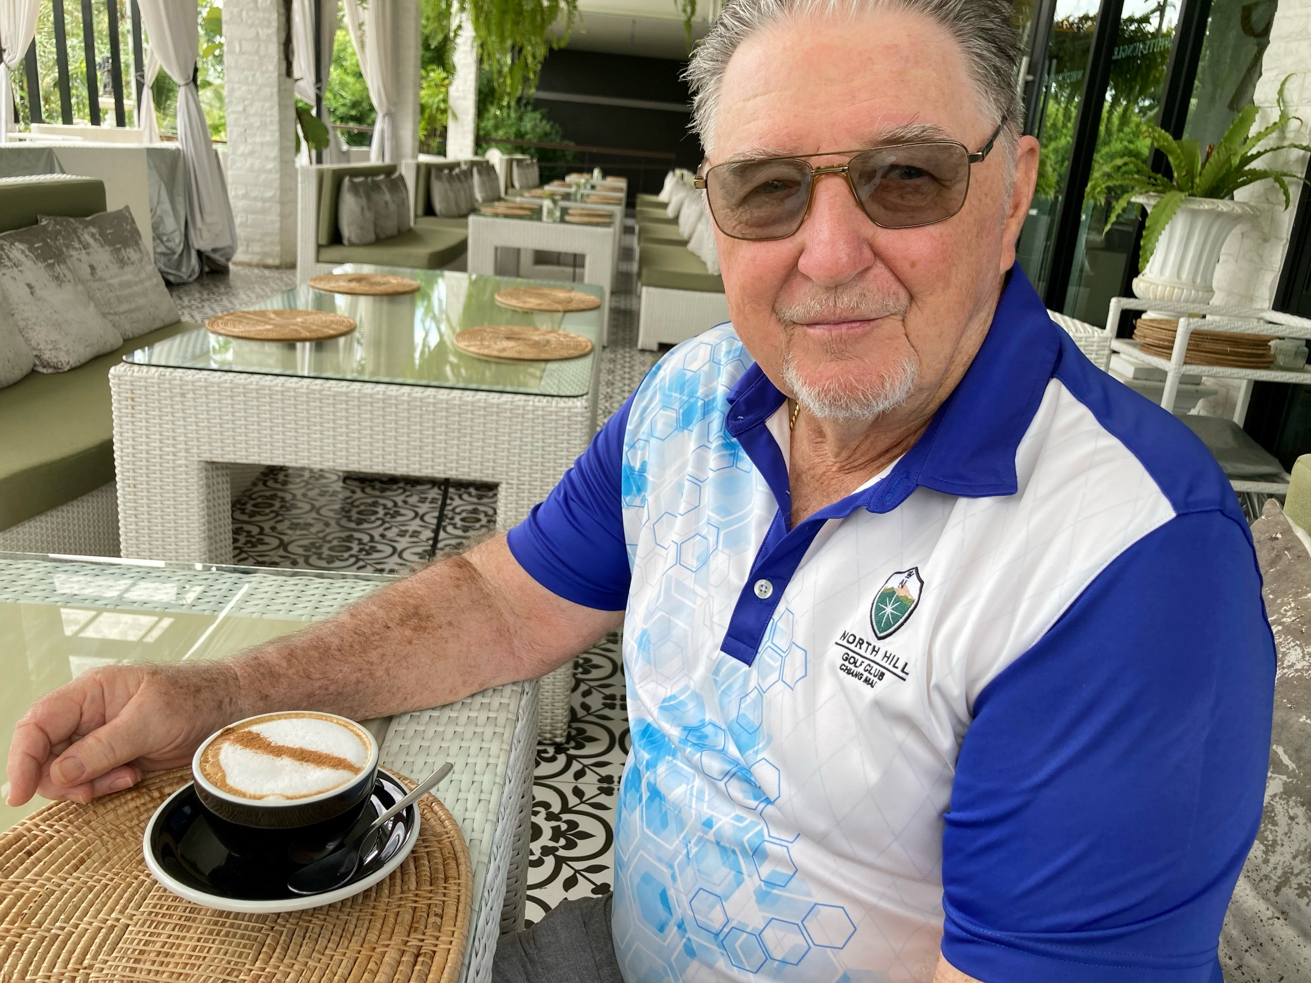

Slide 28
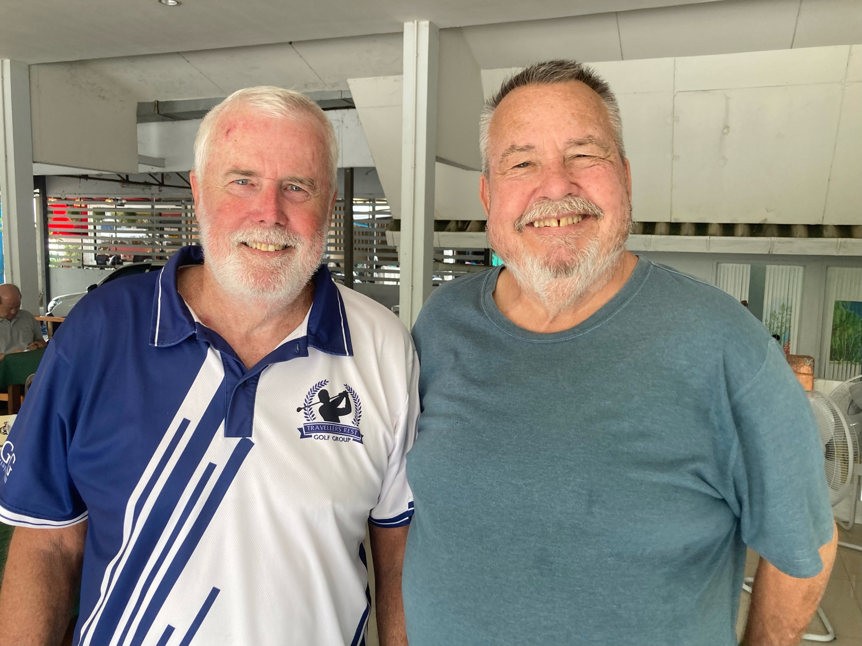

Slide 29
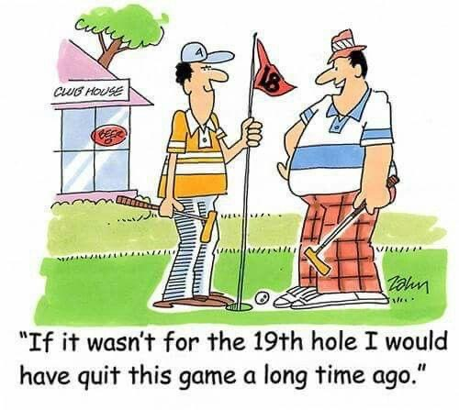

Slide 30
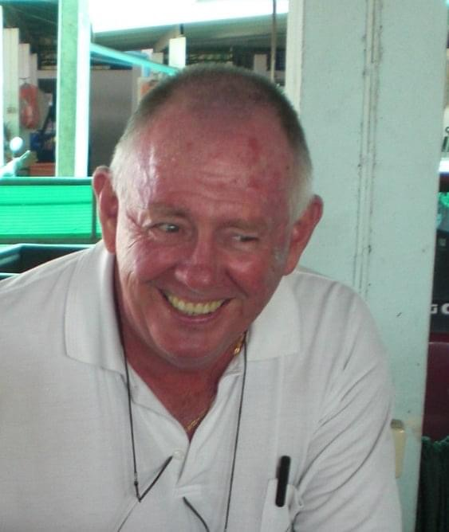

Slide 31
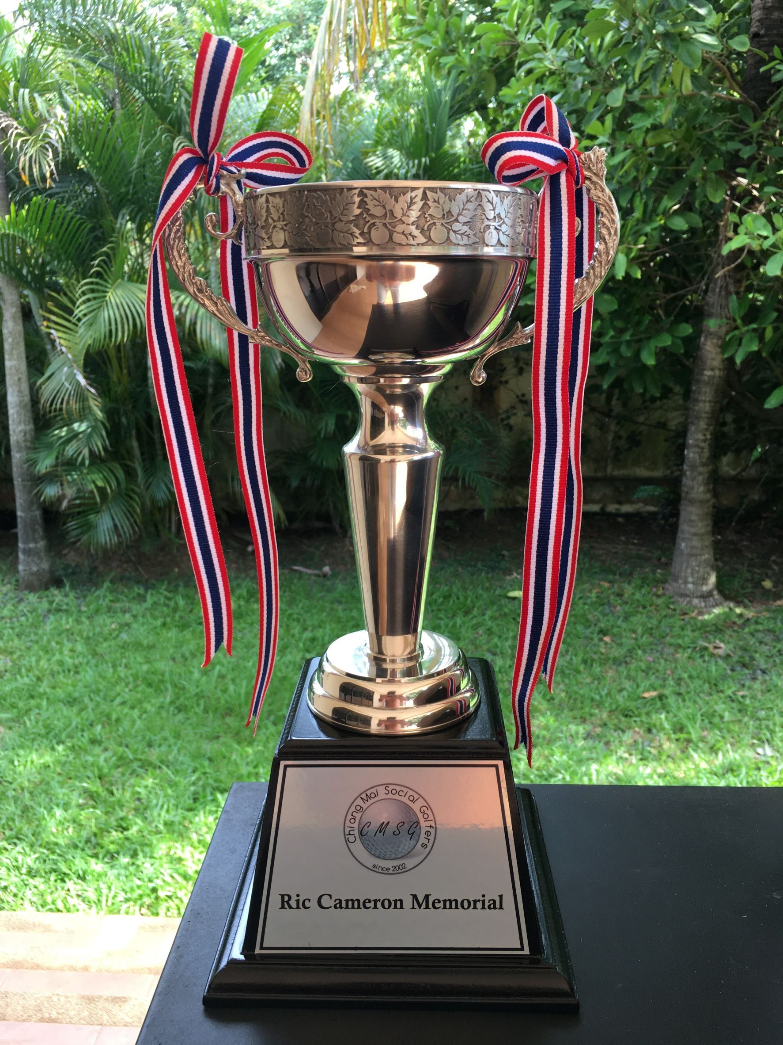

Slide 32
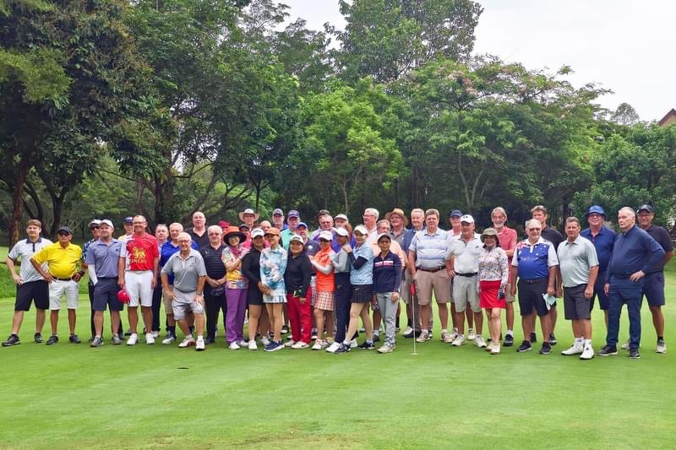

Slide 33
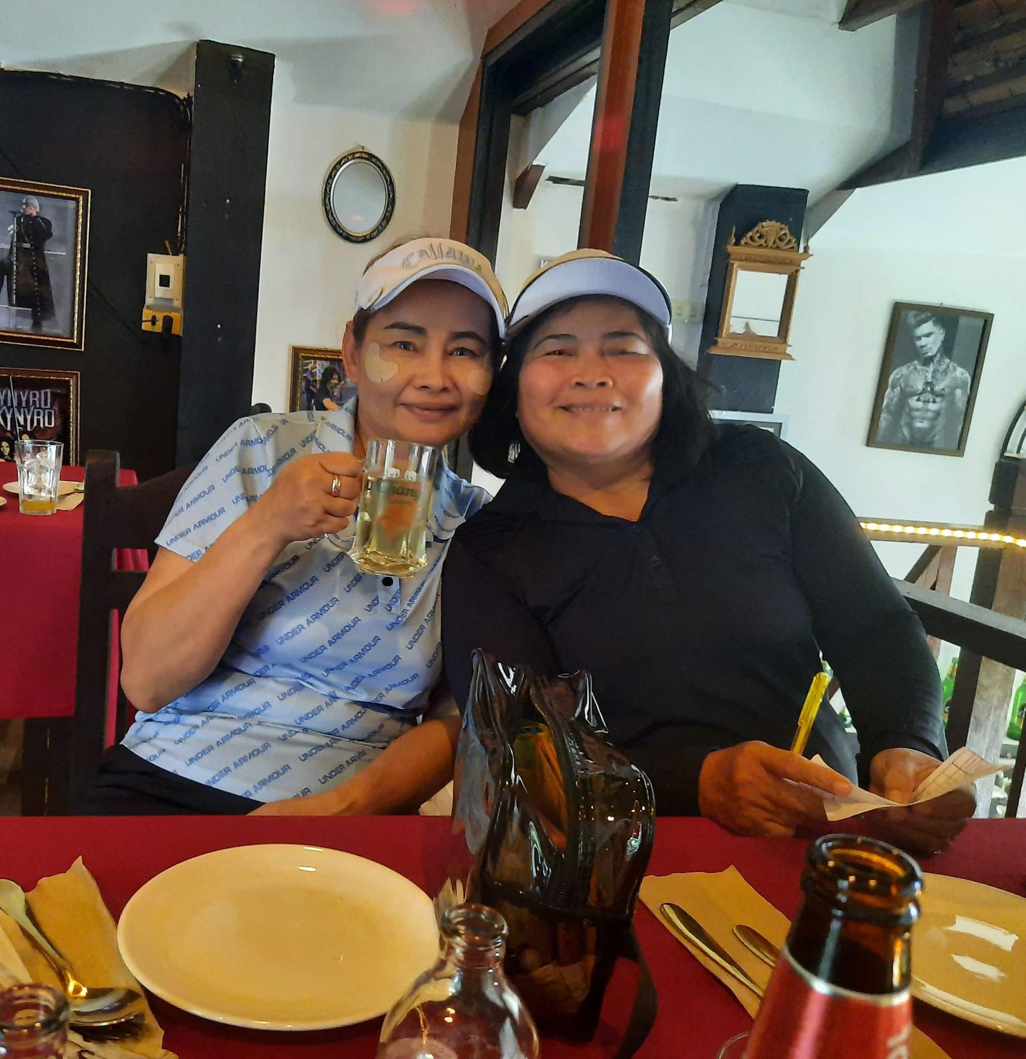

Slide 34
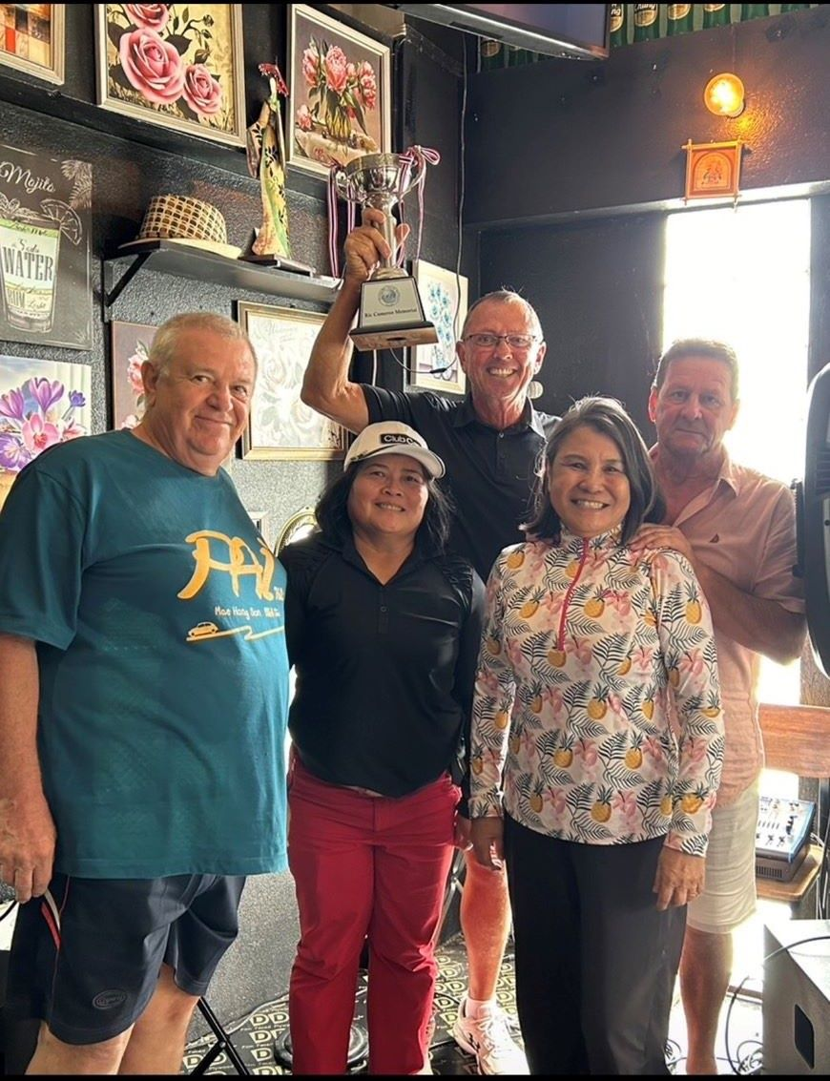

Slide 35
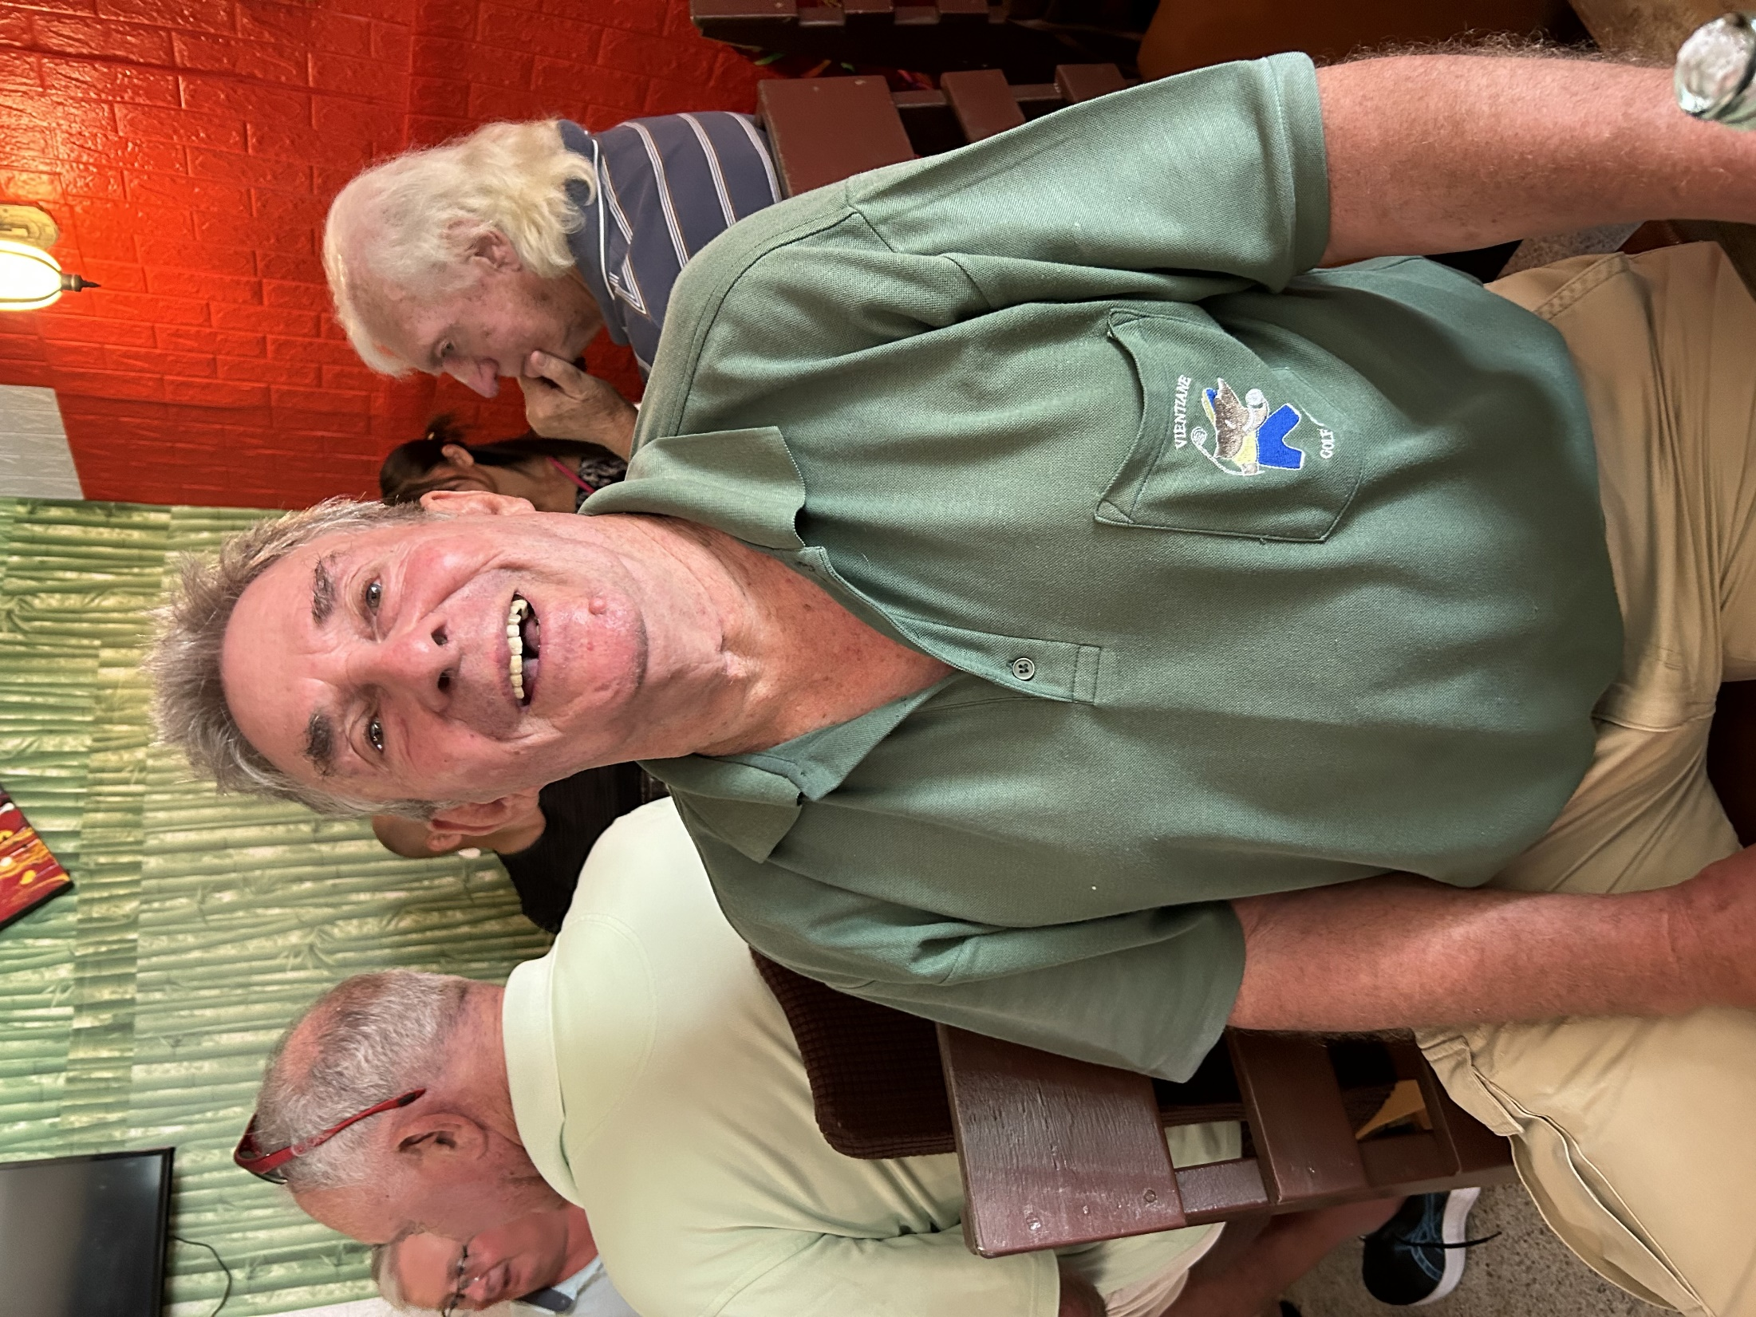
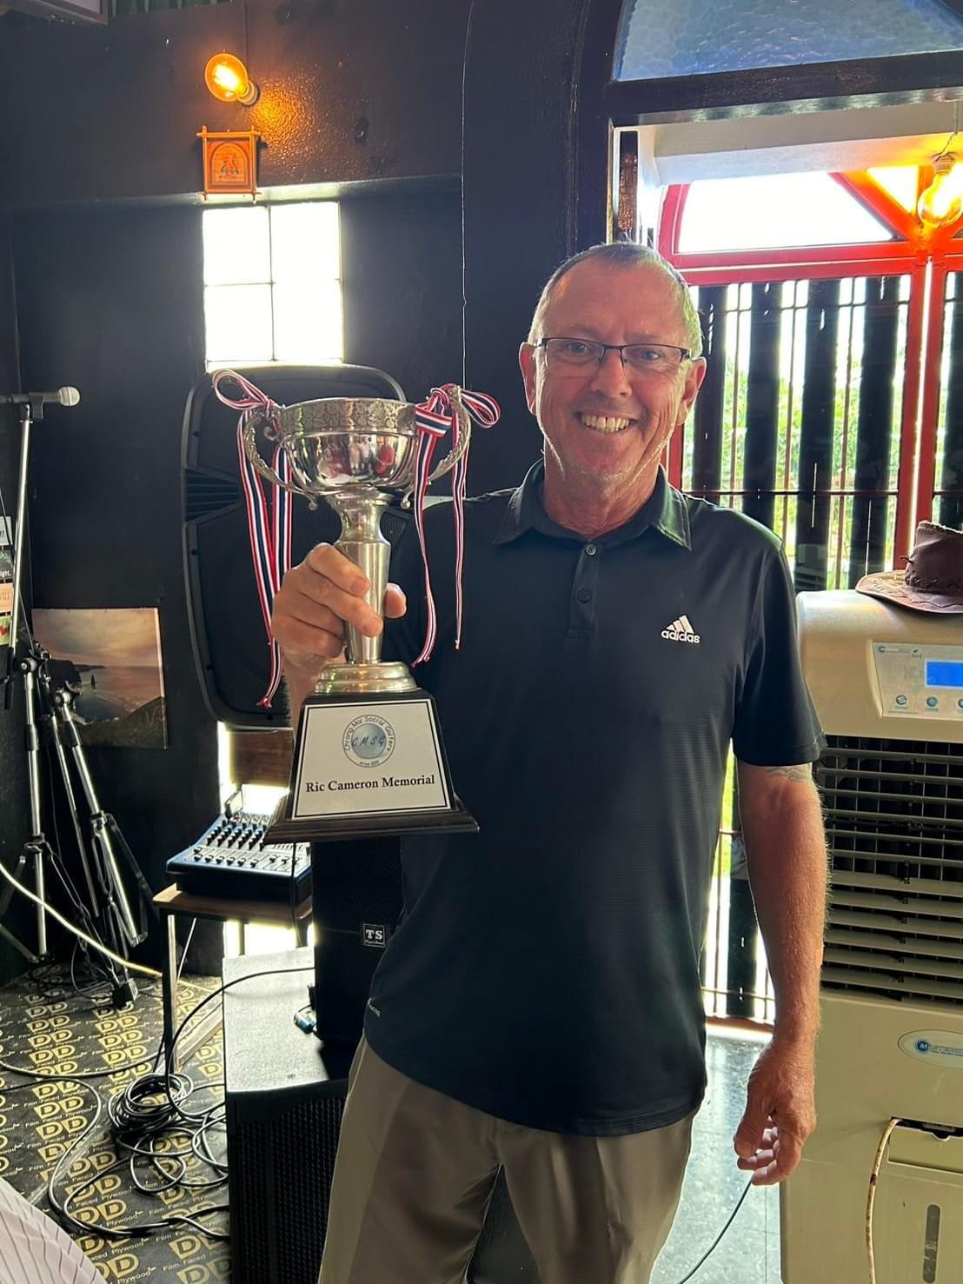
2024
WINNER
RANDY
TIESL

Slide 36
Thank you to all our sponsors.

Slide 37
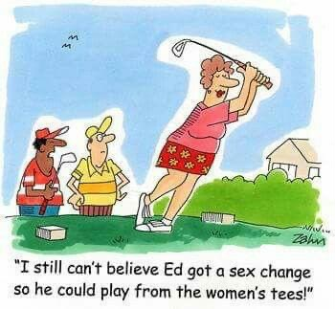

Slide 38
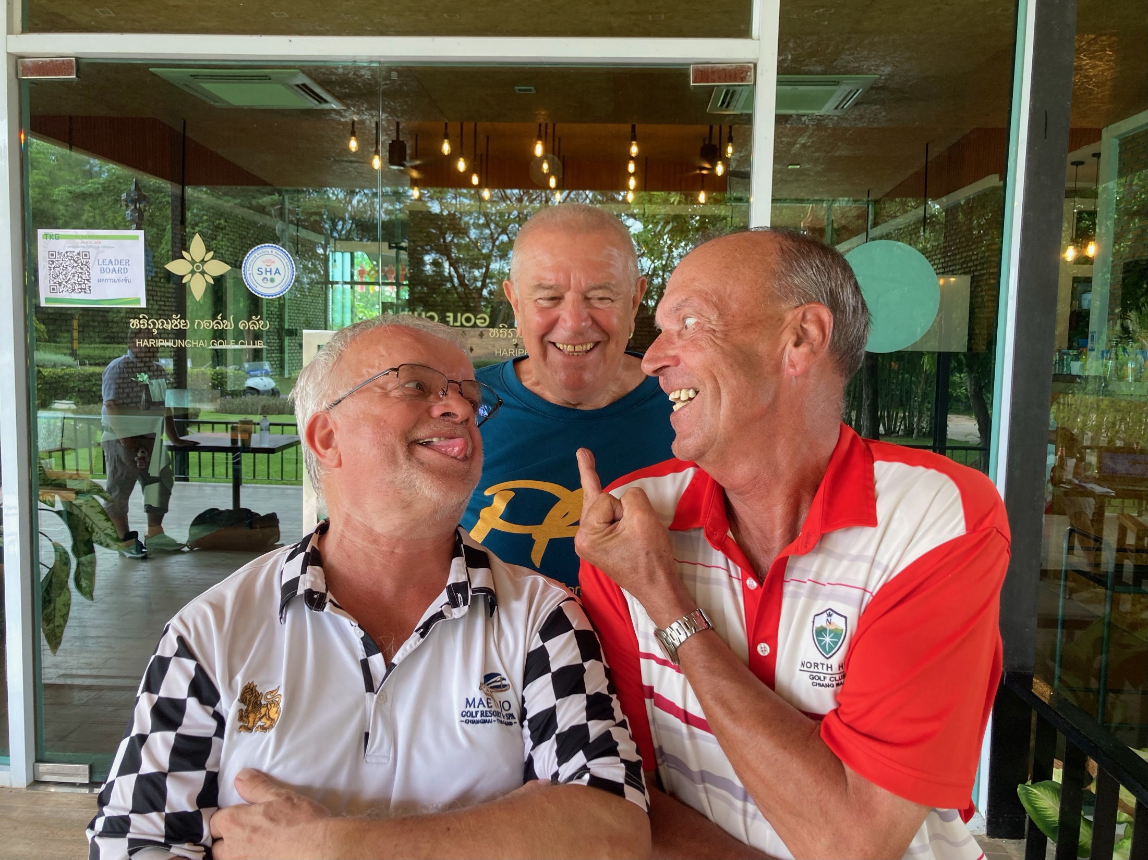

Slide 39
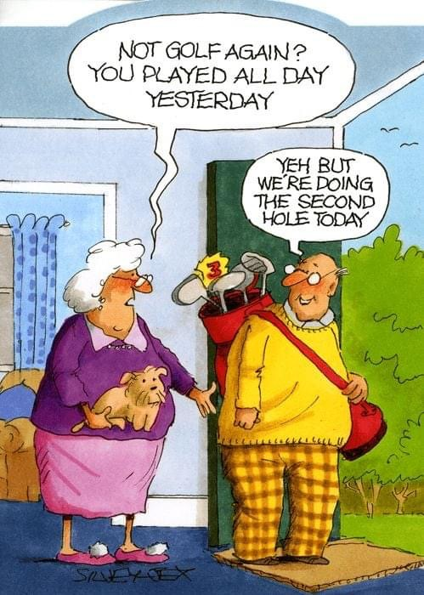

Slide 40


Slide 41
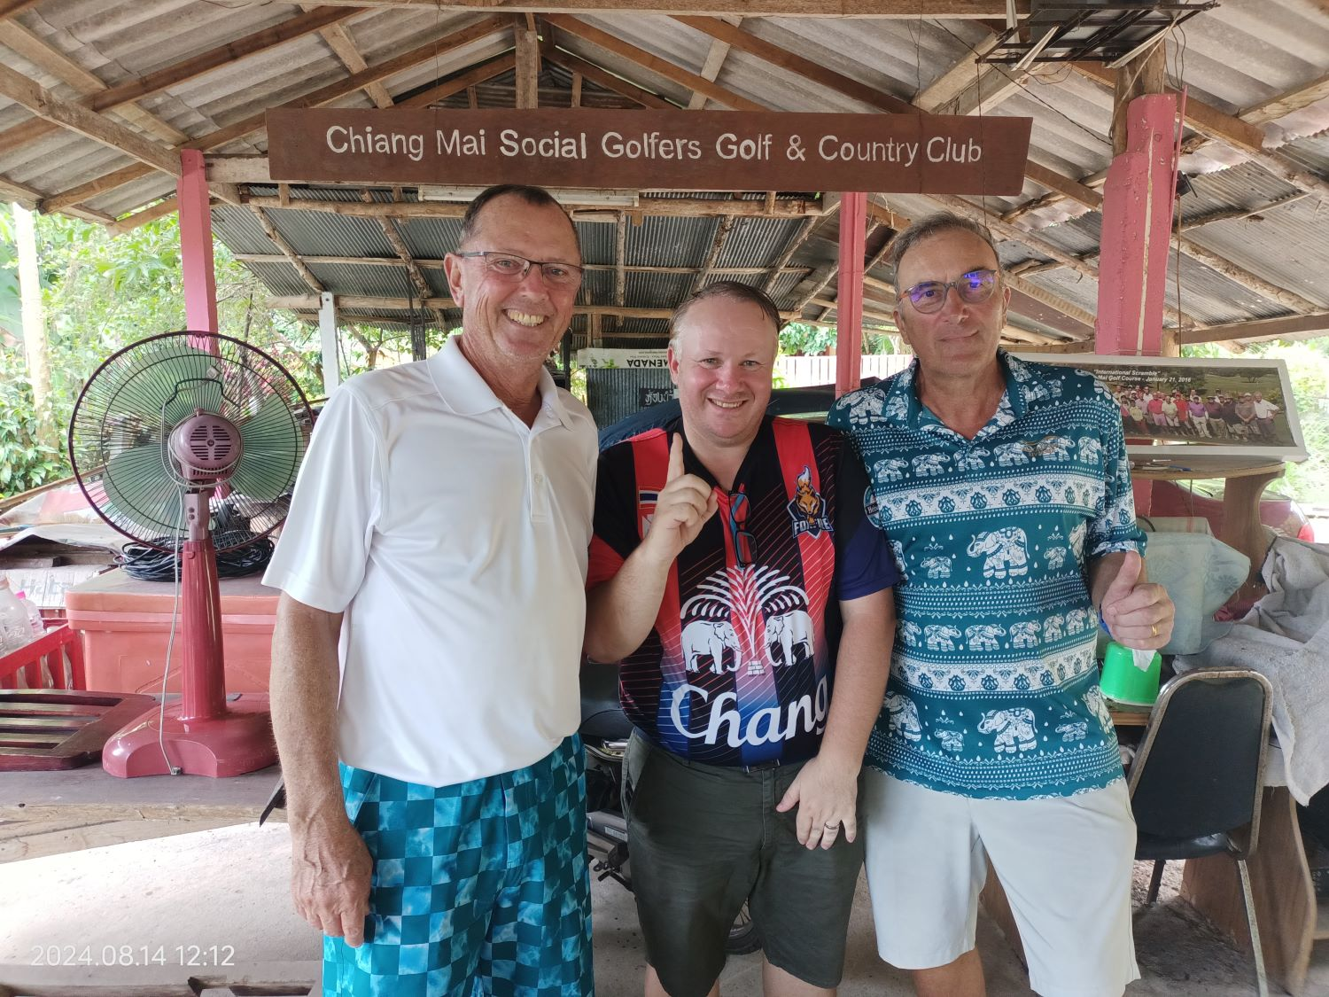

Slide 42
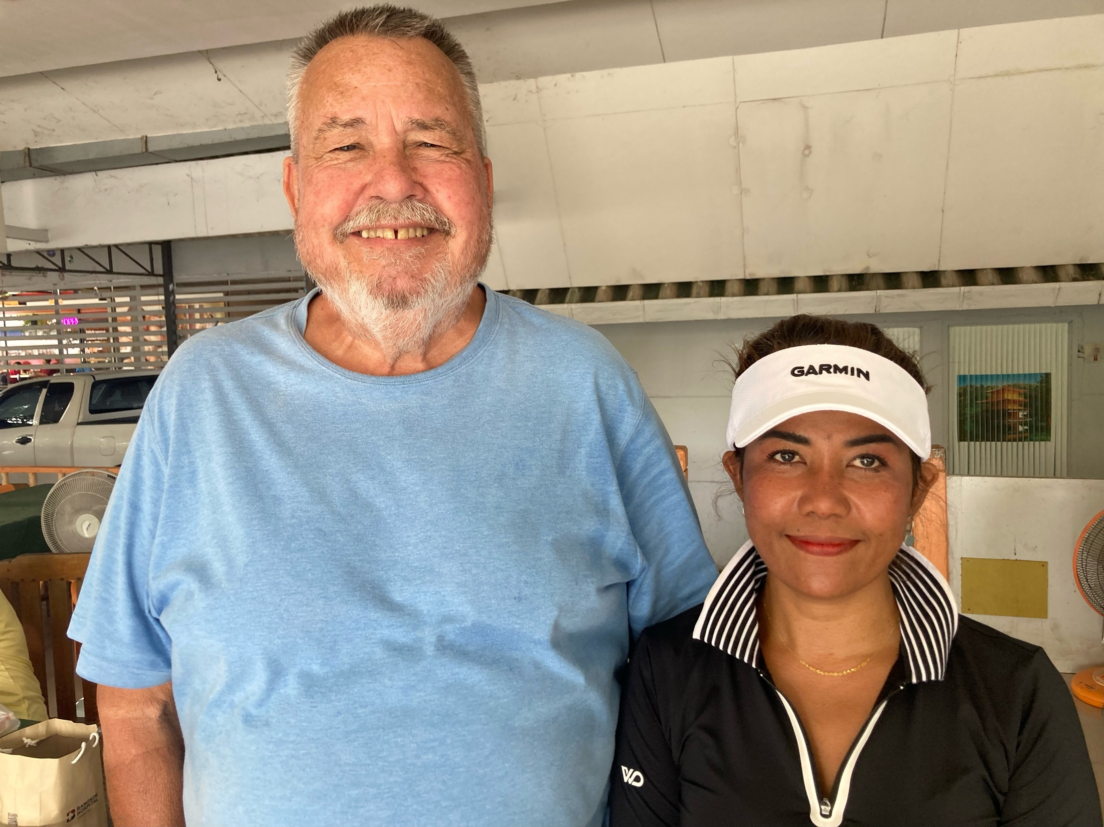

Slide 43
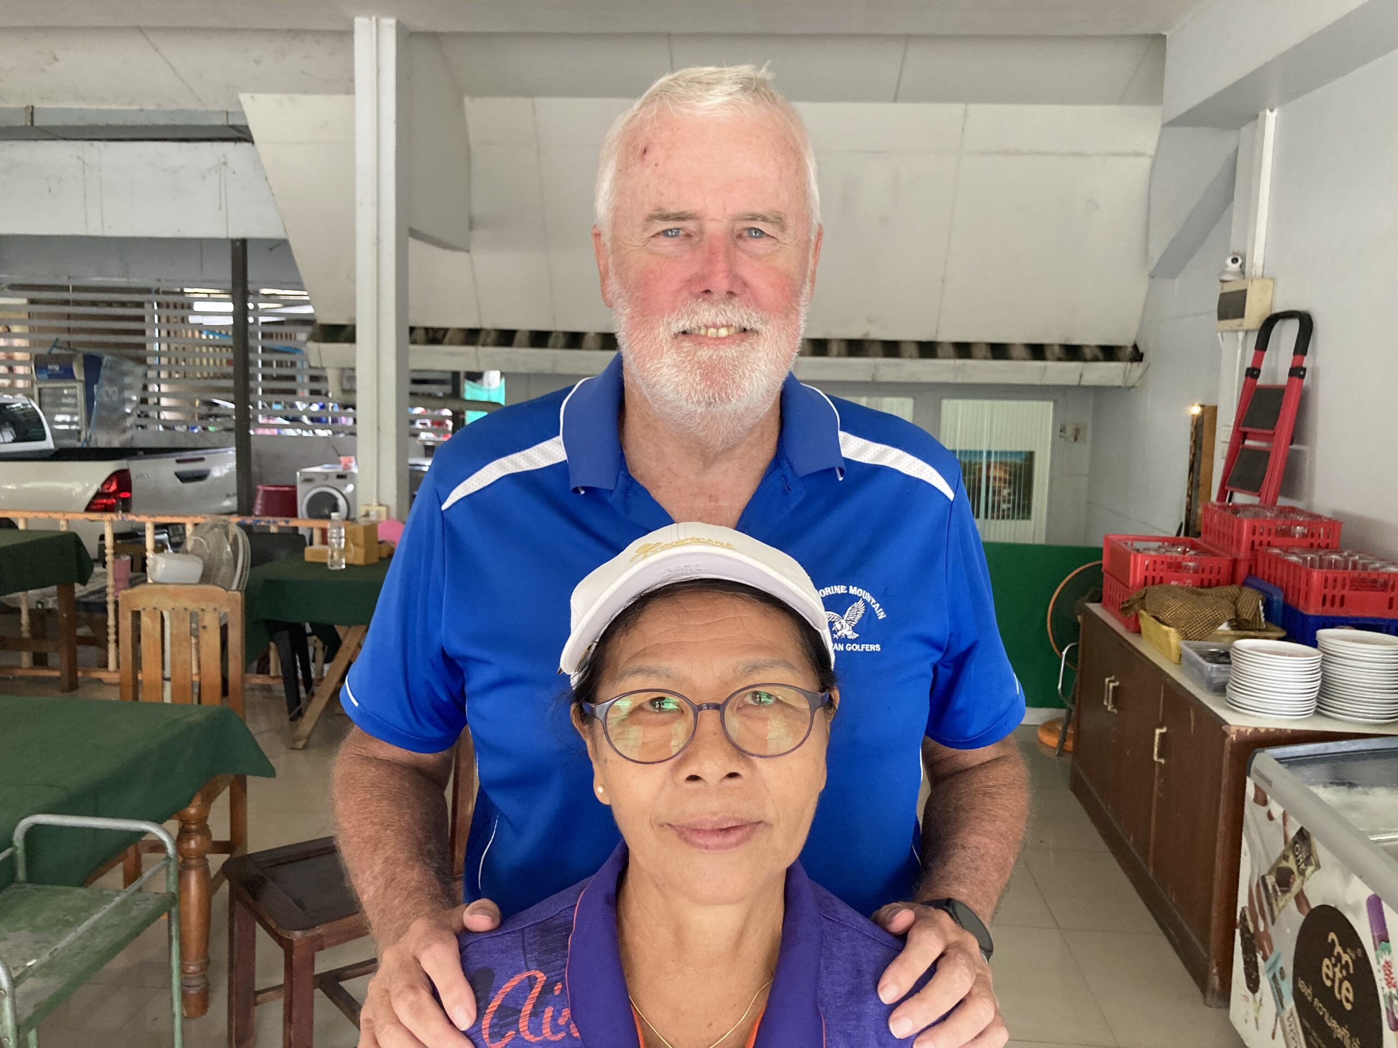

Slide 44
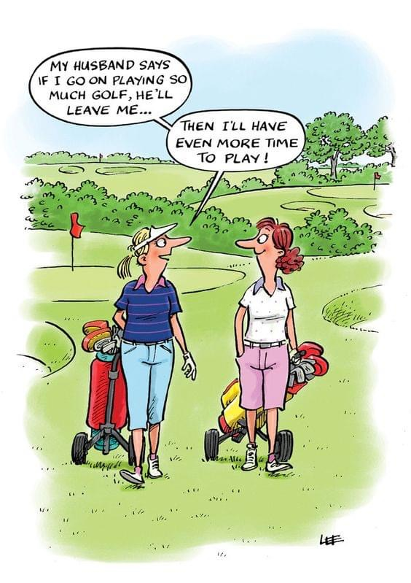

Slide 45
ANNUAL
TOURNAMENT

Slide 46

Thank you for your generous sponsorship, Chris Ryan

Slide 47
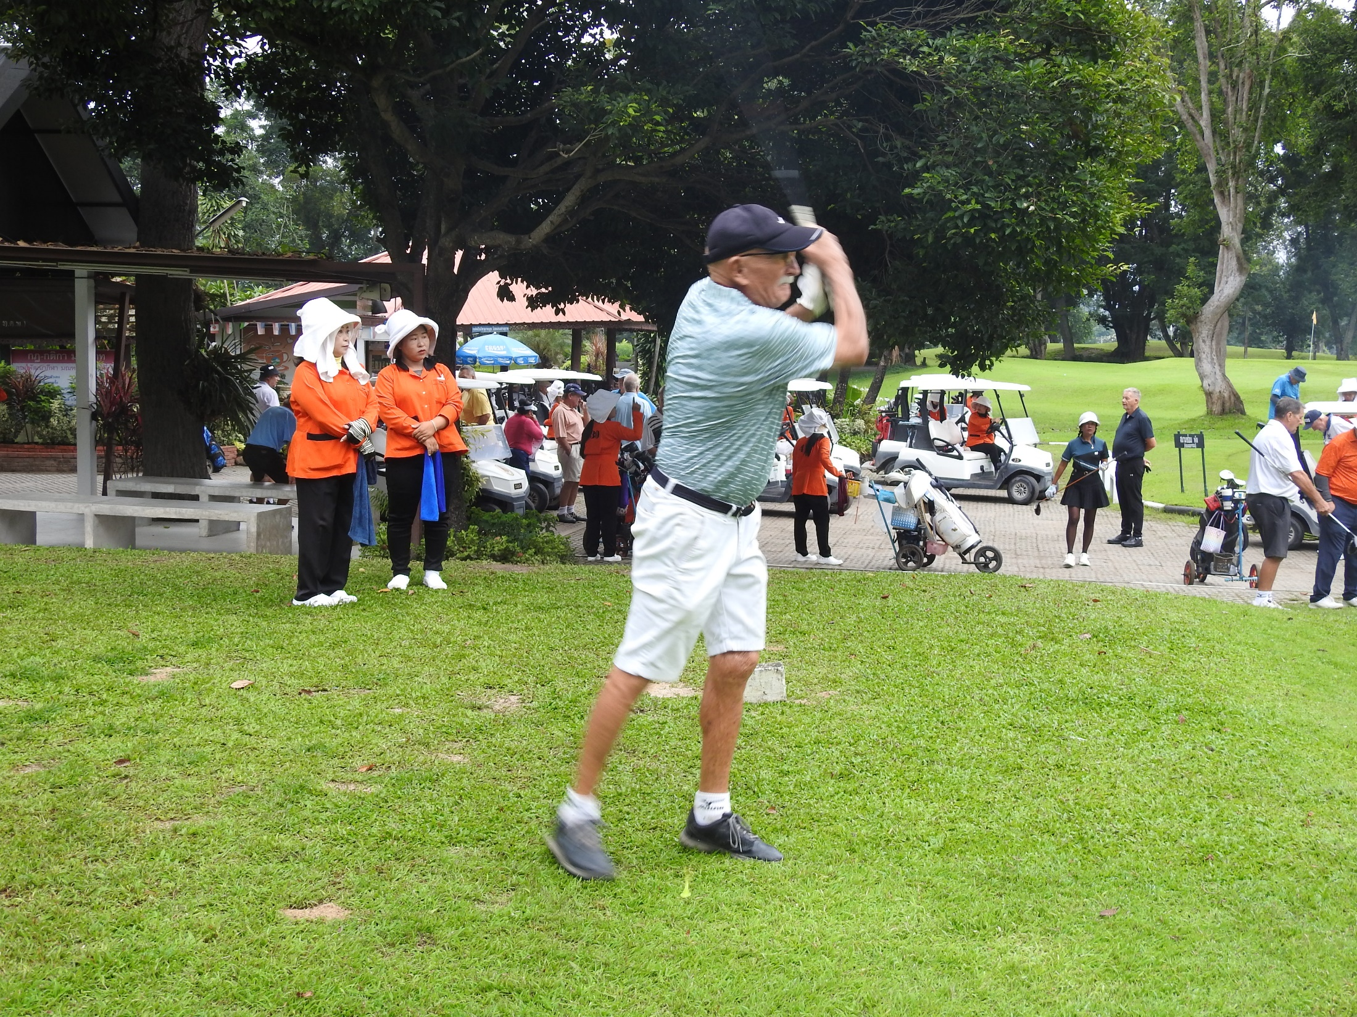

Slide 48
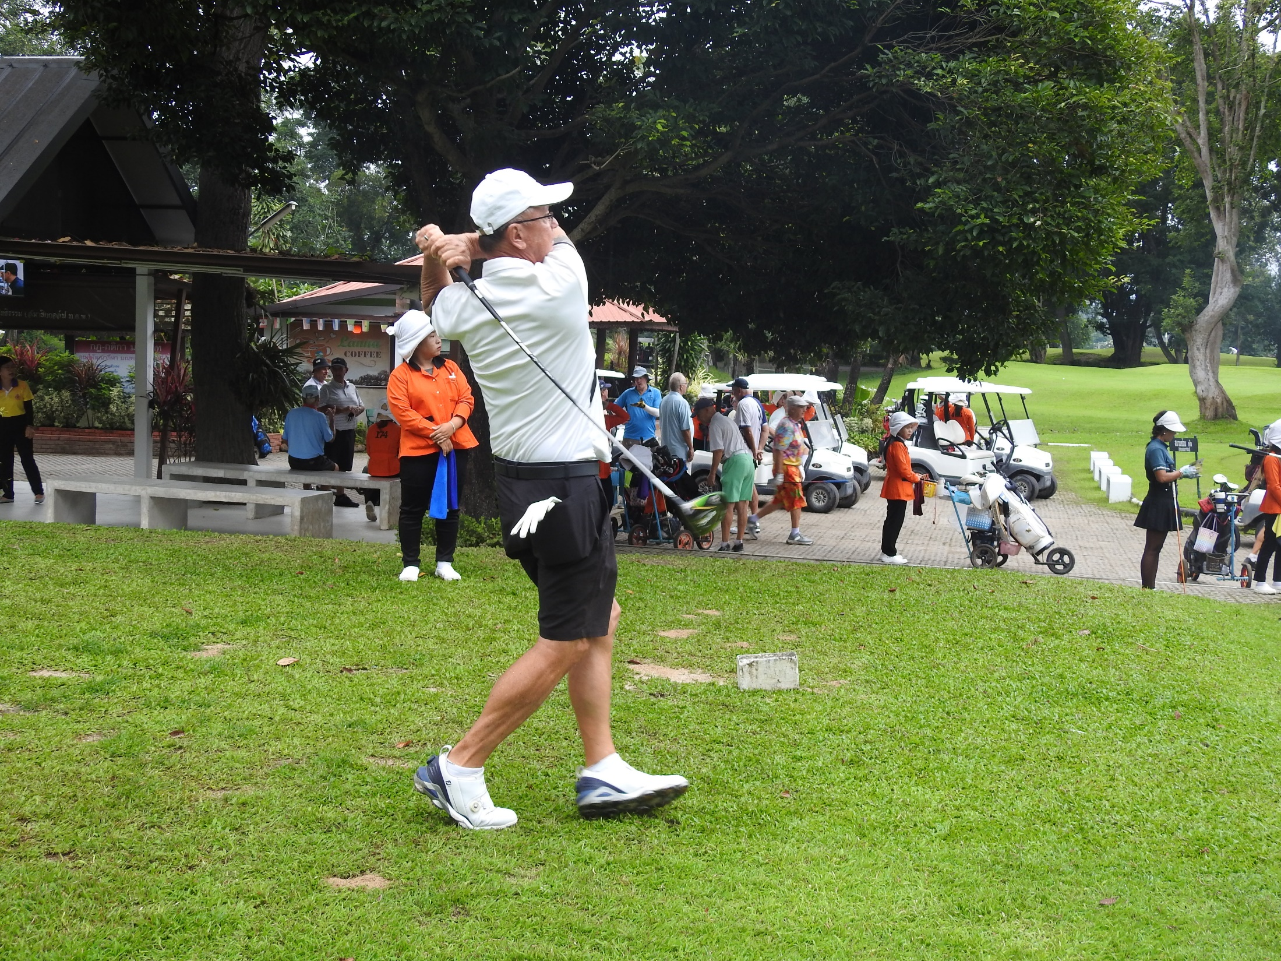

Slide 49
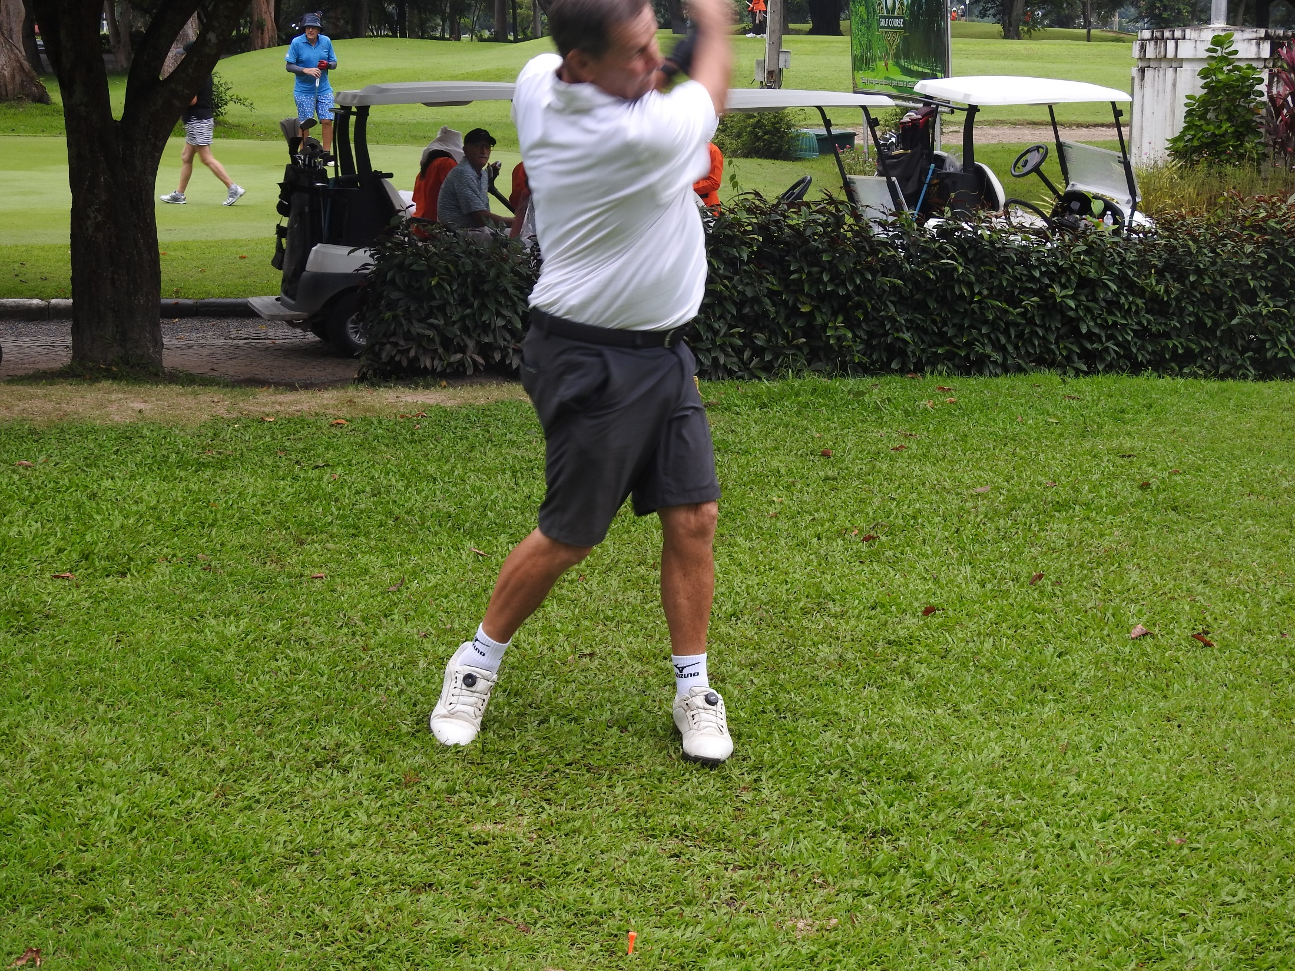

Slide 50
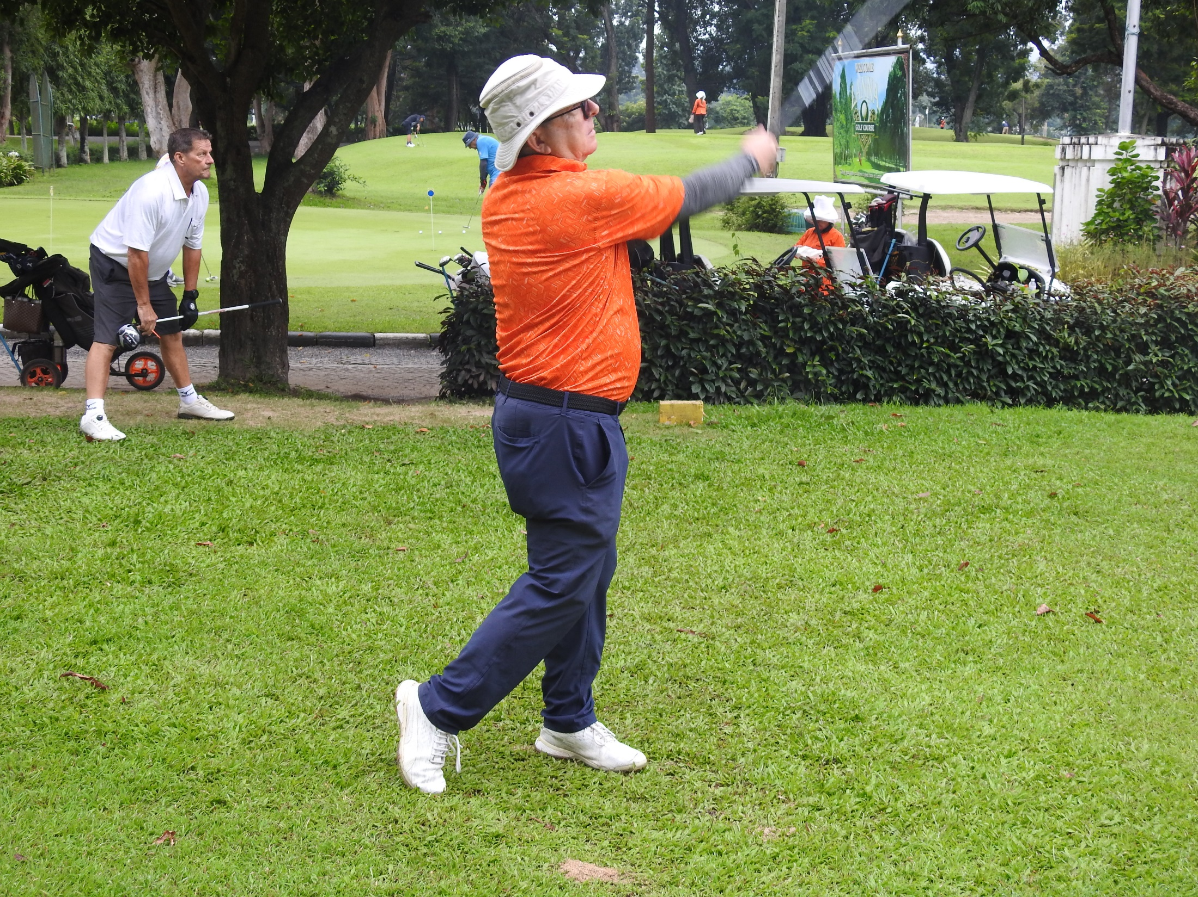

Slide 51
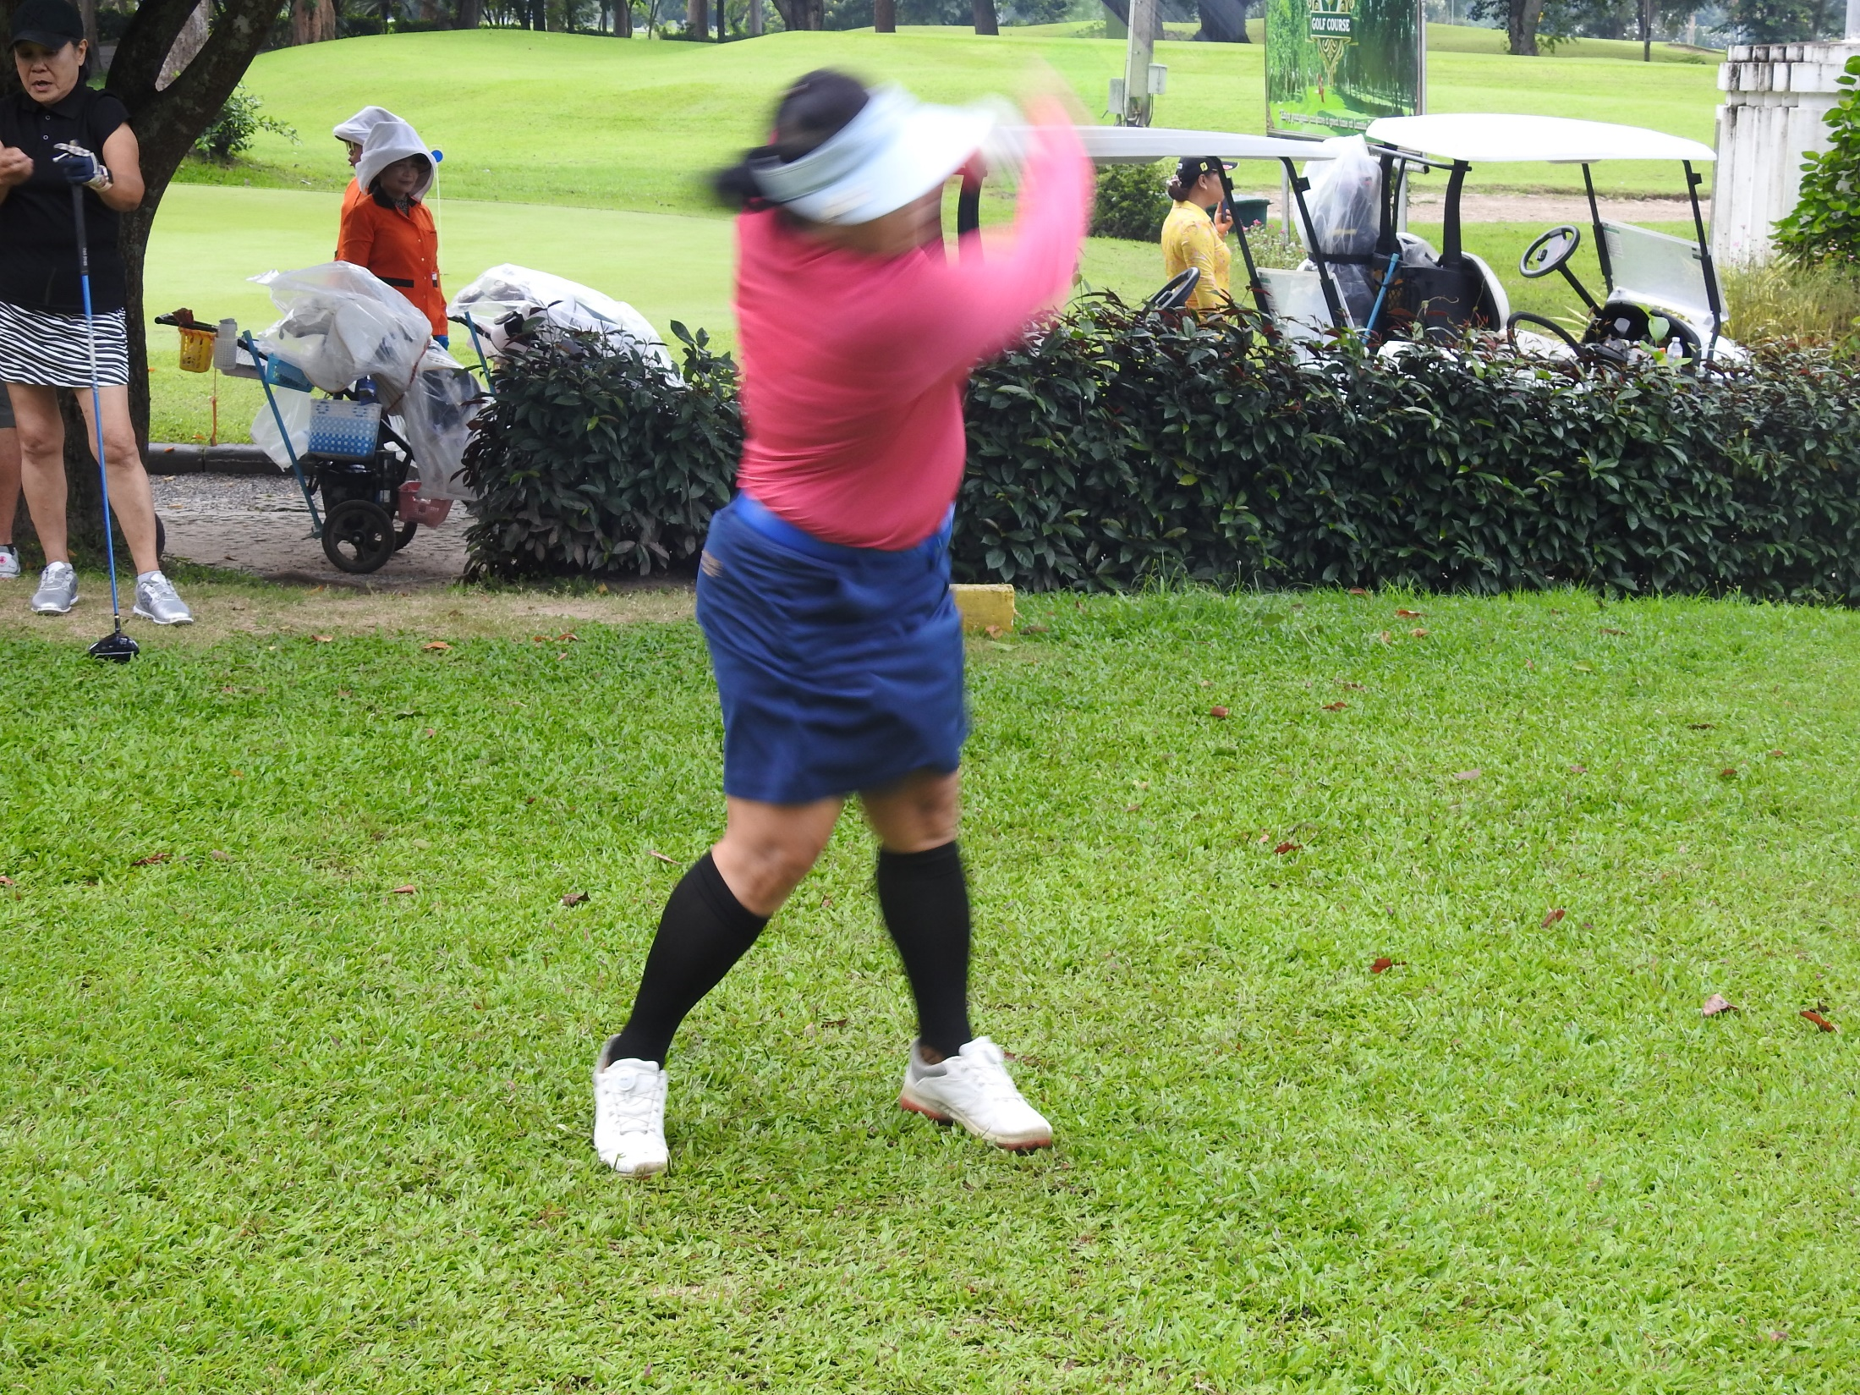

Slide 52
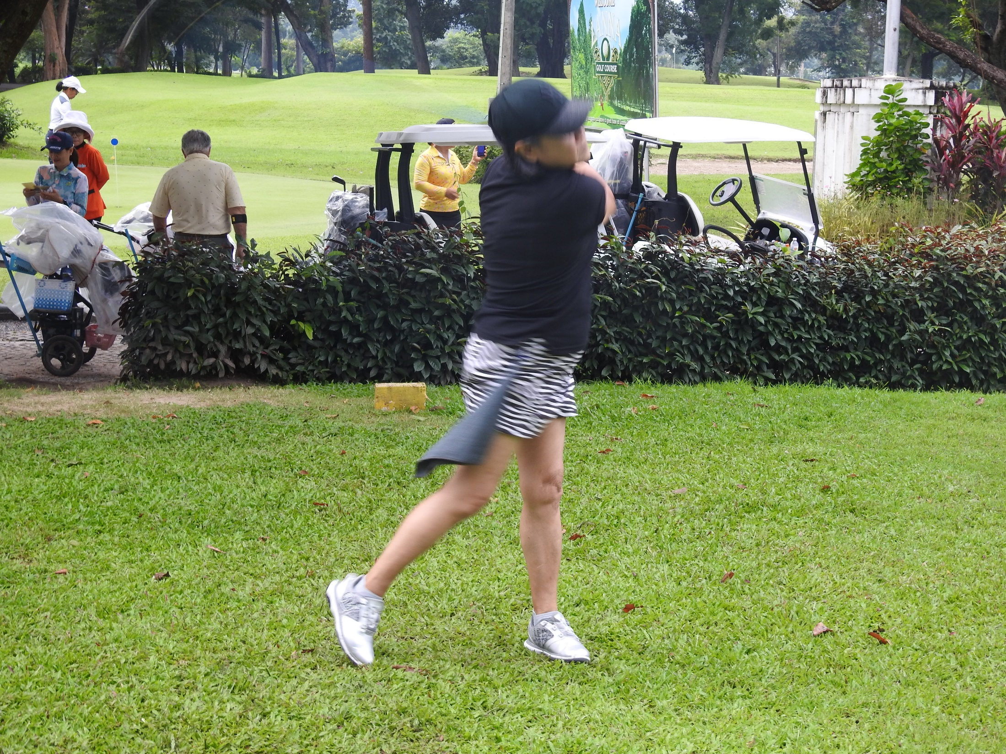

Slide 53
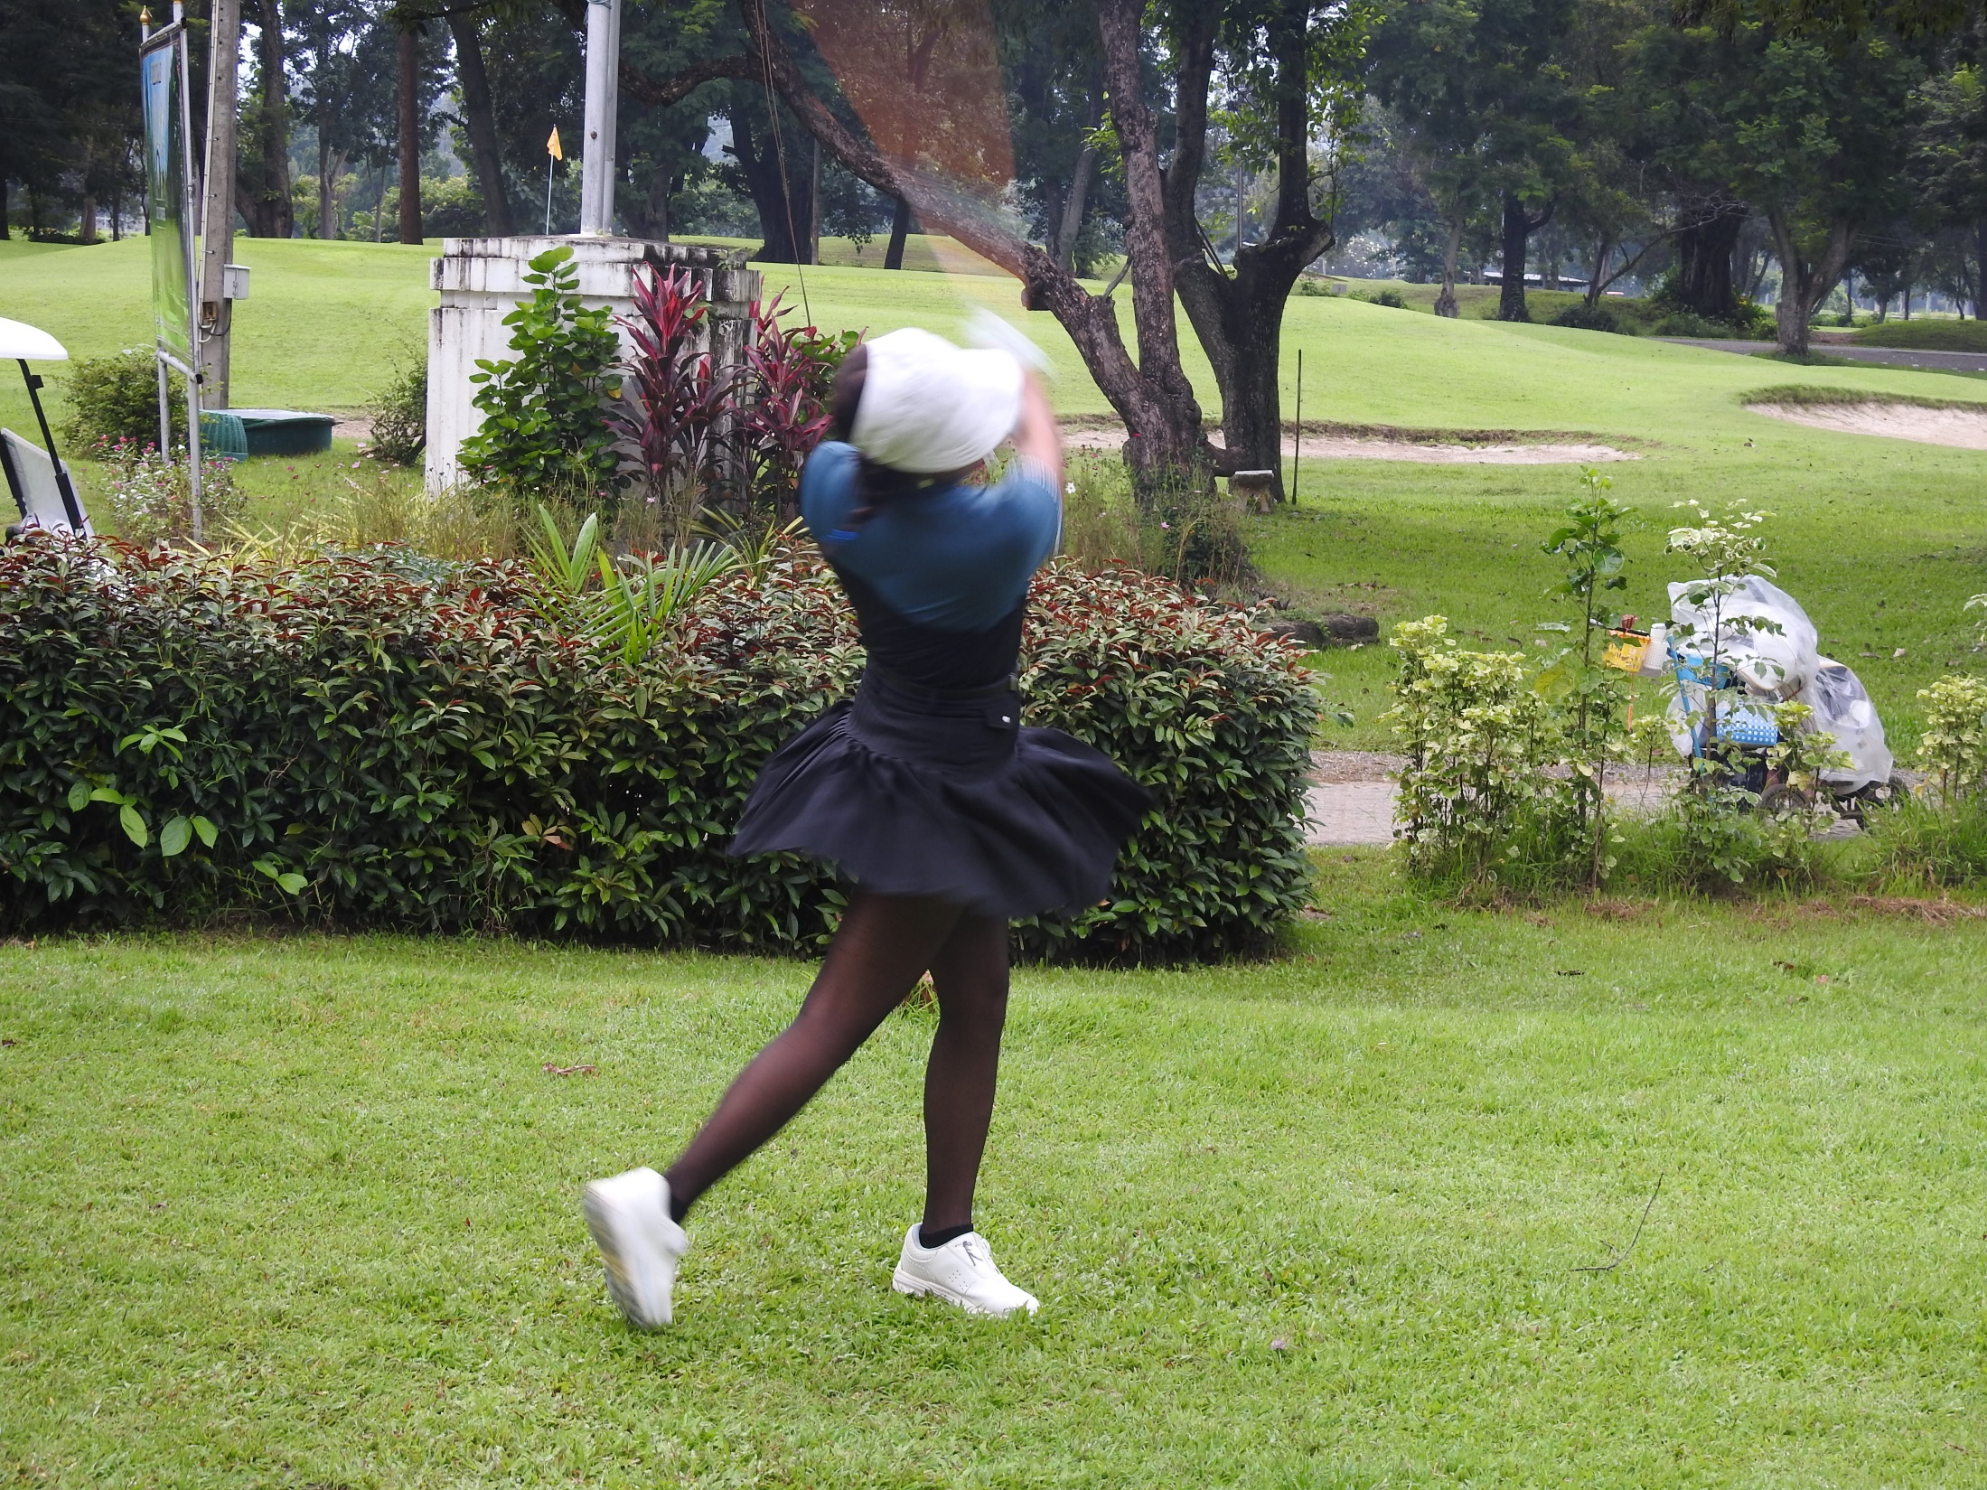

Slide 54
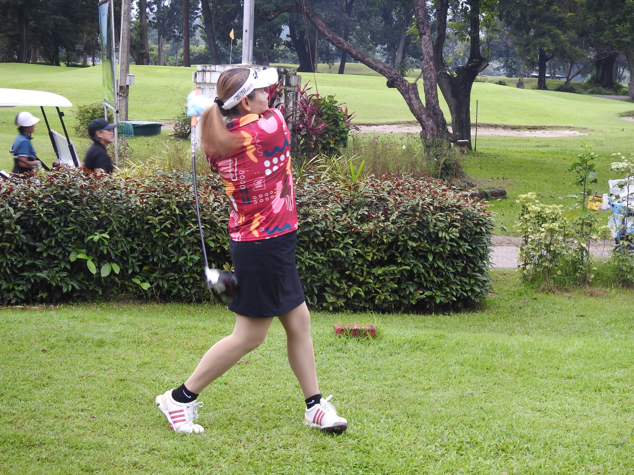

Slide 55
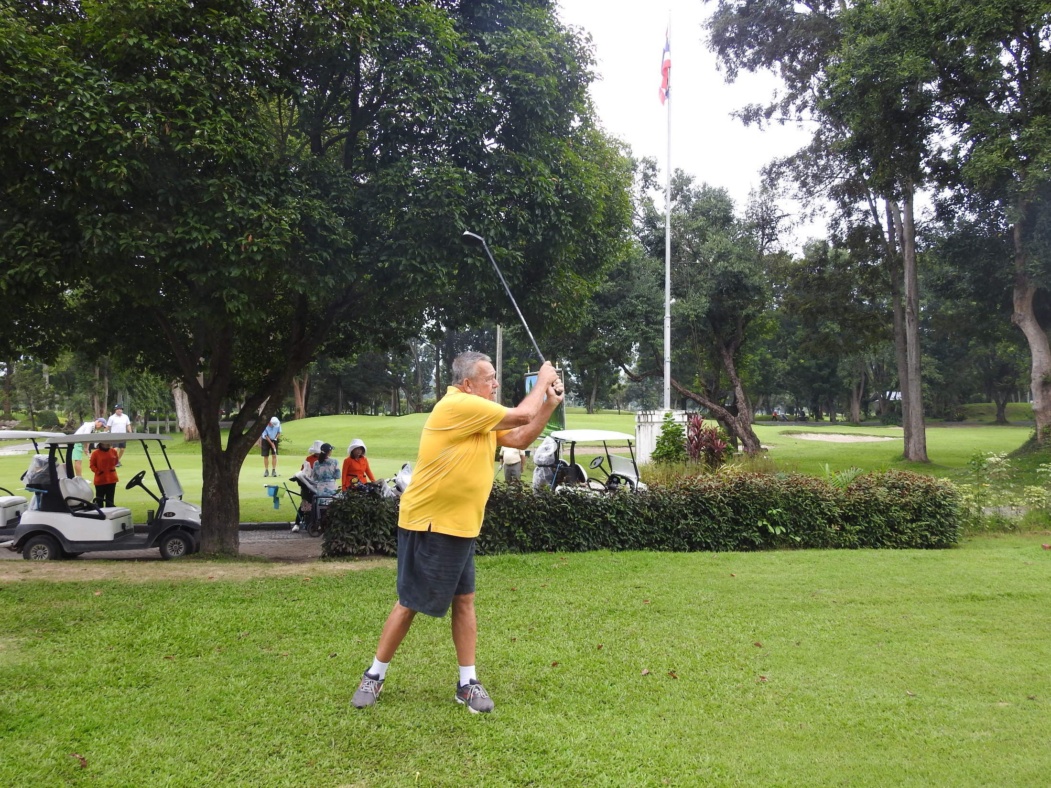

Slide 56
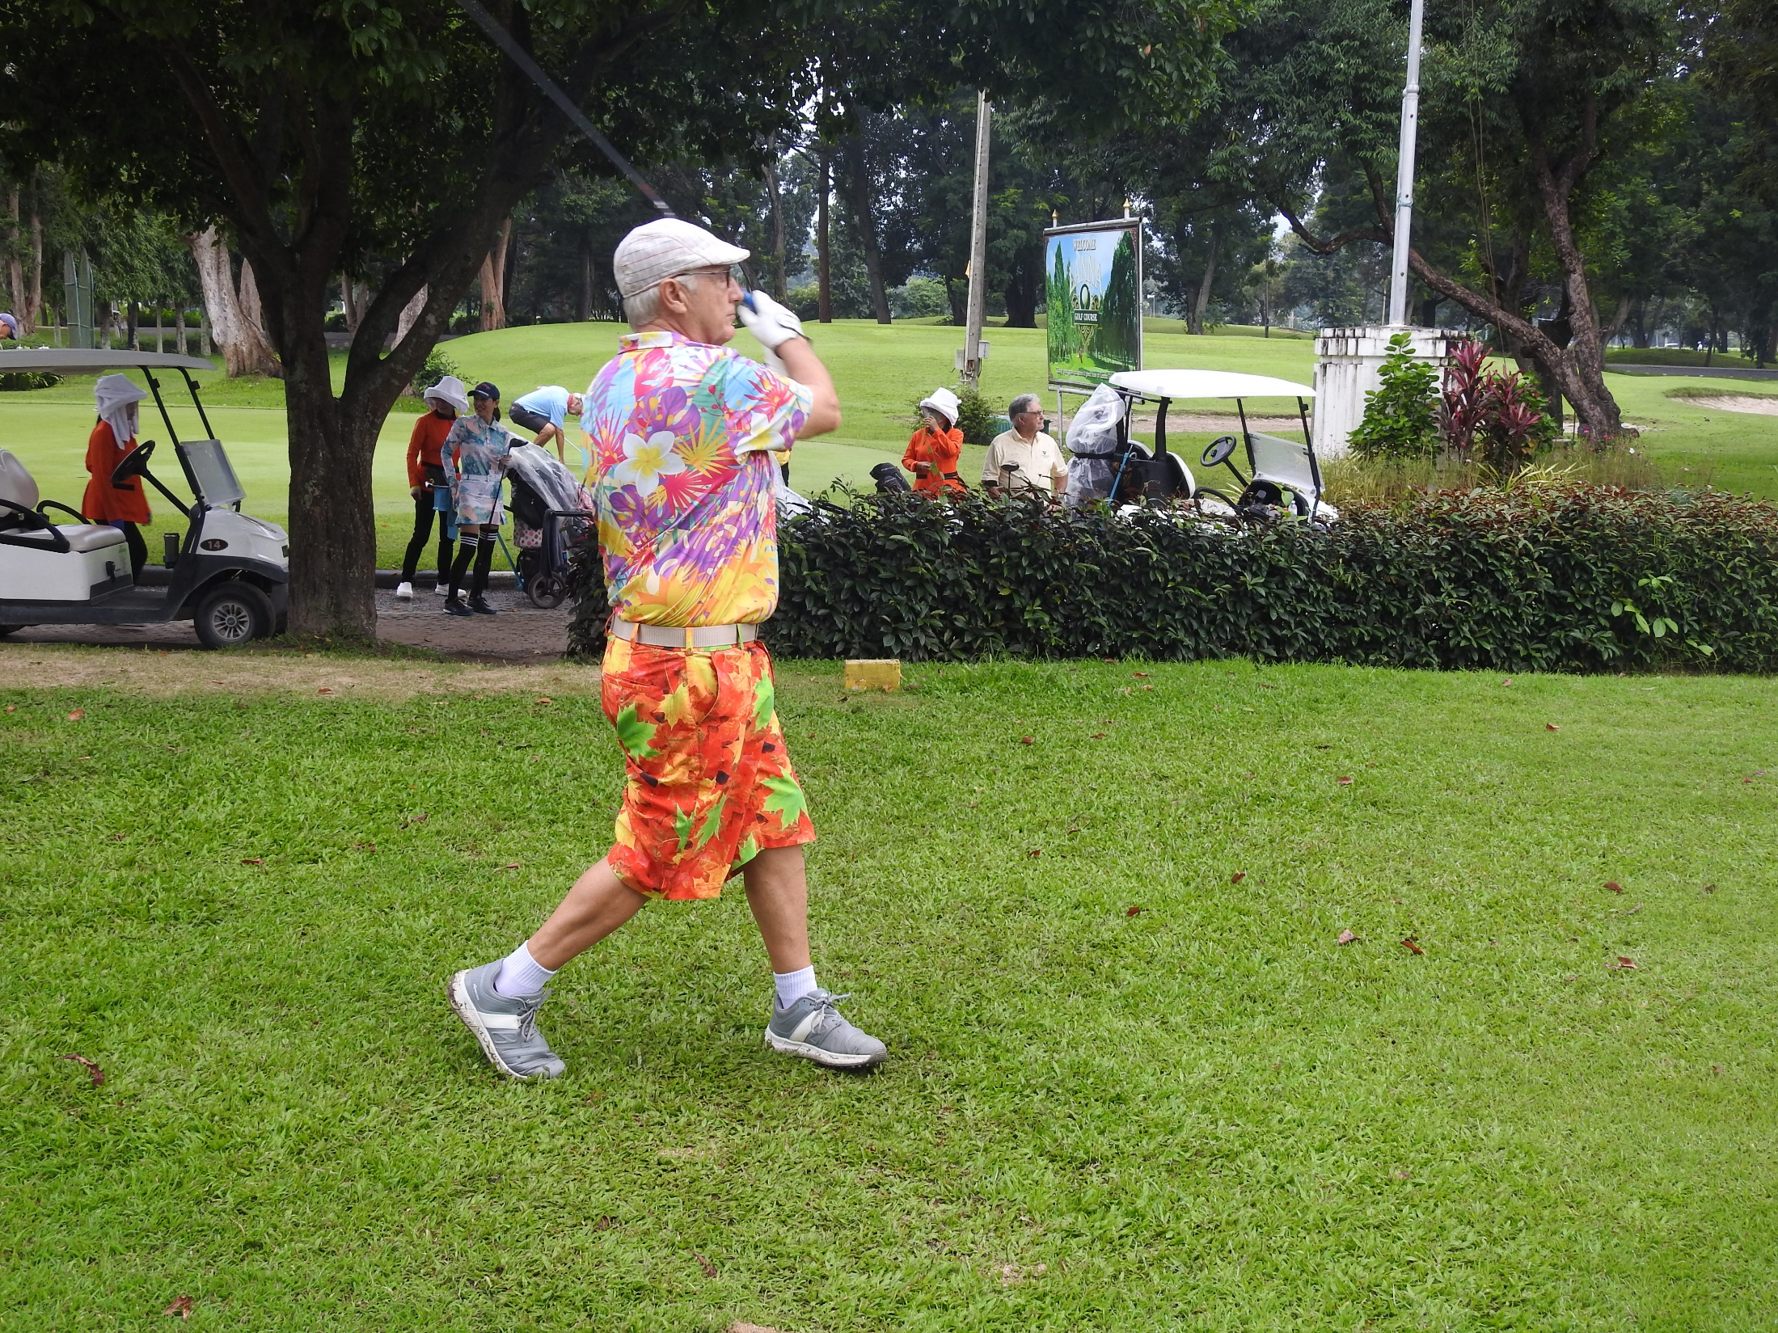

Slide 57
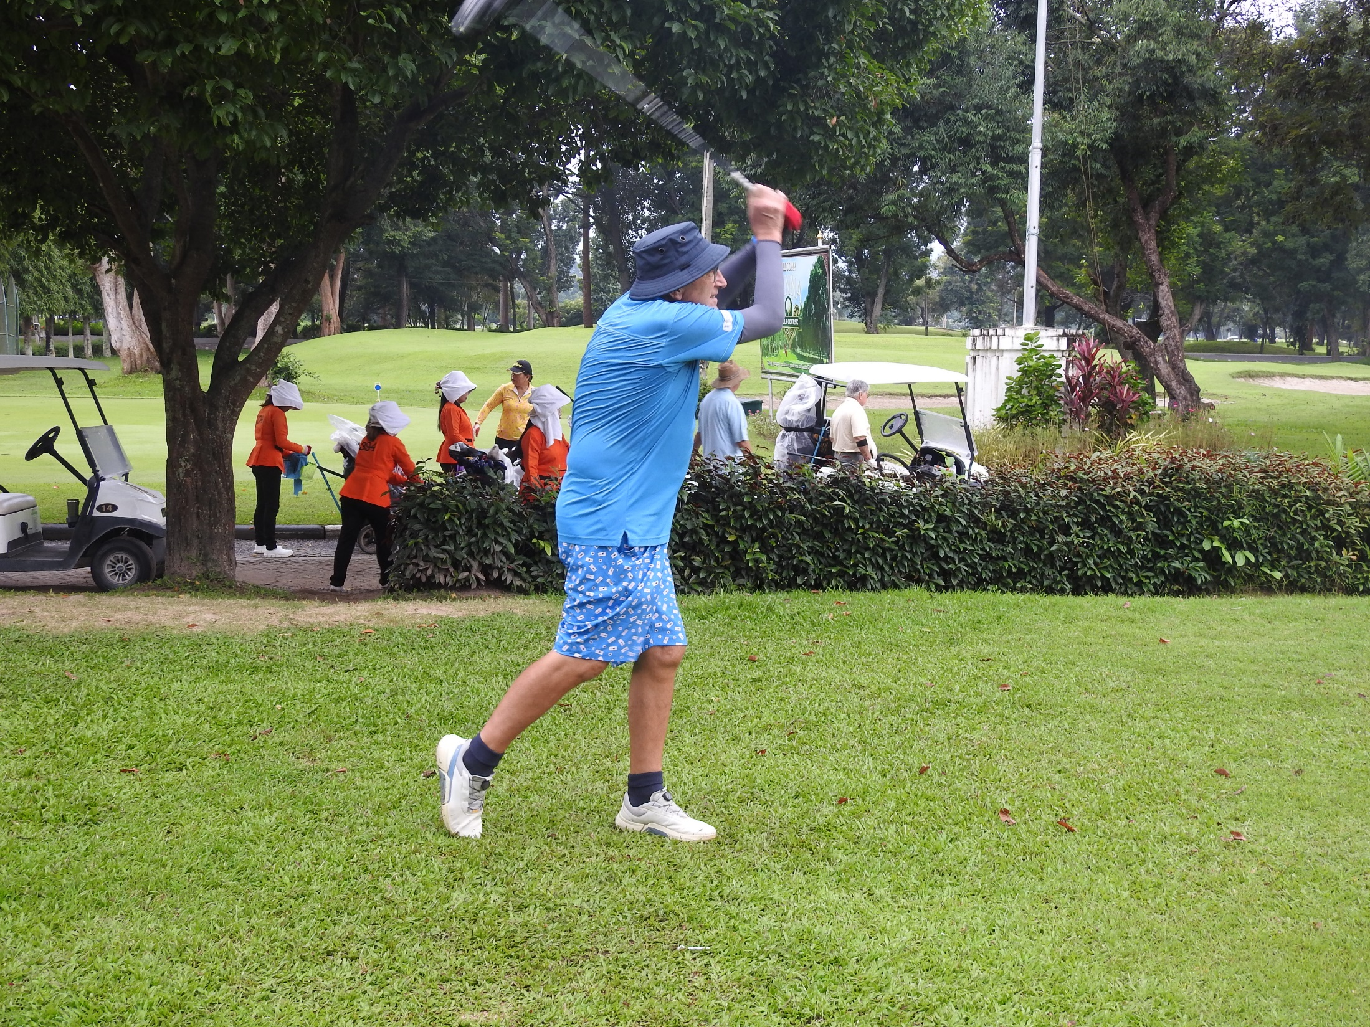

Slide 58
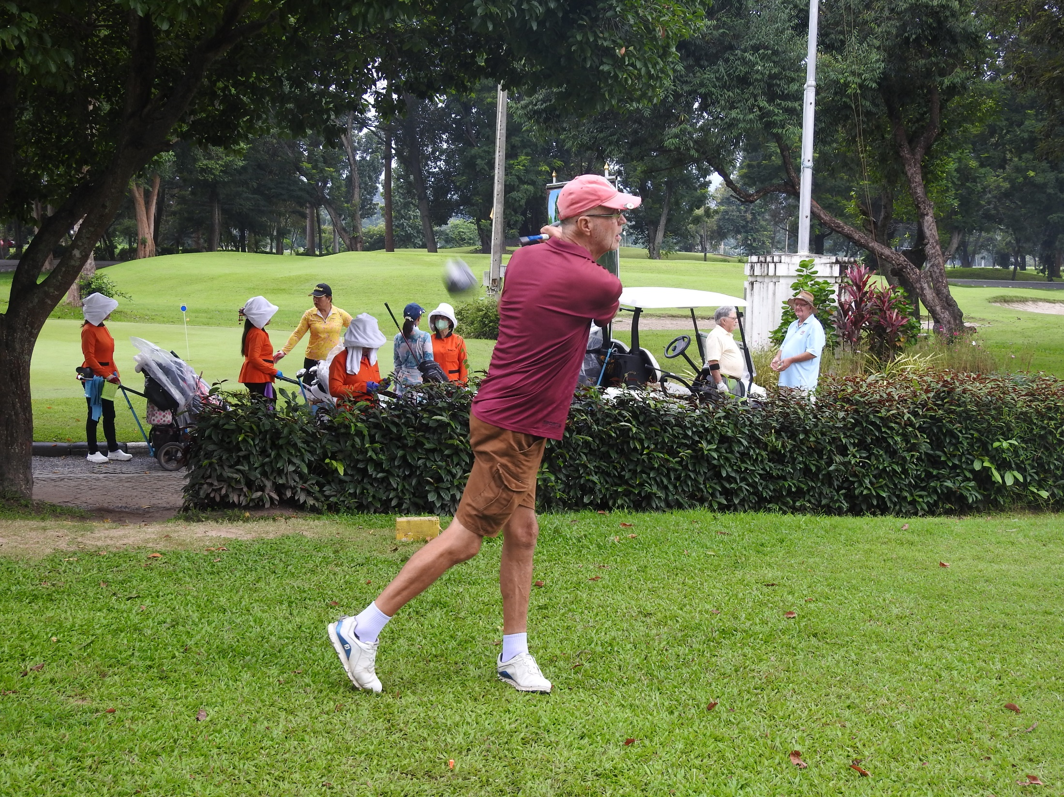

Slide 59


Slide 60


Slide 61


Slide 62


Slide 63


Slide 64


Slide 65


Slide 66


Slide 67


Slide 68



Slide 70


Slide 71


Slide 72


Slide 73

LANNA WINNERS

Slide 74

MAE JO WINNERS

Slide 75

HARIPHUNCHAI WINNERS

Slide 76

NORTH HILL WINNERS

Slide 77

Chiang Rai Cup Winner 2024
Kenny Jones

Slide 78


