Slide 1

Annual Party
2025

Slide 2
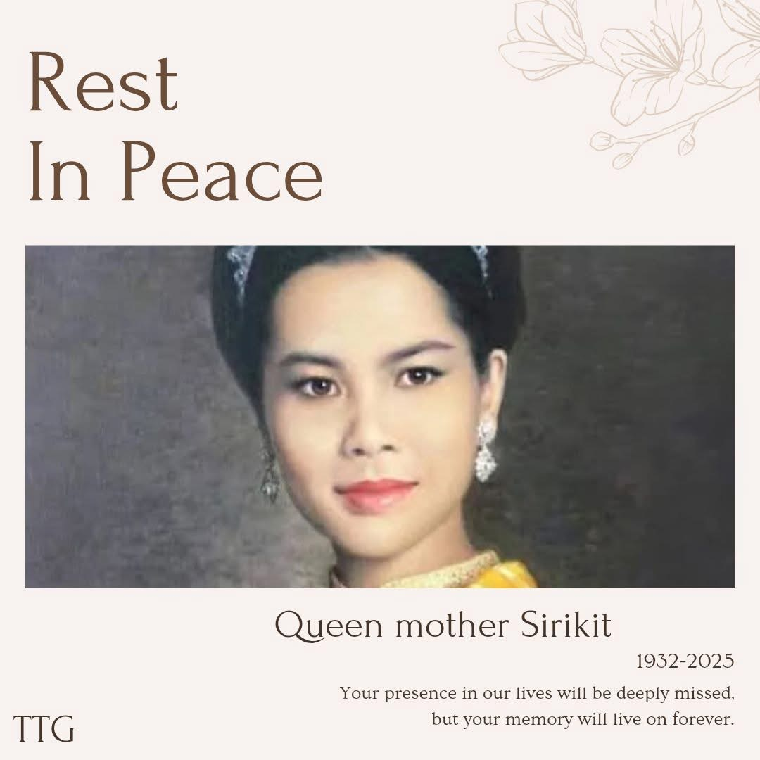
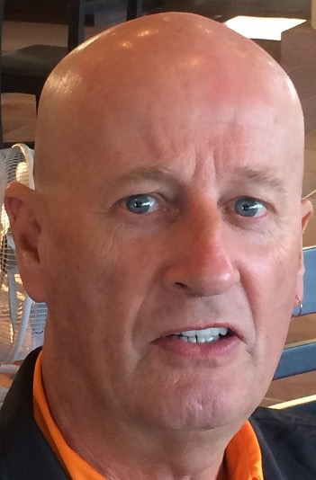
R.I.P
CALVIN
DAVIS
R.I.P. CALVIN DAVIS

Slide 3
Annual Party
2025

Slide 4
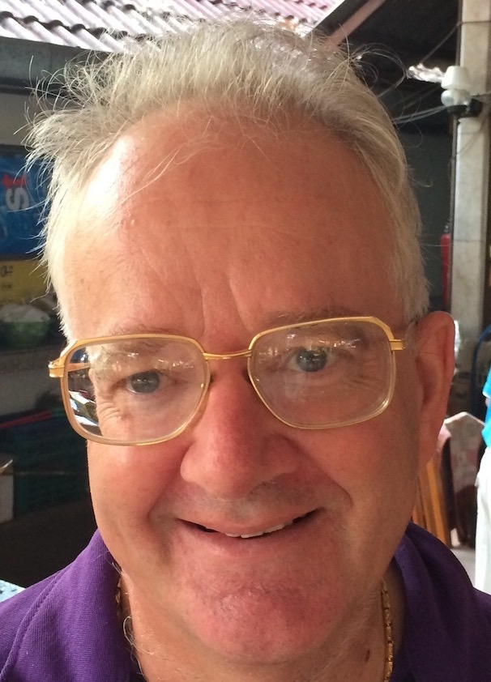
CONGRATULATIONS
JULIAN
WING

Slide 5
Annual Party
2025

Slide 6
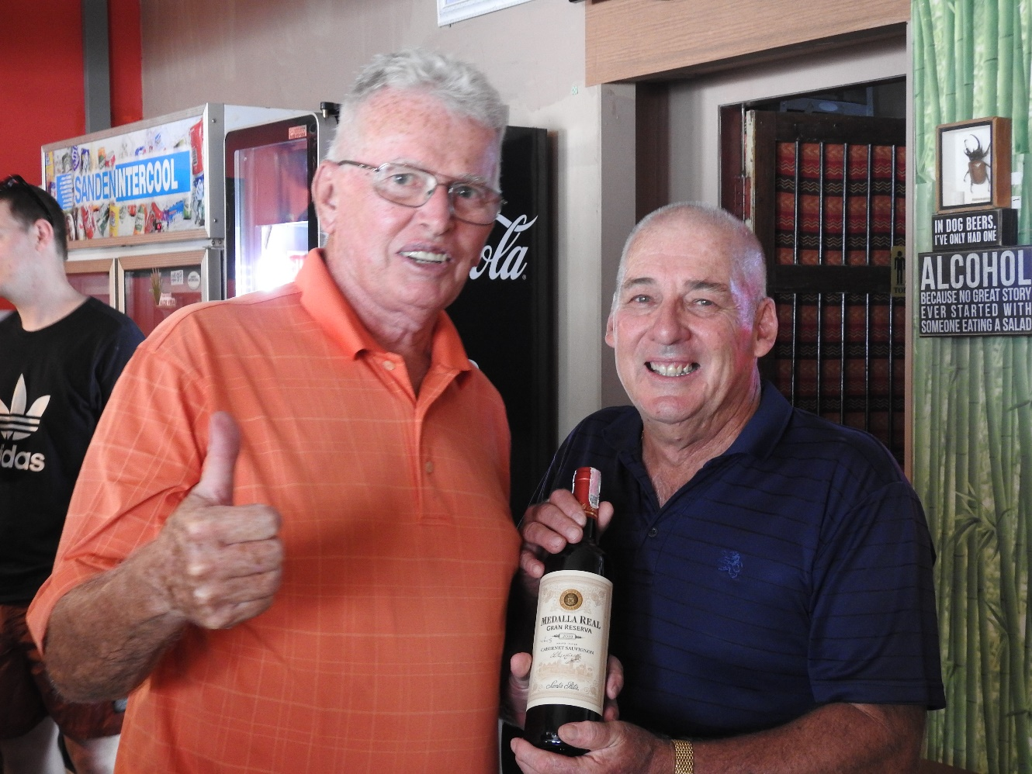
HONORARY
LIFE MEMBER
JACK KUZINA

Slide 7
Annual Party
2025

Slide 8
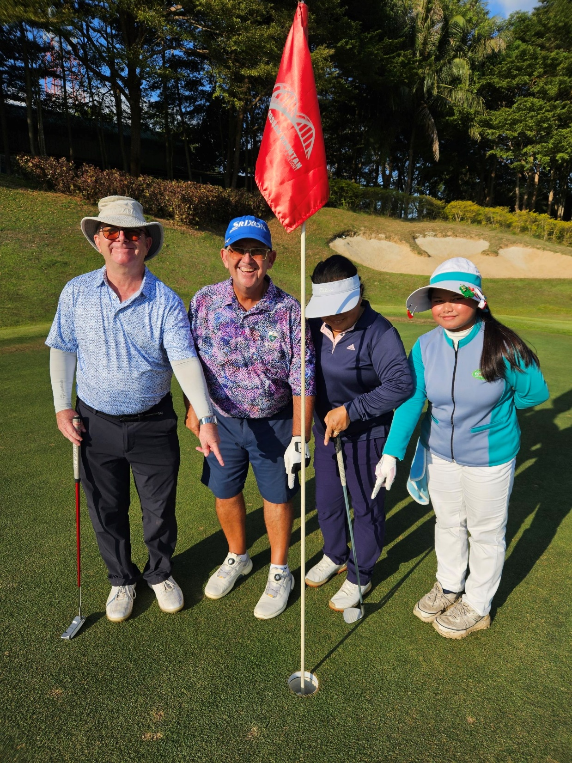
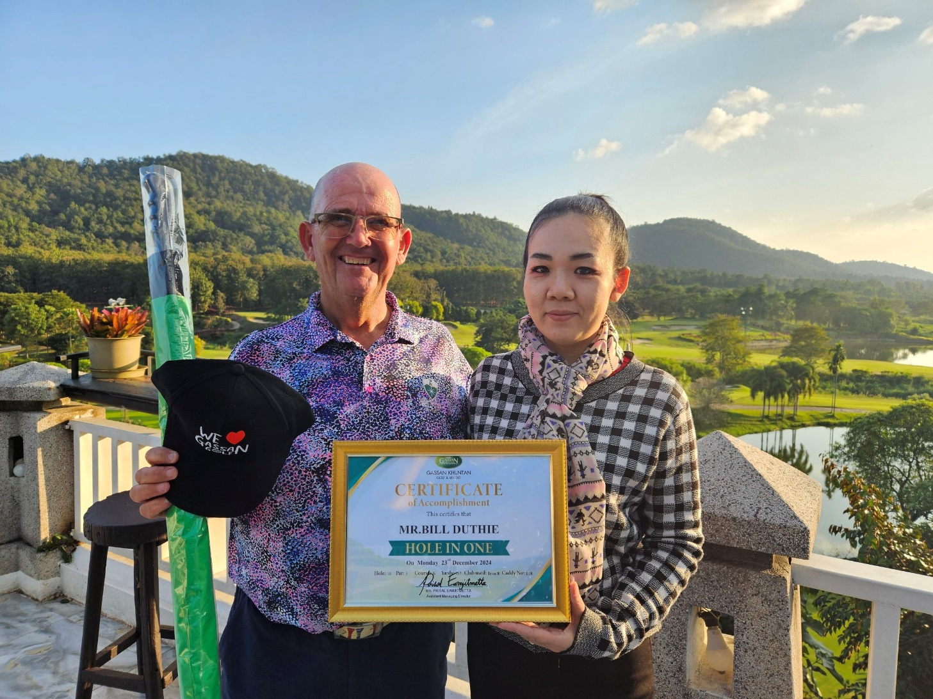
Bill Duthie
Hole in One
Gassan Khuntan
23 December 2024

Slide 9
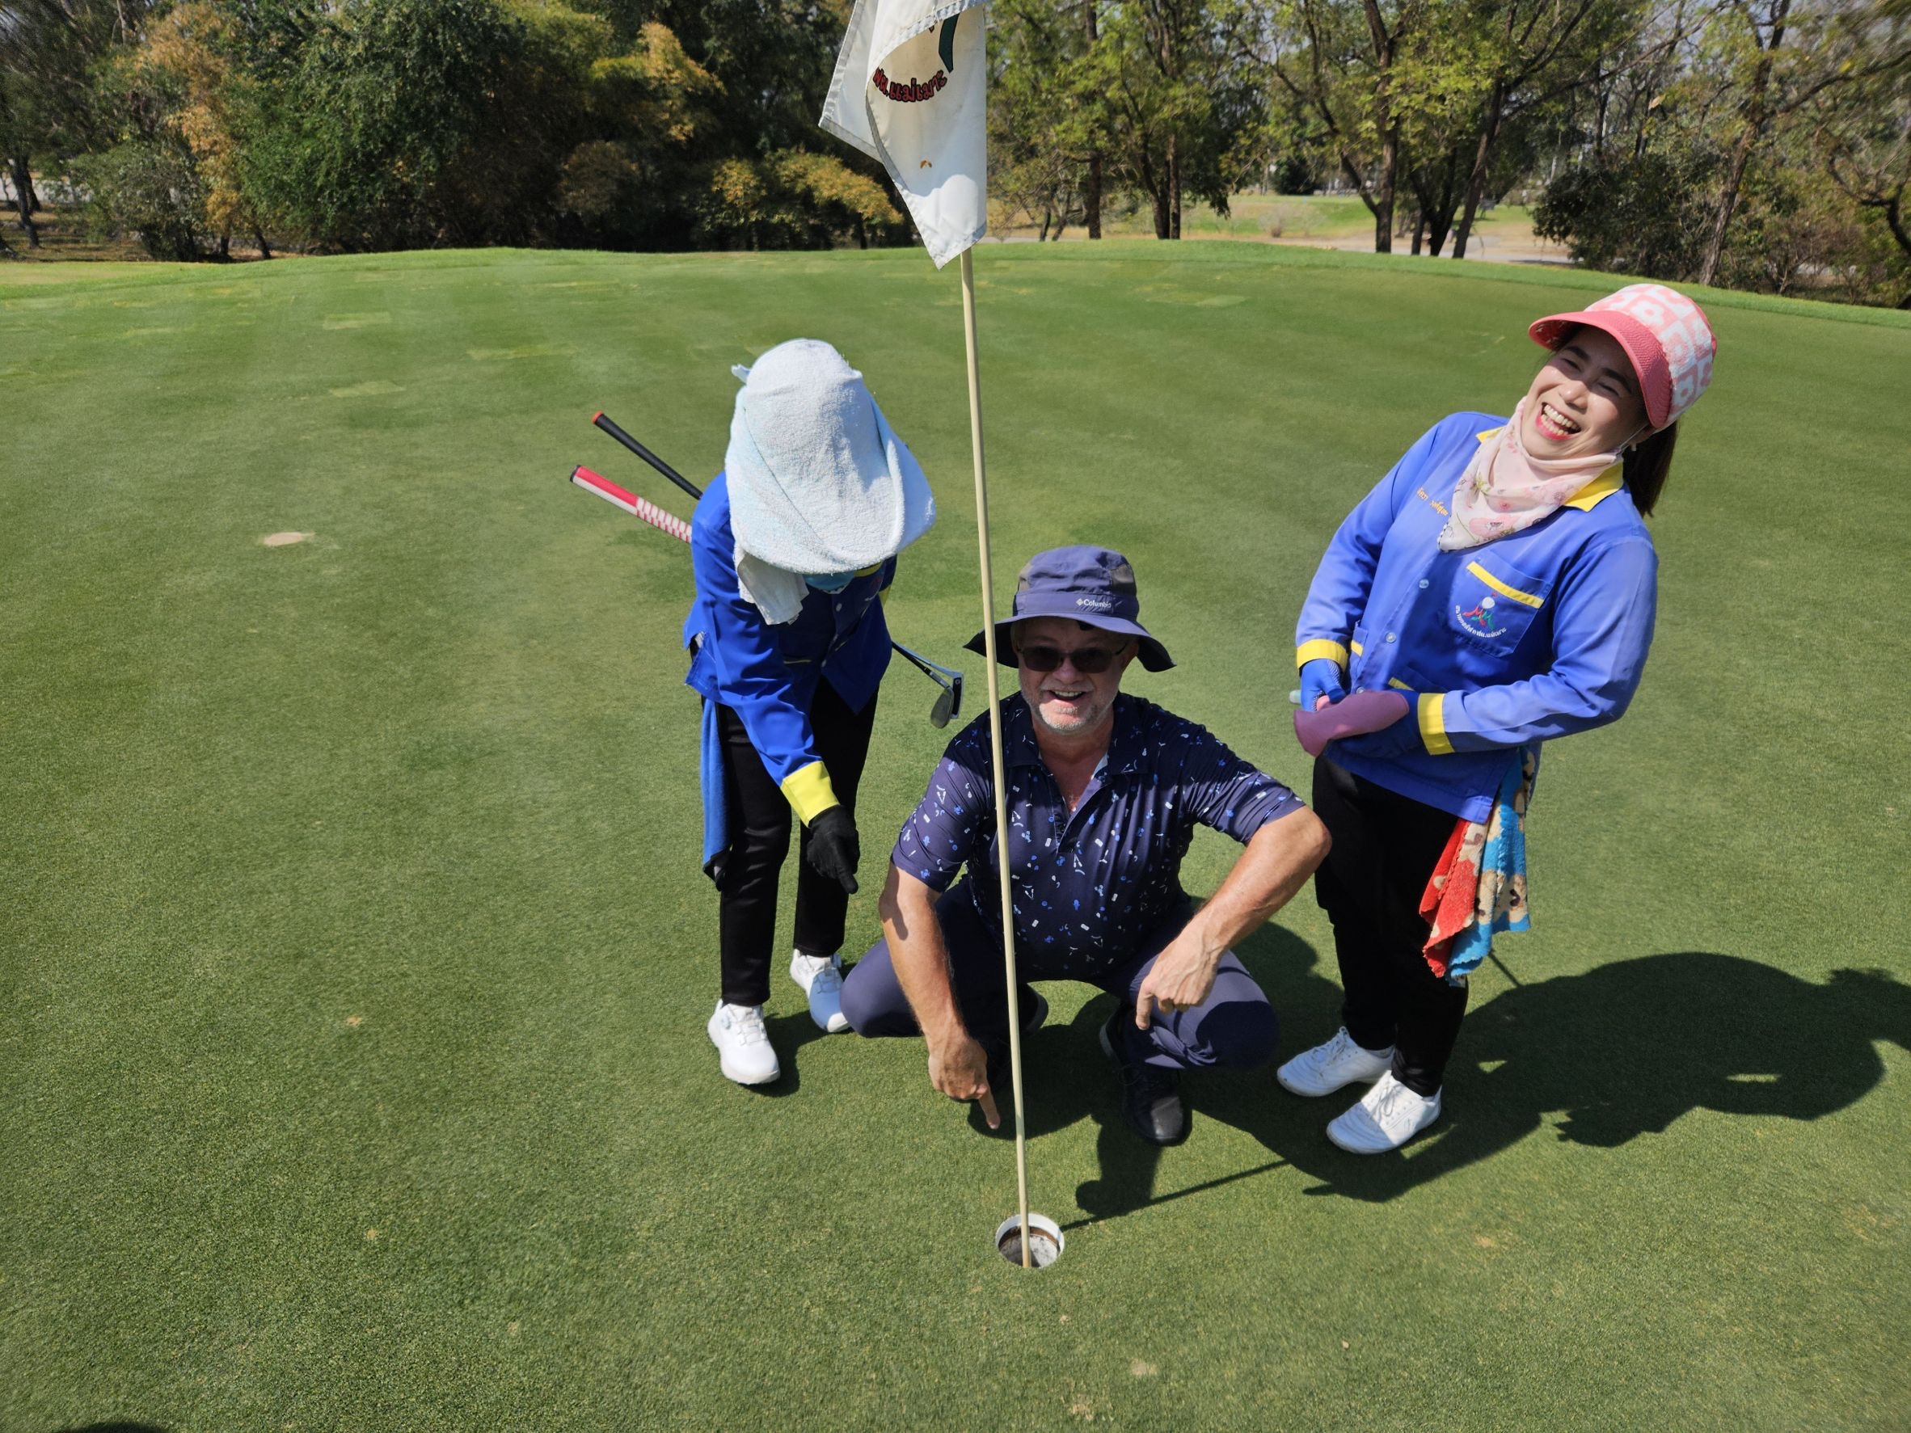
SERGE
ARNAUD
MAE MOH
30TH JANUARY
17TH HOLE
SERGE ARNAUD
MAI MOH
30TH JANUARY
17TH HOLE

Slide 10
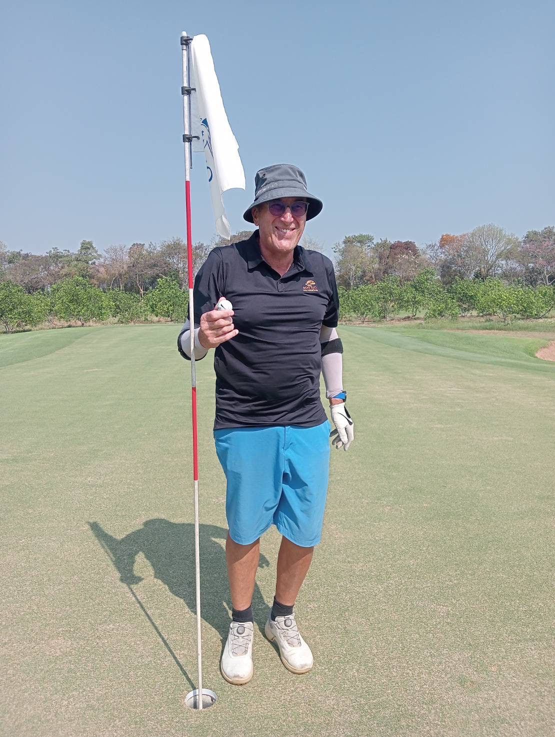
Roger
Bishop
7th March
Mae Jo
14th Hole
ROGER BISHOP
7TH MARCH
MAE JO
14TH HOLE

Slide 11
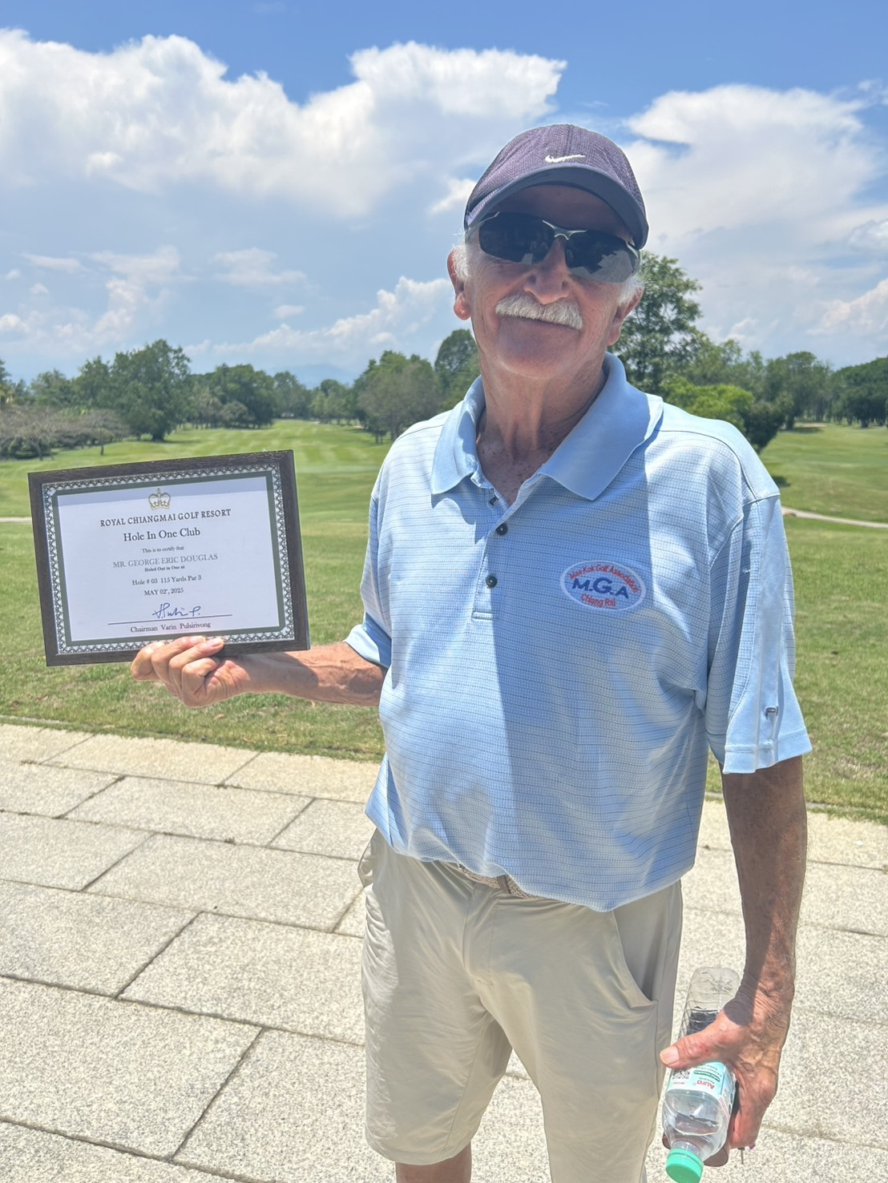
ERIC GEORGE
2ND MAY
ROYAL CHIANG
MAI
3RD HOLE
Eric
George
2nd May
Royal
Chiang Mai
3rd Hole

Slide 12
This Years Winners

Slide 13
LADIES RUNNERS UP

Slide 14
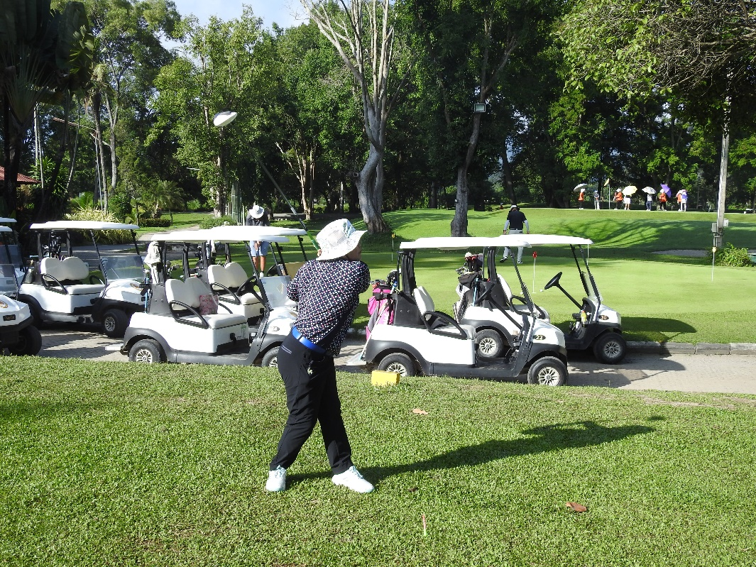
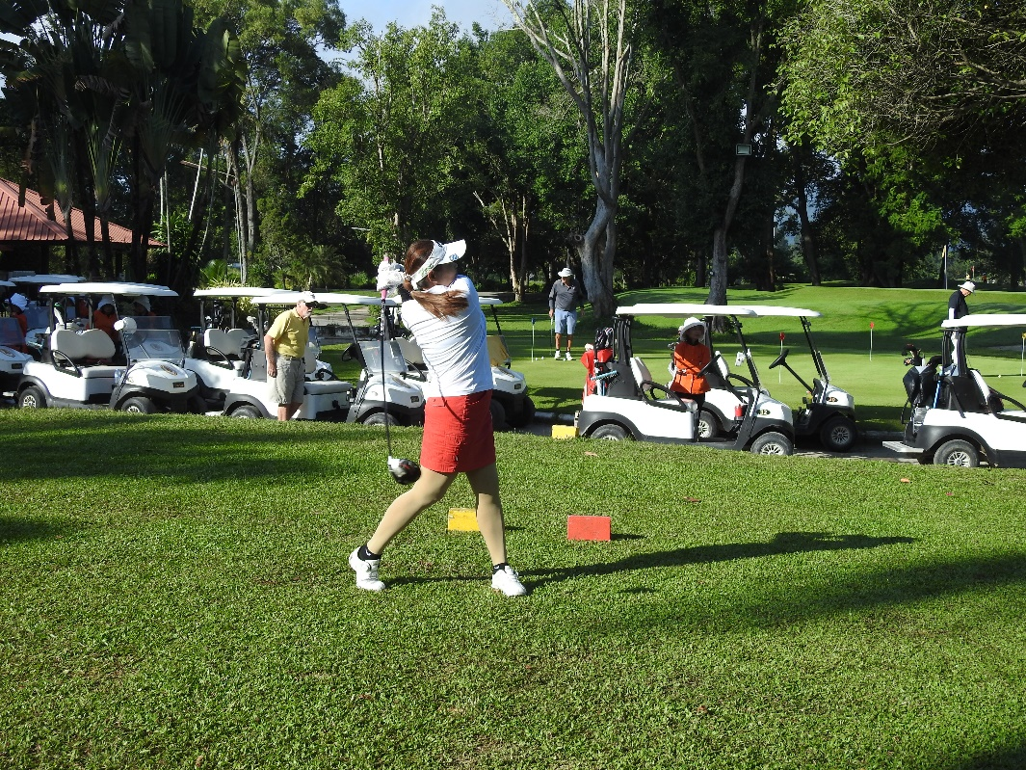
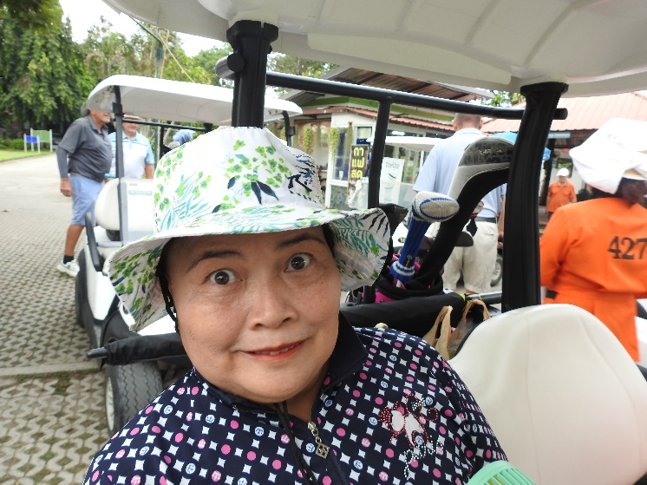
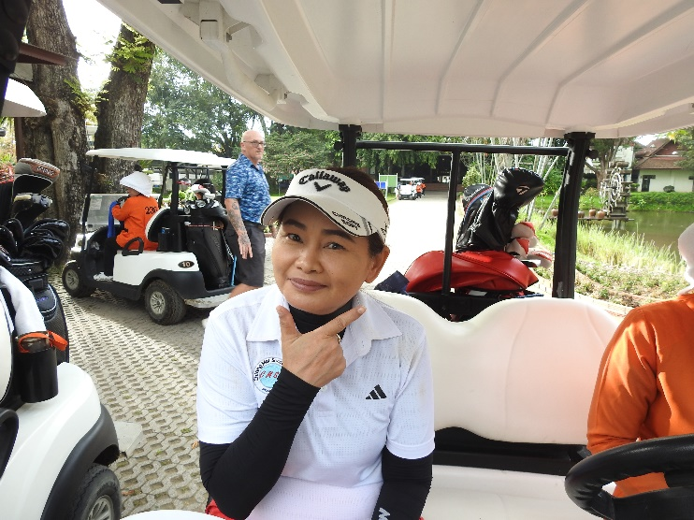
JOINT RUNNERS UP
LAMYAI PRASARN AND AOM TEISL

Slide 15
LADIES WINNER

Slide 16
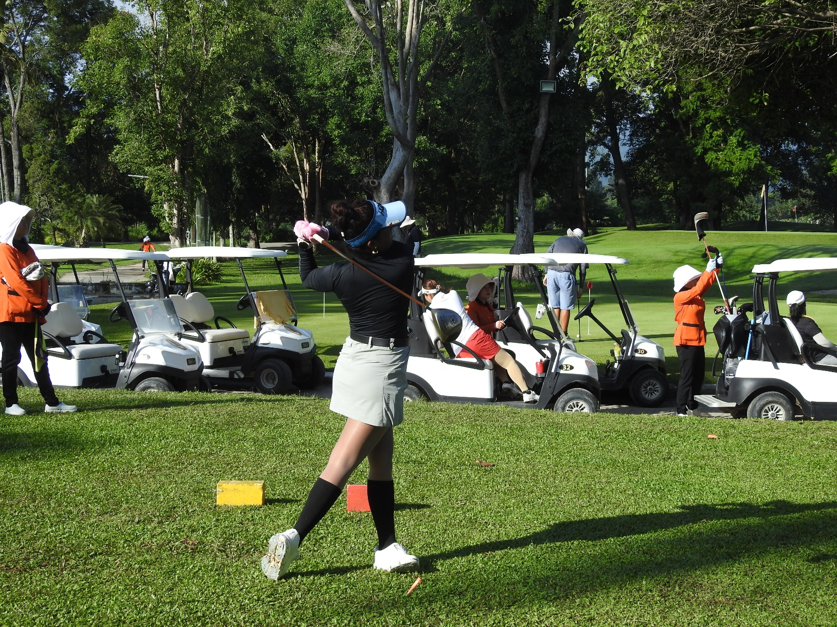
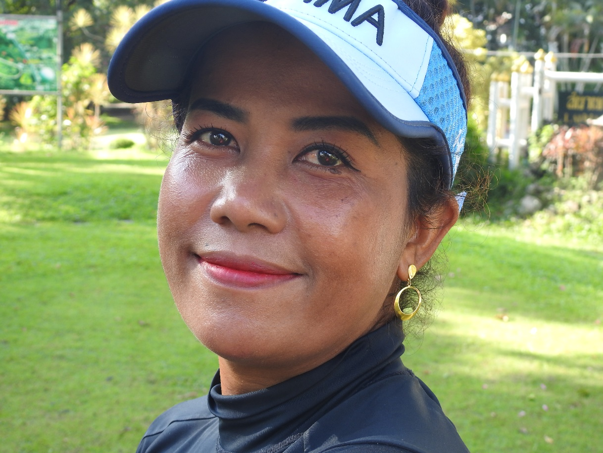
KAY KAY OTTEN
Lam 94 points.
Jay Jones

Slide 17
MENS RUNNERS UP

Slide 18
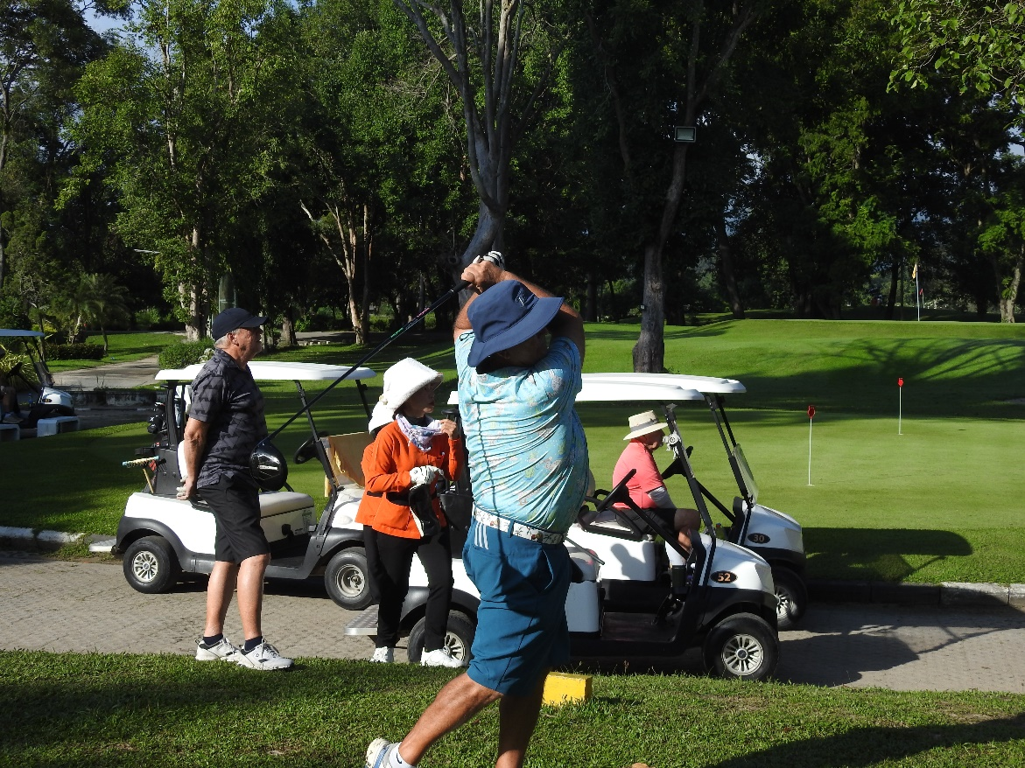
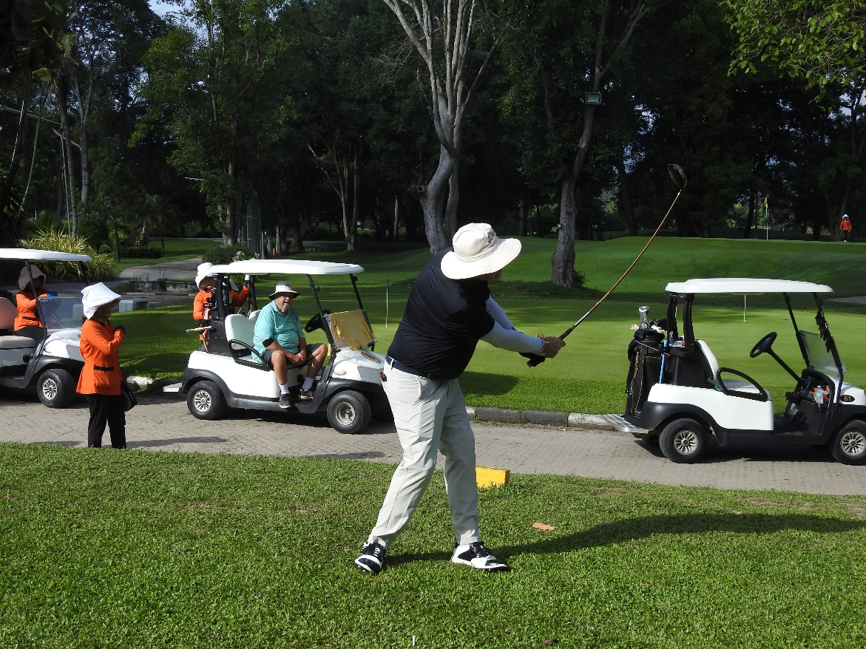
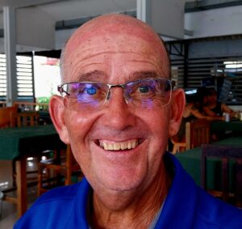
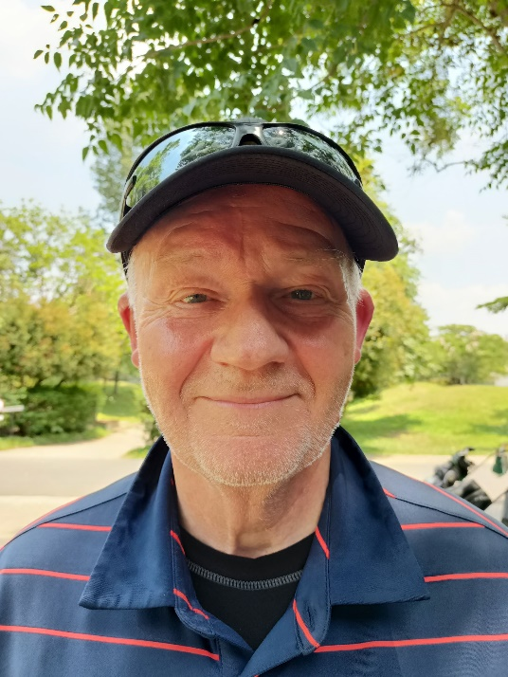
JOINT RUNNERS UP
BILL DUTHIE &
DONALD OTTEN

Slide 19
MENS OVERALL WINNER

Slide 20
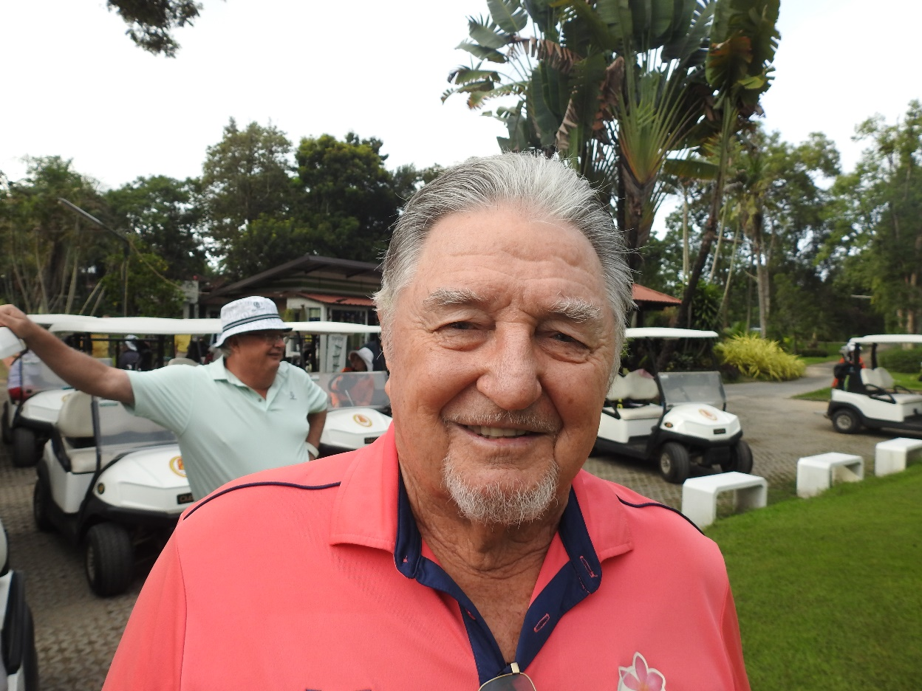
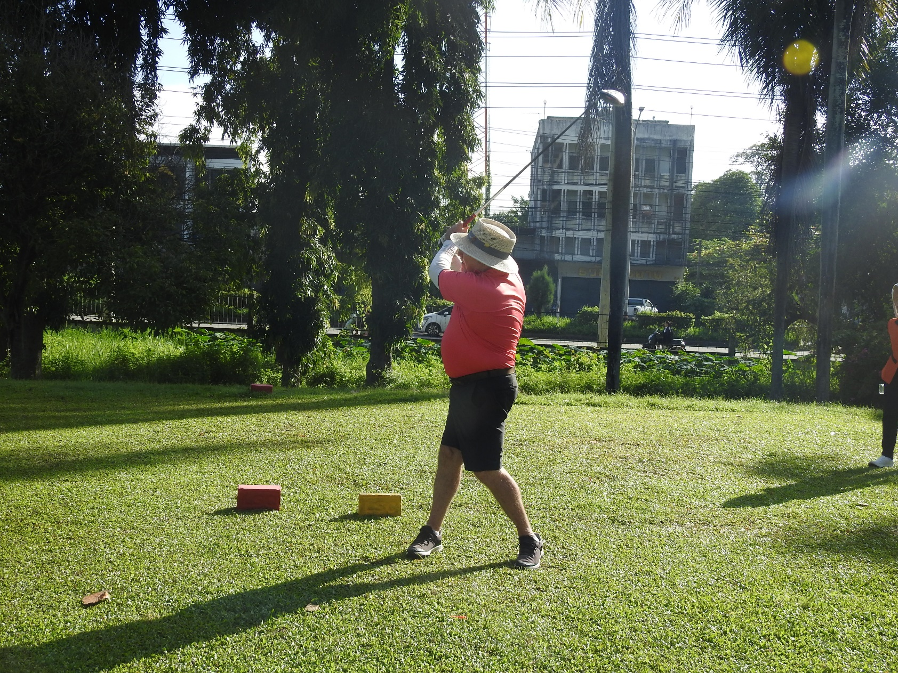
GARRY WALKER

Slide 21
LOW GROSS WINNER

Slide 22
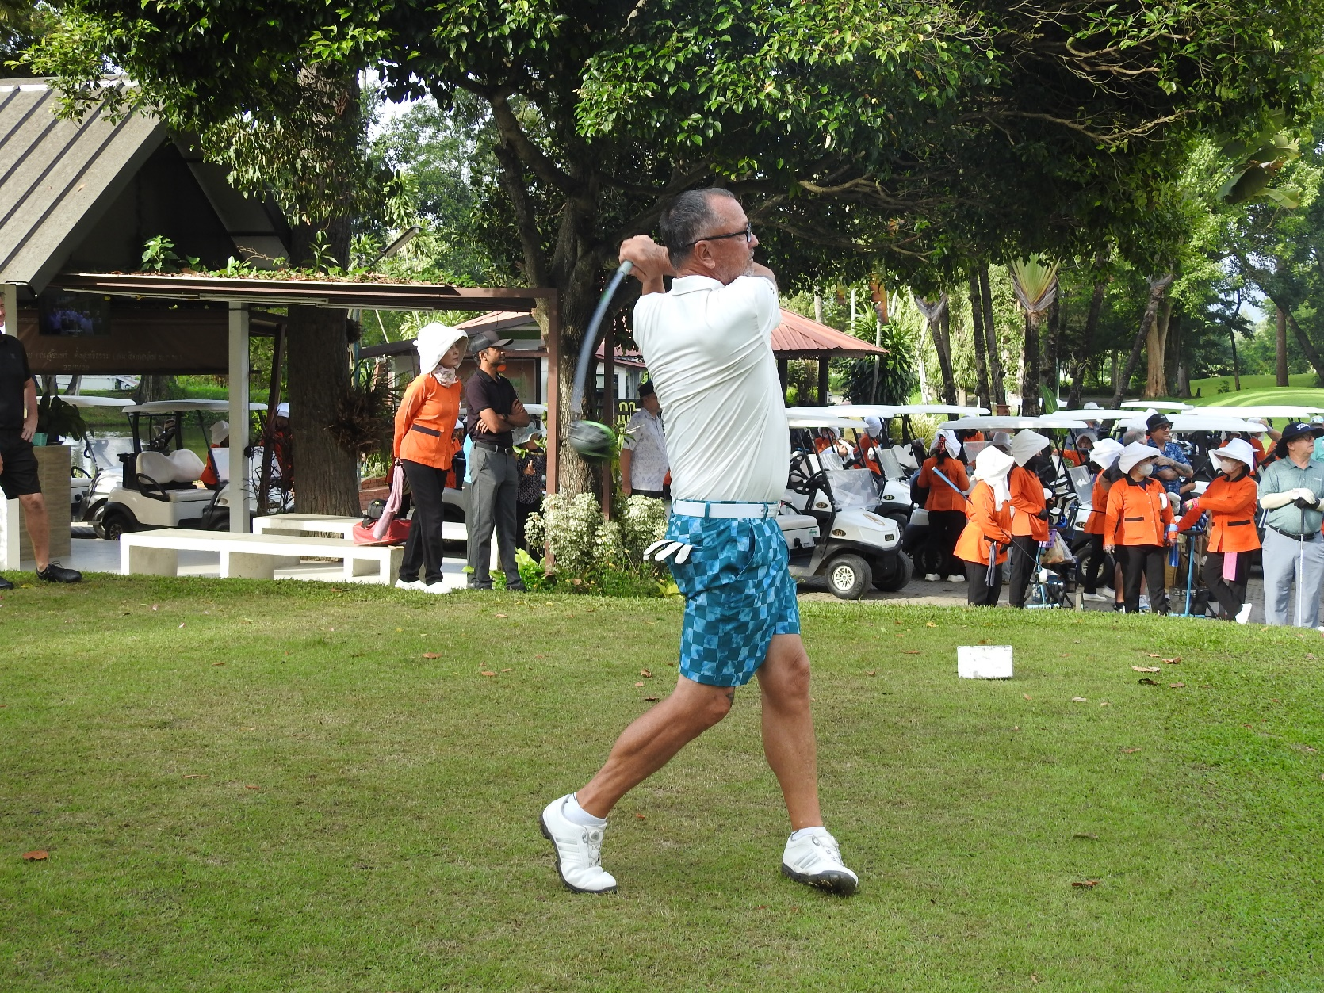
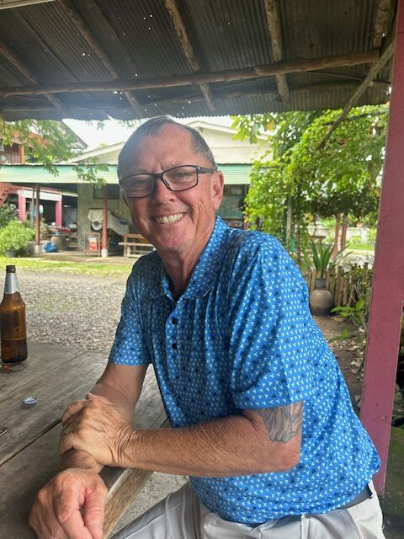
RANDY TEISL

