Slide 1

ANNUAL PRESENTATION PARTY

Slide 2
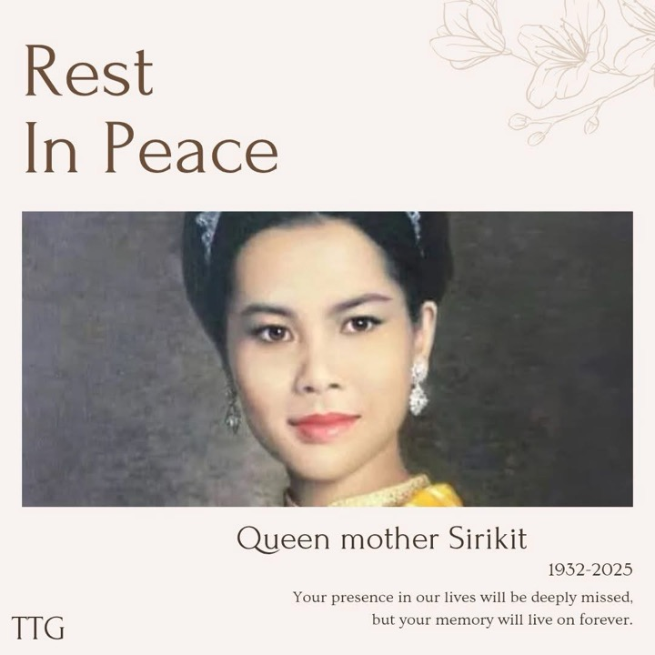
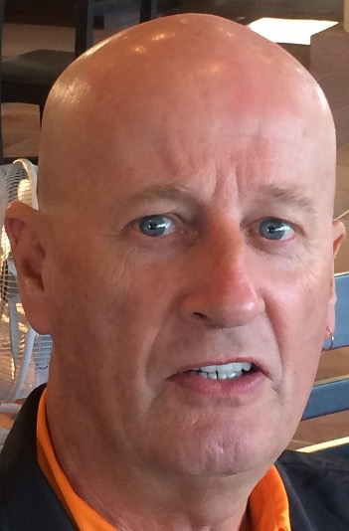
R.I.P
CALVIN
DAVIS
R.I.P. CALVIN DAVIS

Slide 3
HOLES
IN
ONE

Slide 4
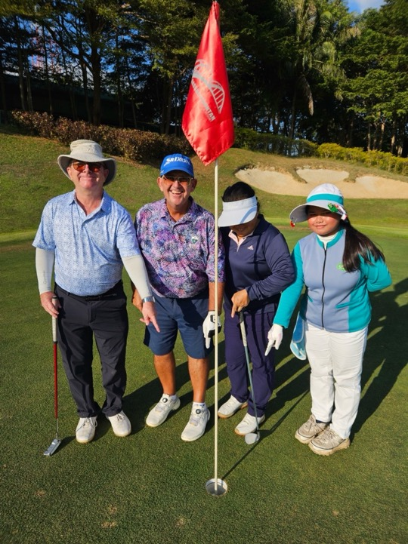
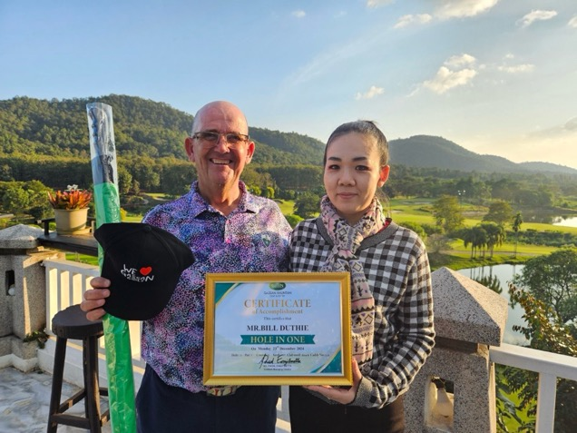
Bill Duthie
Hole in One
Gassan Khuntan
23 December 2024

Slide 5
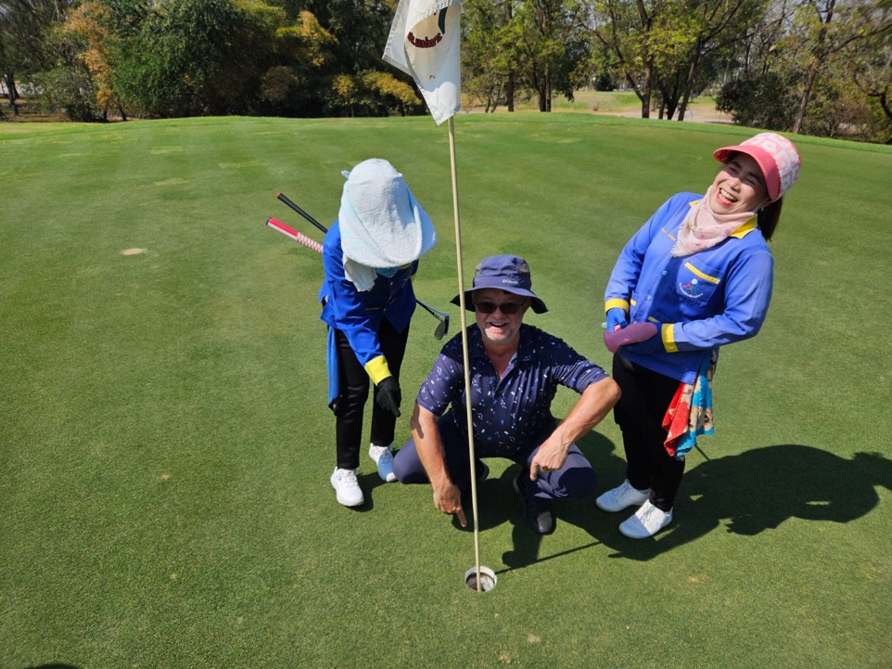
SERGE ARNAUD
MAI MOH
30TH JANUARY
17TH HOLE

Slide 6
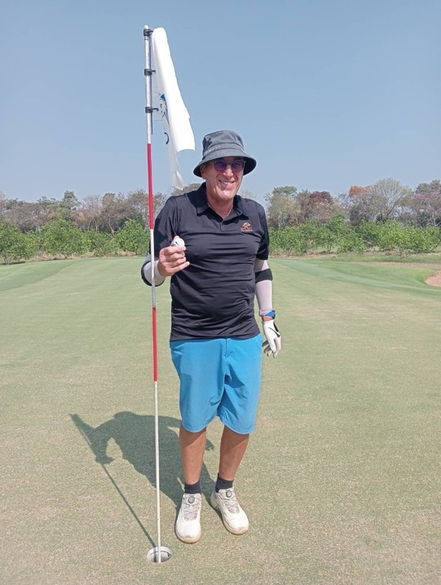
Roger
Bishop
7th March
Mae Jo
14th Hole

Slide 7
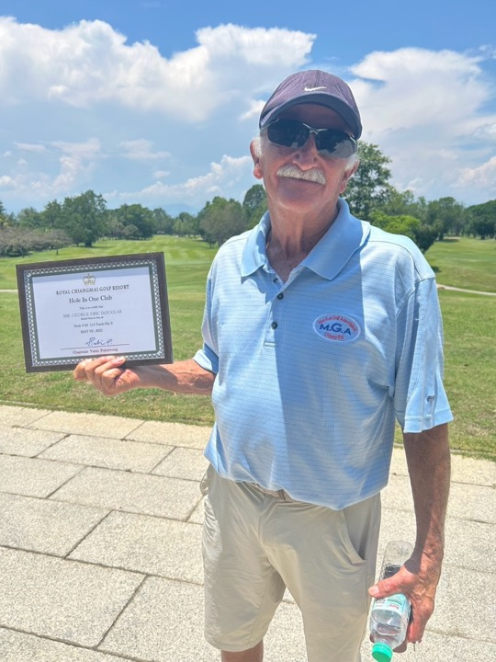
Eric
George
2nd May
Royal
Chiang Mai
3rd Hole

Slide 8
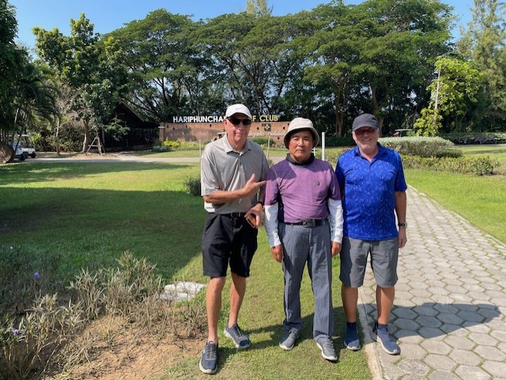

Slide 9
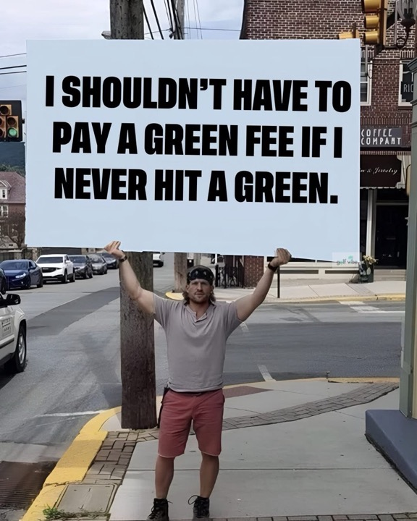

Slide 10
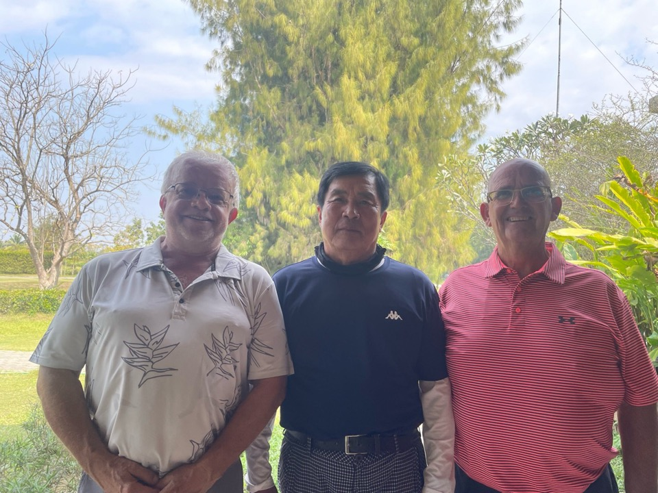
SERGE 42 C CUP

Slide 11
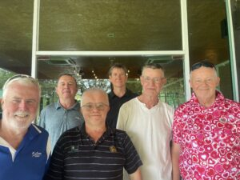
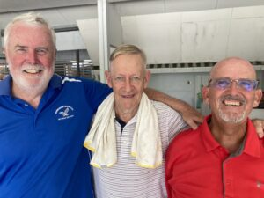
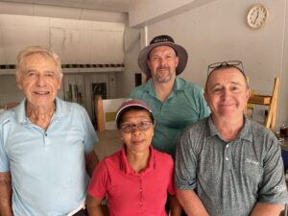
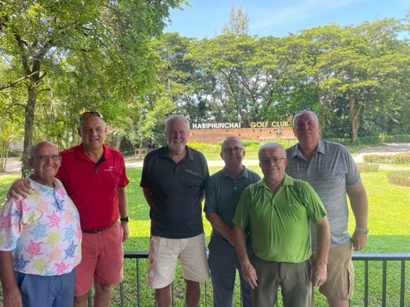

Slide 12
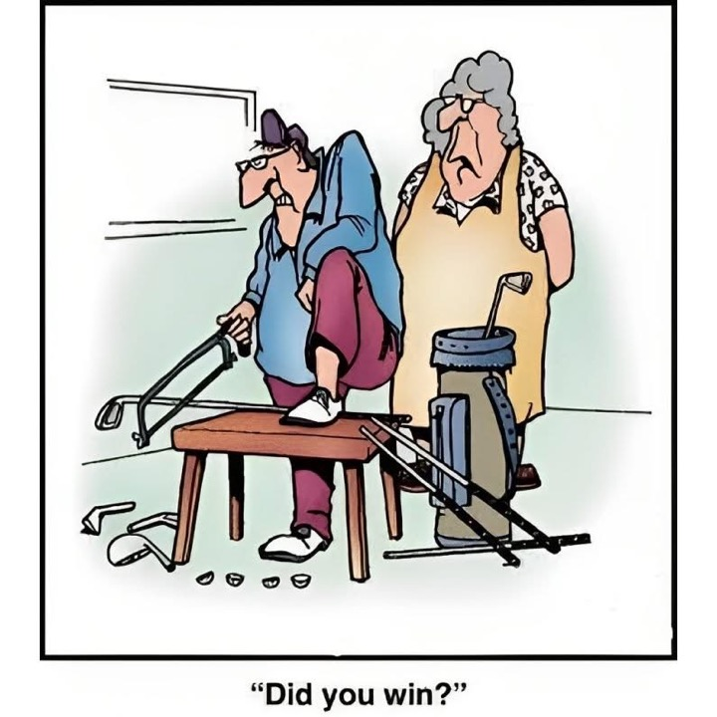

Slide 13
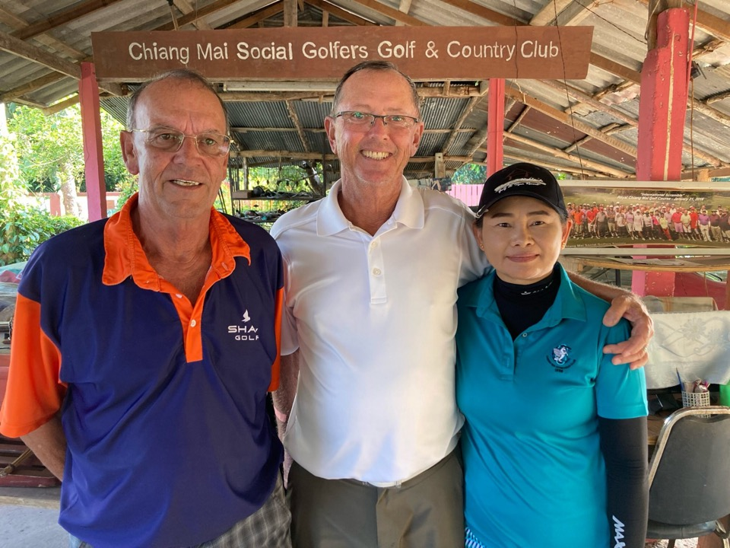

Slide 14
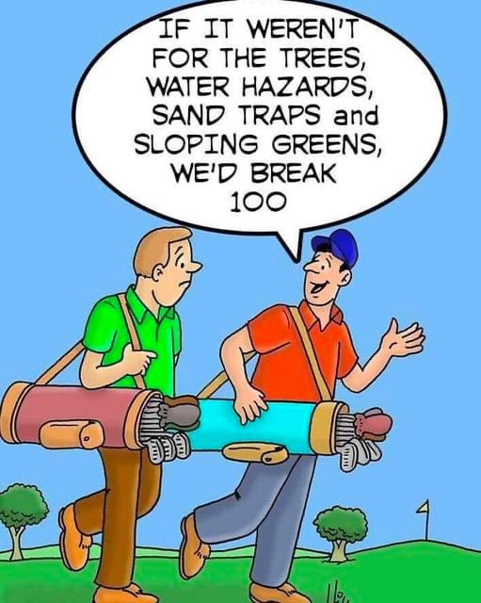

Slide 15
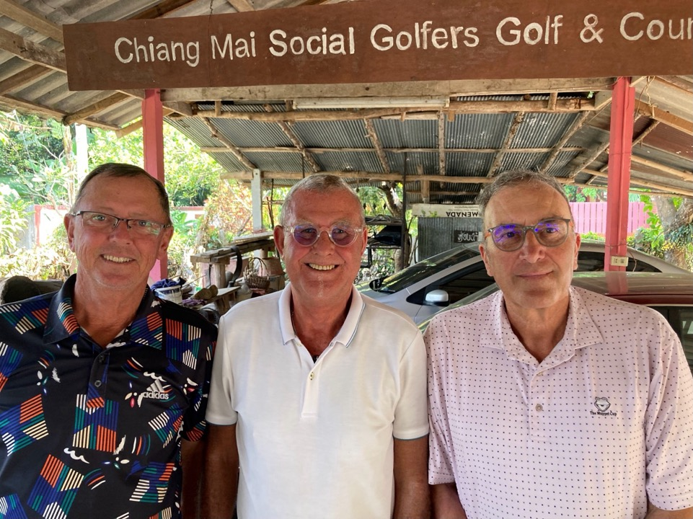

Slide 16
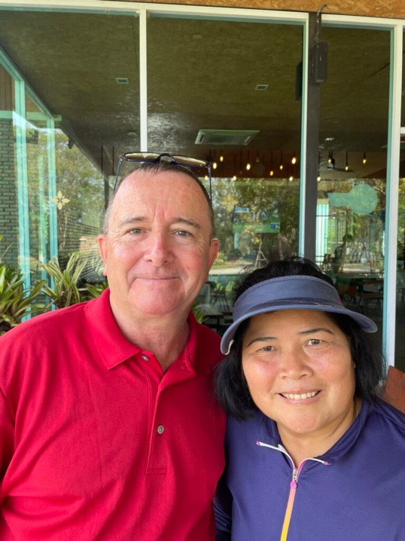

Slide 17
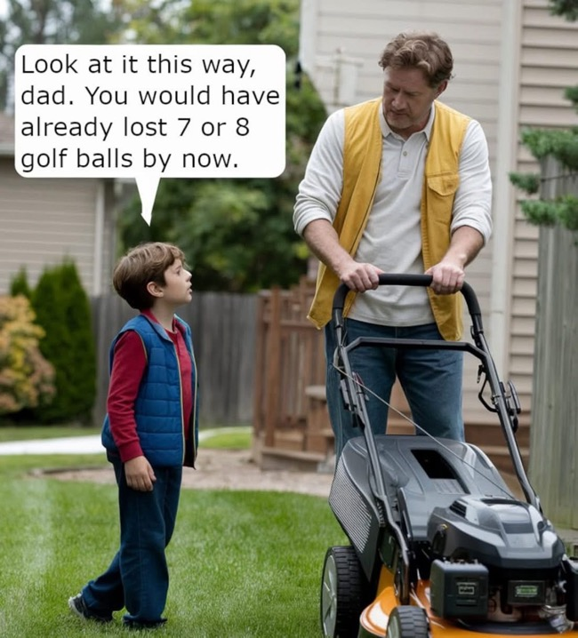

Slide 18
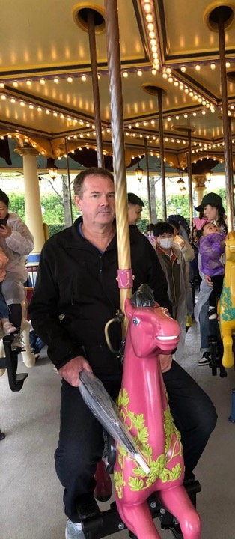
THE
GALLOPING
GORDON

Slide 19
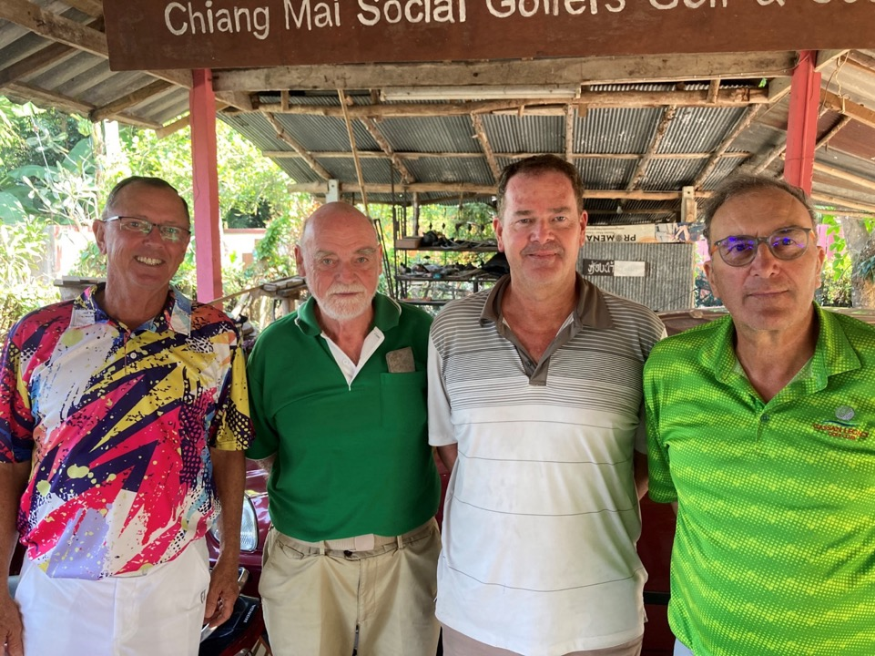

Slide 20
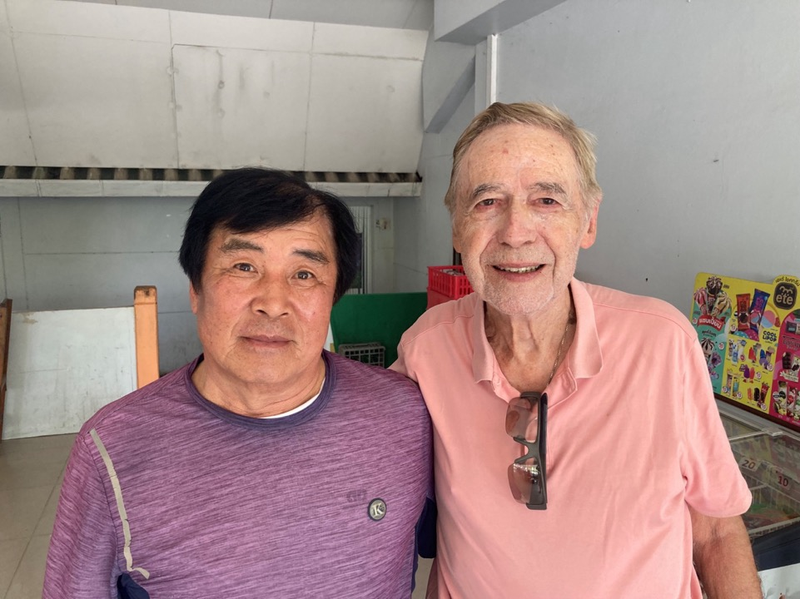
JACK REUTTER, 90TH BIRTHDAY WINNER!

Slide 21
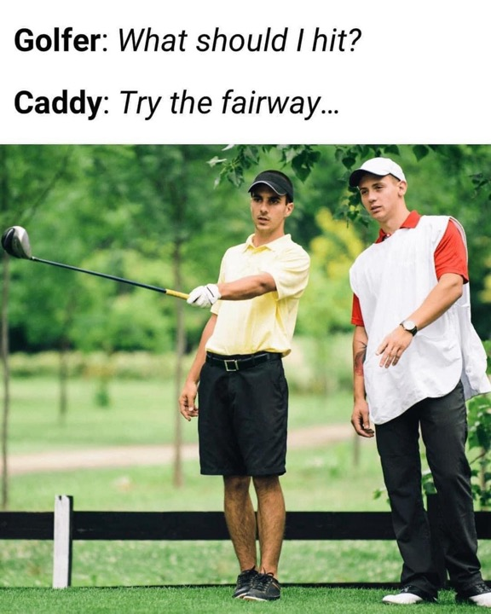

Slide 22
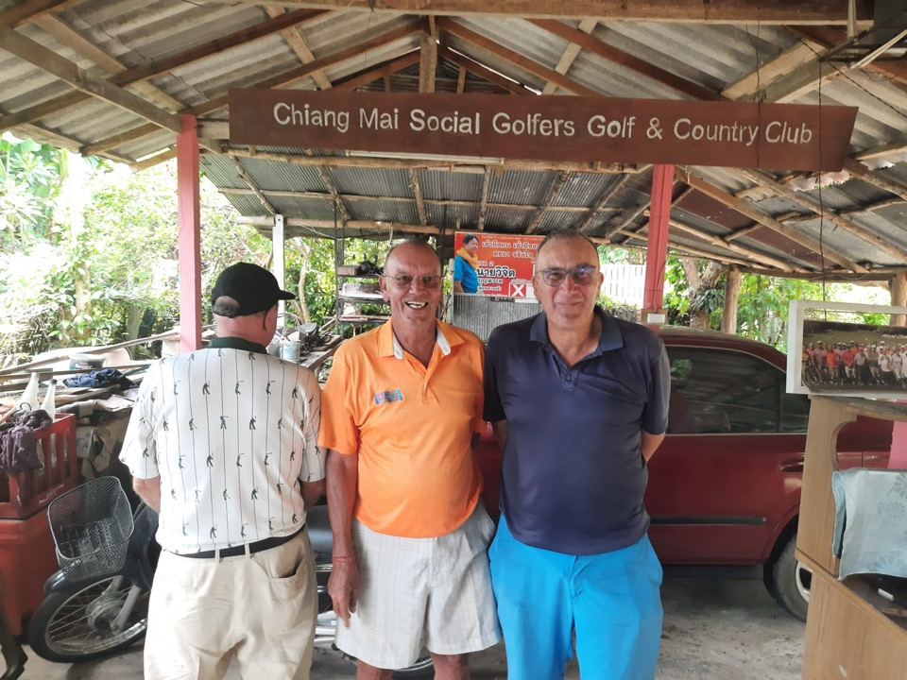

Slide 23
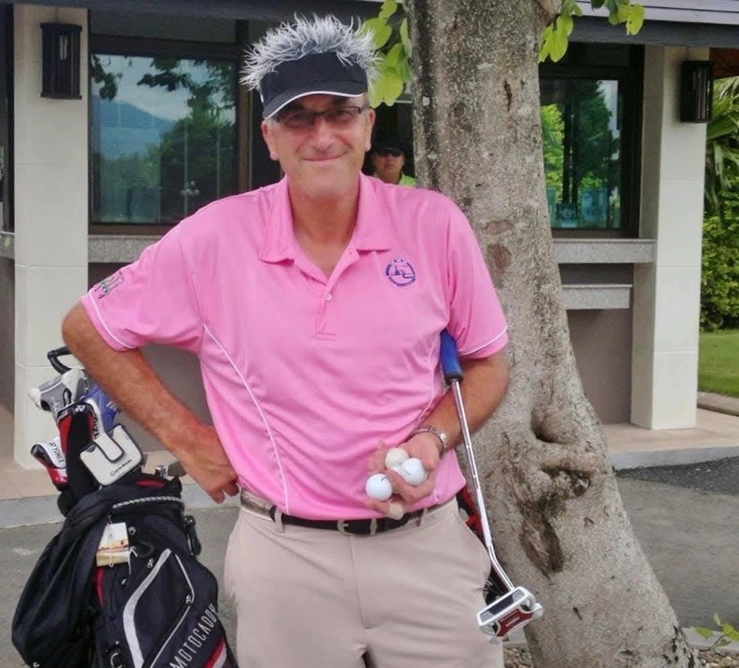

Slide 24
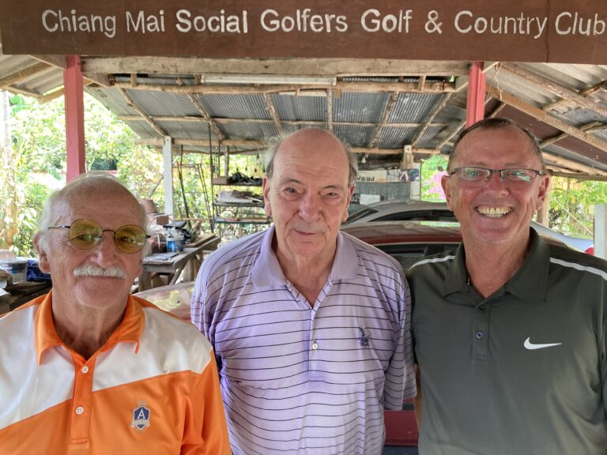

Slide 25
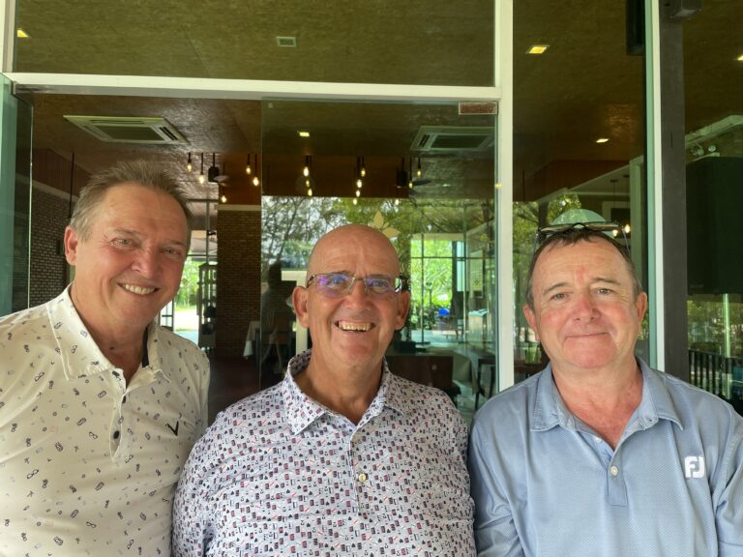

Slide 26
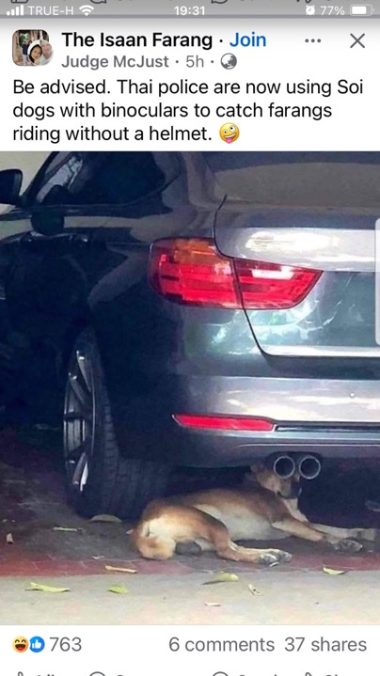

Slide 27
THE INTERNATIONAL

Slide 28
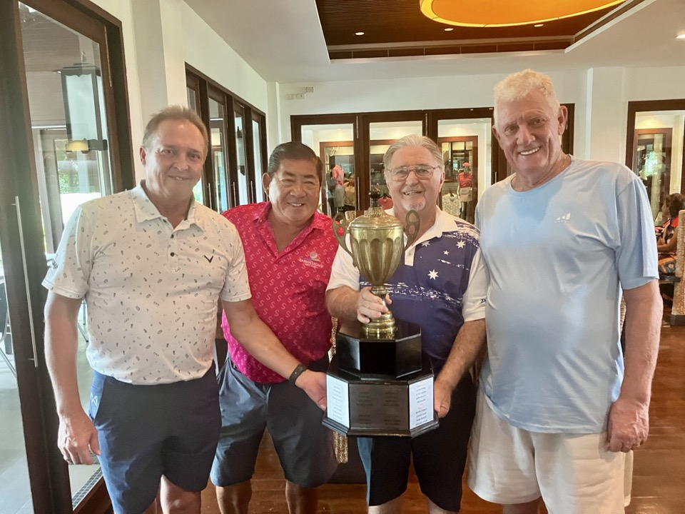
TEAM AUSTRALIA

Slide 29
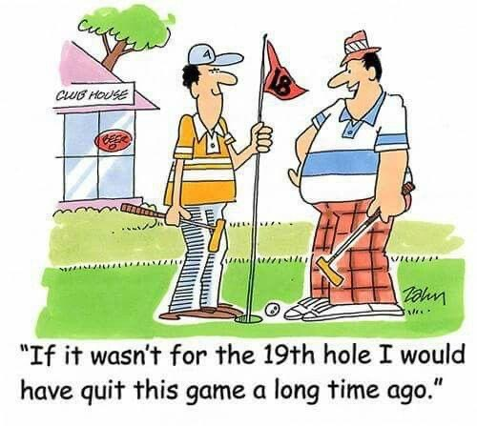

Slide 30
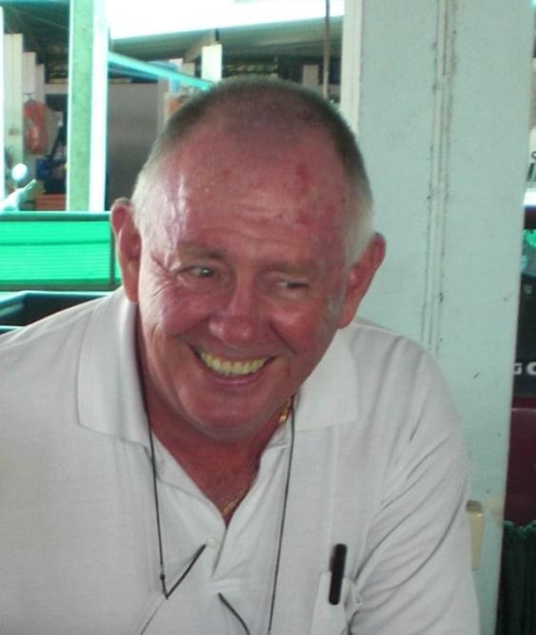

Slide 31
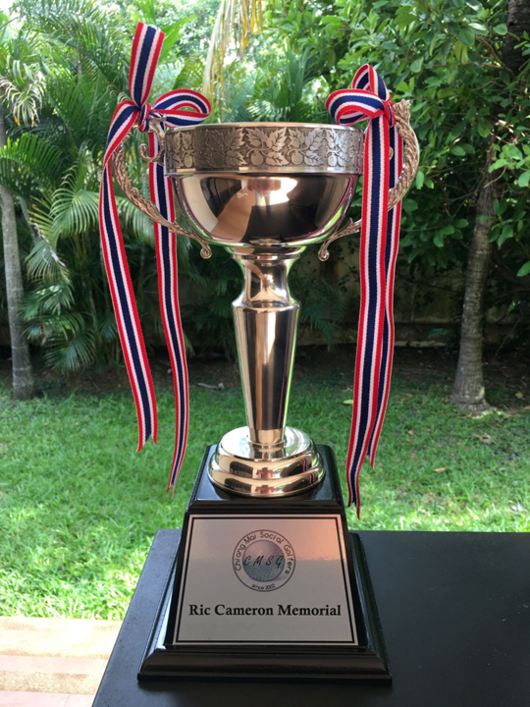

Slide 32
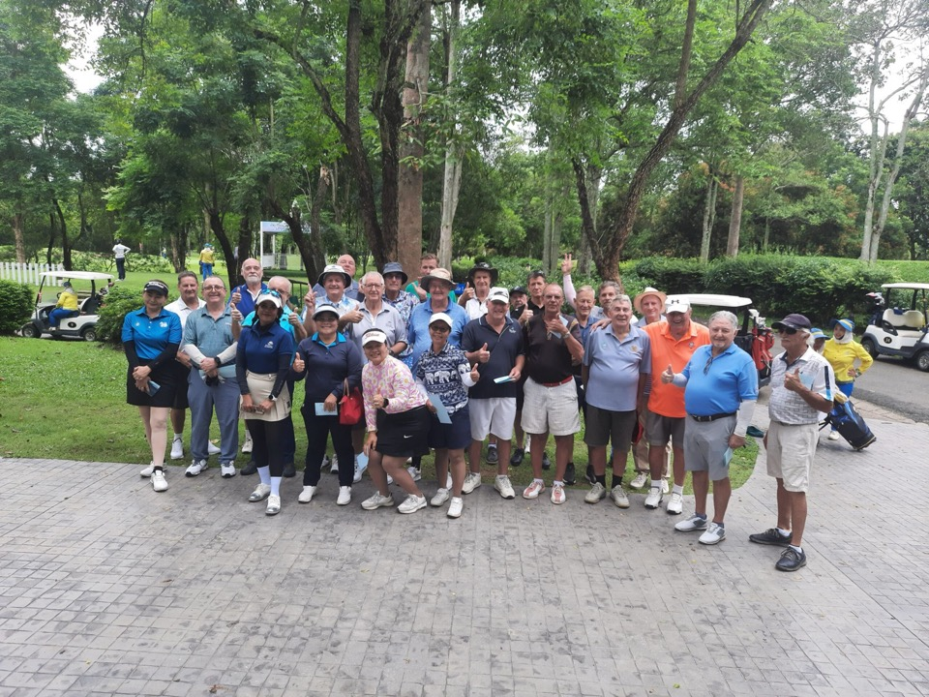

Slide 33
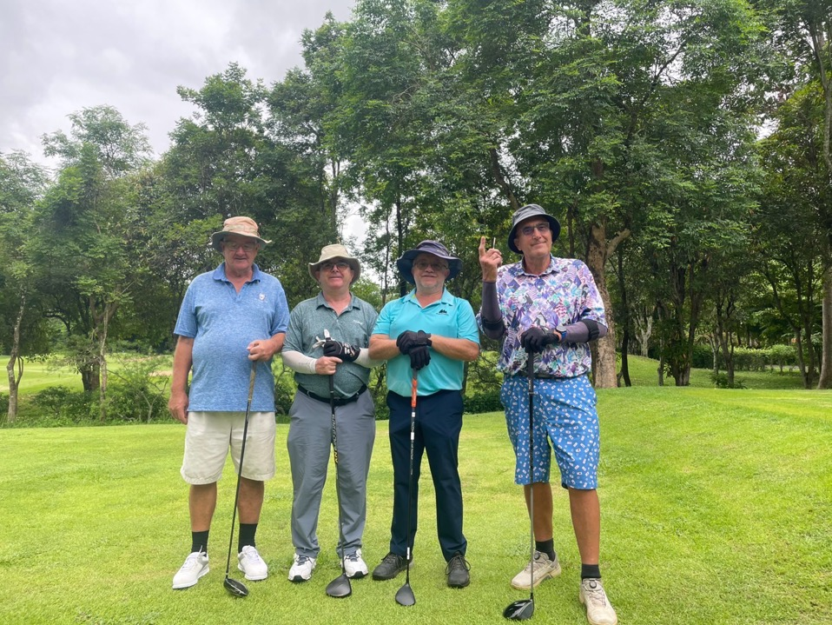

Slide 34
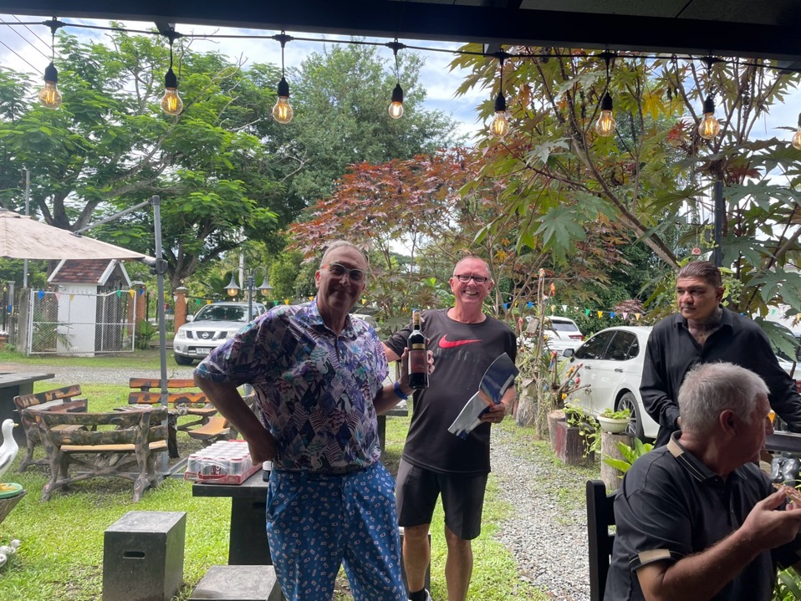

Slide 35
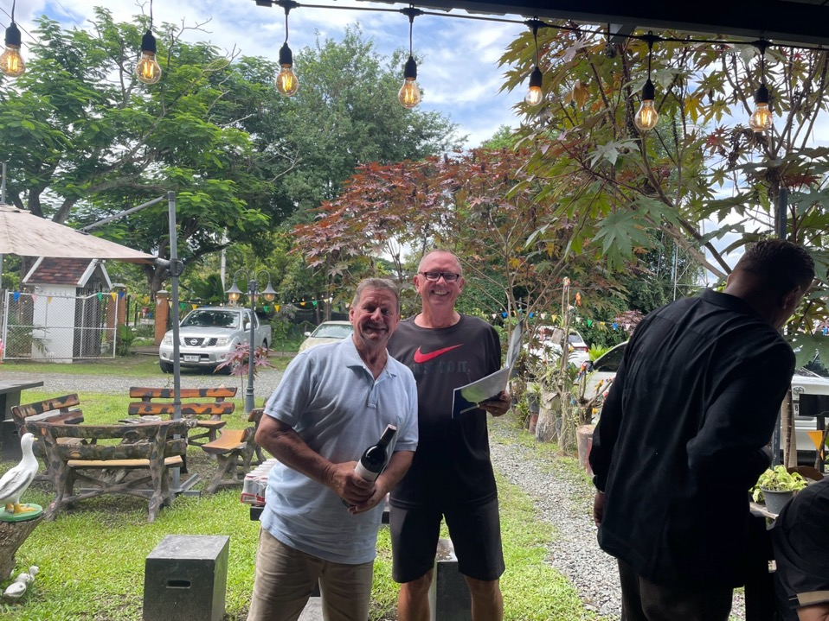

Slide 36
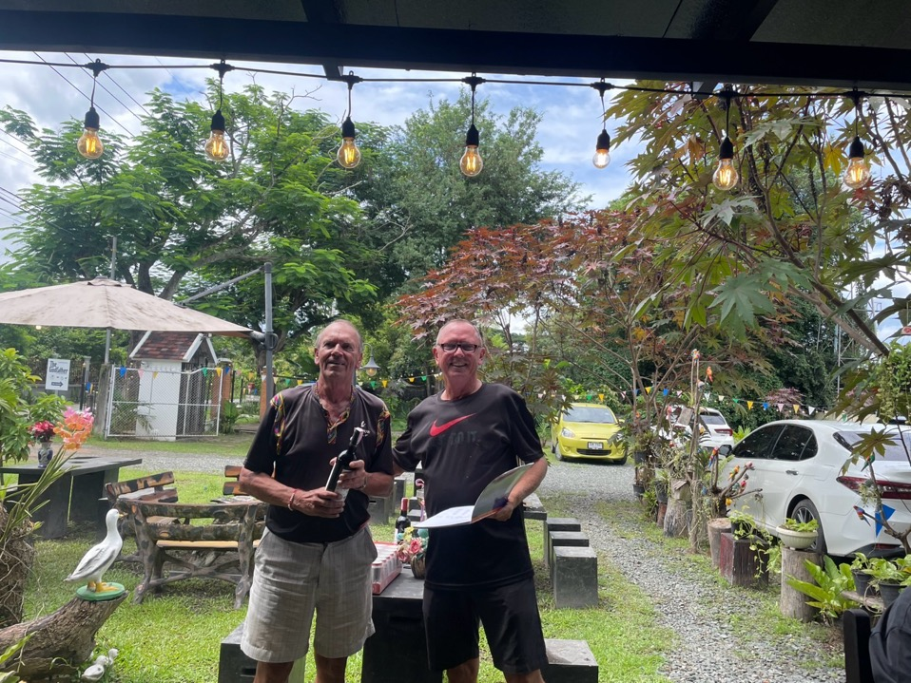

Slide 37
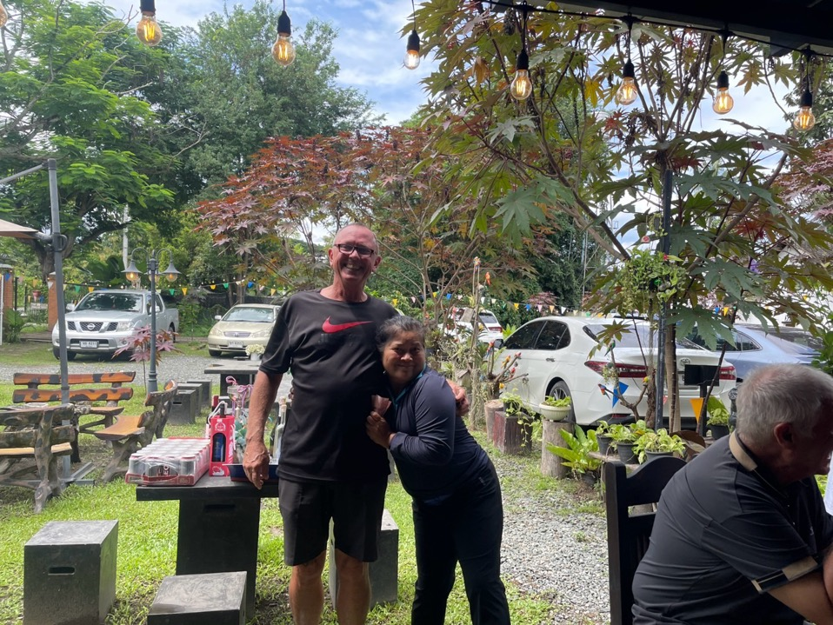

Slide 38
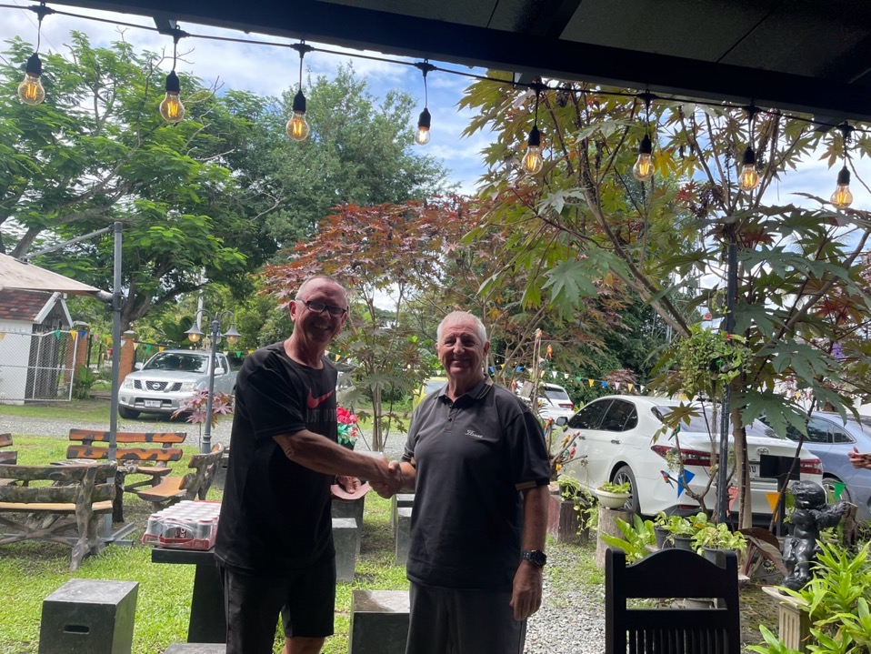

Slide 39
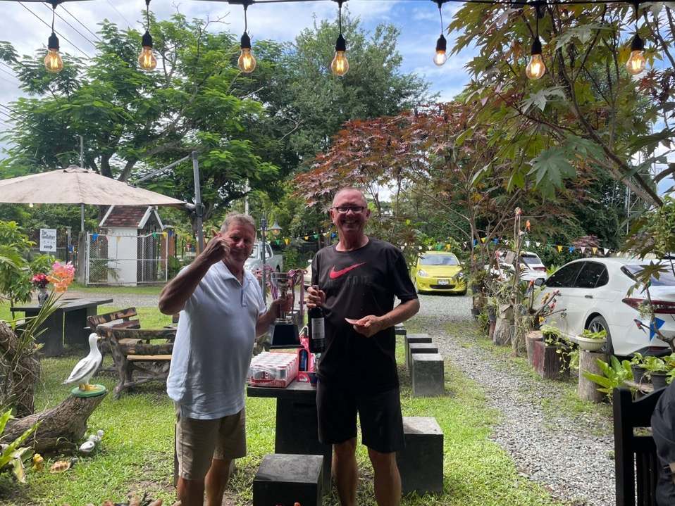
WINNER MIKE ROYCROFT

Slide 40


Slide 41
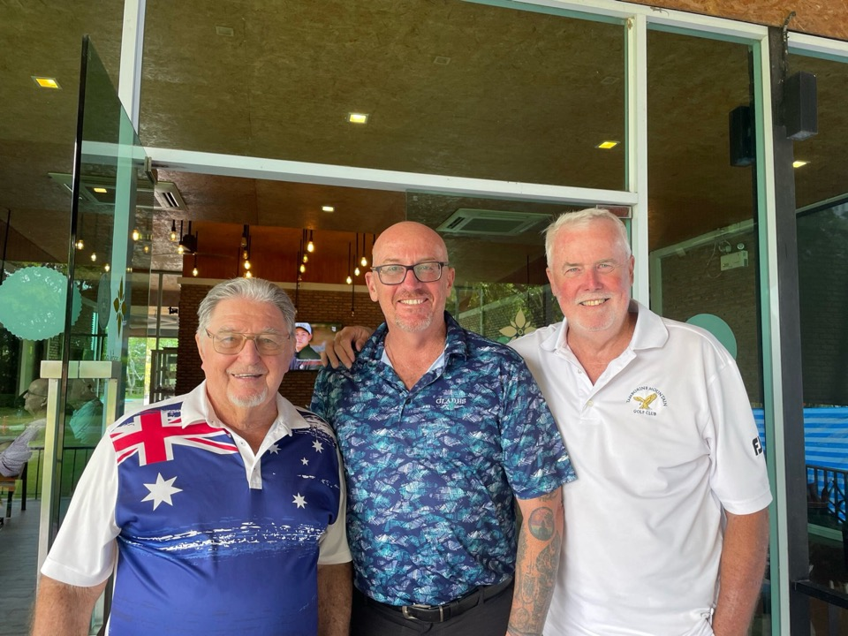
HARI AUSSIES

Slide 42
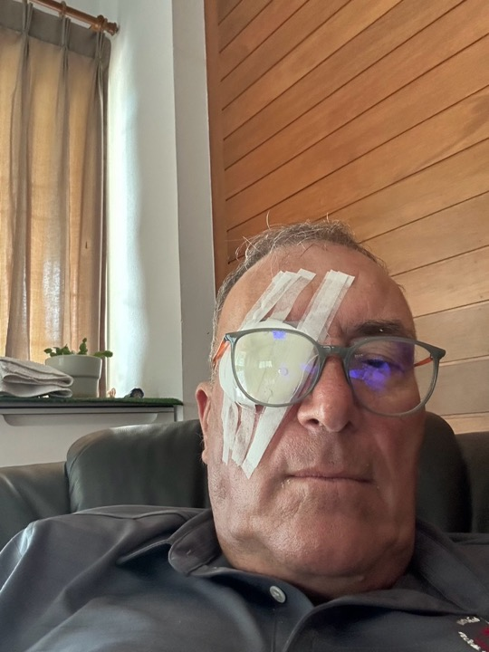

Slide 43
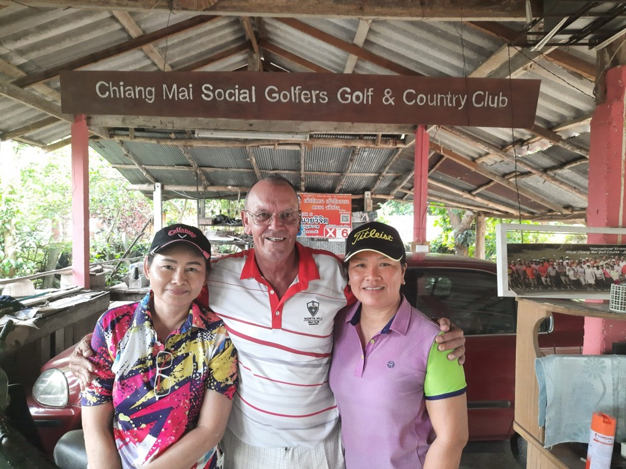

Slide 44
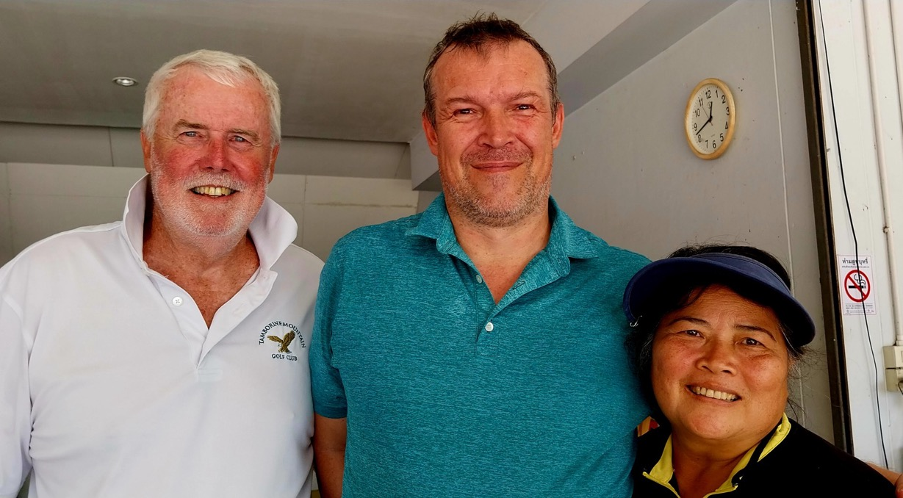

Slide 45
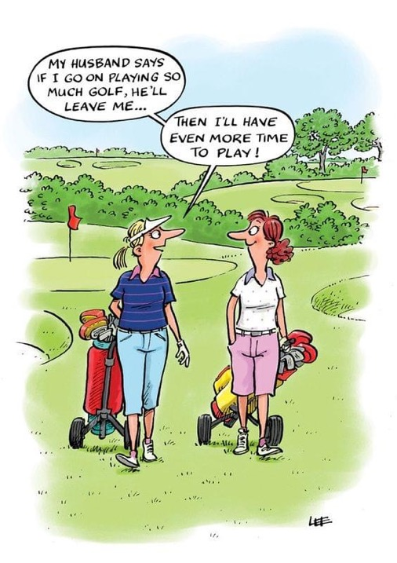

Slide 46
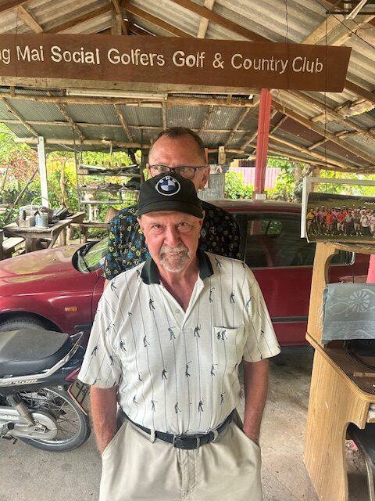

Slide 47
ANNUAL
TOURNAMENT

Slide 48

Thank you for your generous sponsorship, Chris Ryan

Slide 49
THE SWINGS
NOT MANY FROM THE
COACHING MANUAL

Slide 50
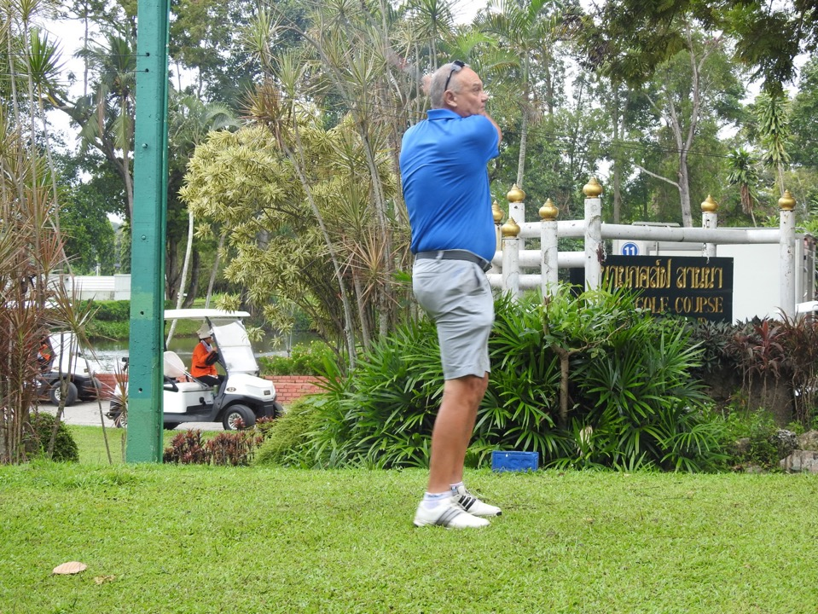

Slide 51
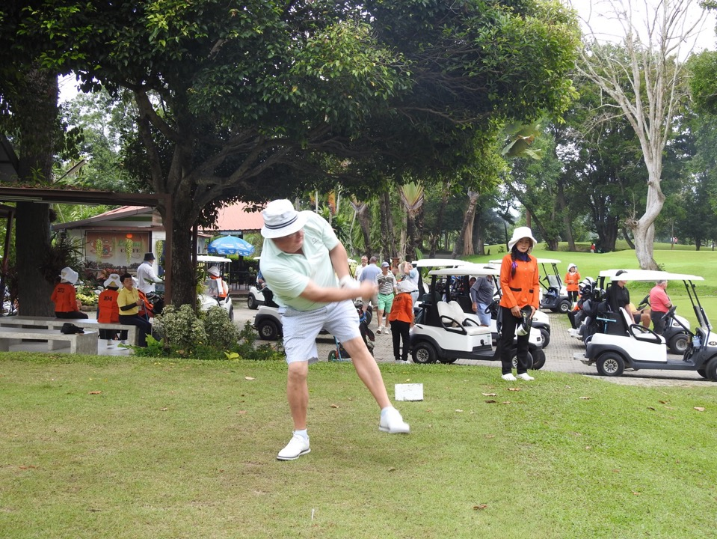
YOU PUT YOUR LEFT LEG IN, AND SHAKE IT ALL ABOUT!

Slide 52
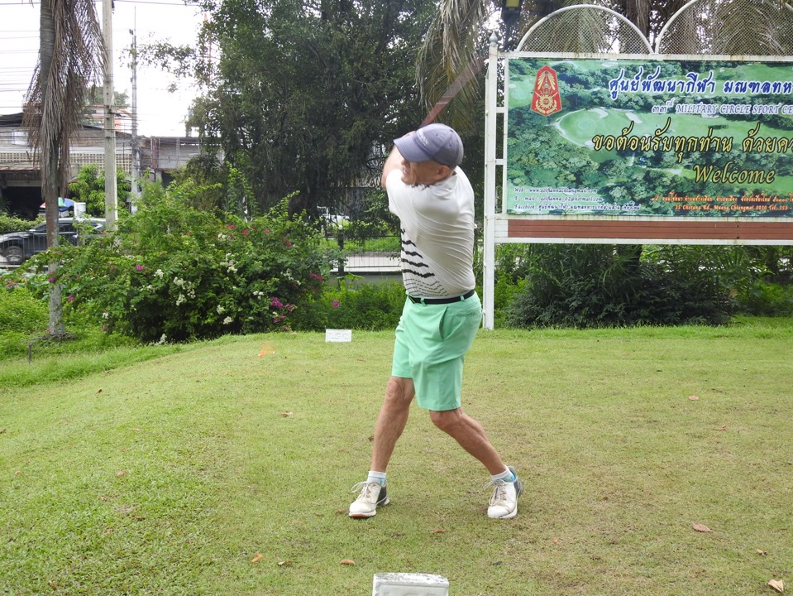

Slide 53


Slide 54


Slide 55


Slide 56


Slide 57


Slide 58


Slide 59


Slide 60


Slide 61


Slide 62


Slide 63


Slide 64


Slide 65


Slide 66


Slide 67


Slide 68


Slide 69


Slide 70


Slide 71


Slide 72


Slide 73


Slide 74


Slide 76


Slide 77


Slide 78


Slide 79


Slide 80


Slide 81

LANNA WINNERS

Slide 82

HARIPHUNCHAI
WINNER

Slide 83

HARIPHUNCHAI RUNNERS UP

Slide 84


Slide 85


Slide 86
HIGHLANDS WINNERS
1ST IAIN JENSEN
2ND BILL DUTHIE
3RD IAN MARTIN
4TH DONALD OTTEN AND TOM AGNA

Slide 87


Slide 88


Slide 89


Slide 90


Slide 91





